Slide 1


Lesson 4:
Applying F, D & P in word problems
www.arithmagicians.com

Slide 2


Ella runs 0.75 of a lap. Noah runs 3/4 of a lap.
Who runs further?
0.75 = 3/4
Both run the same distance

Slide 3
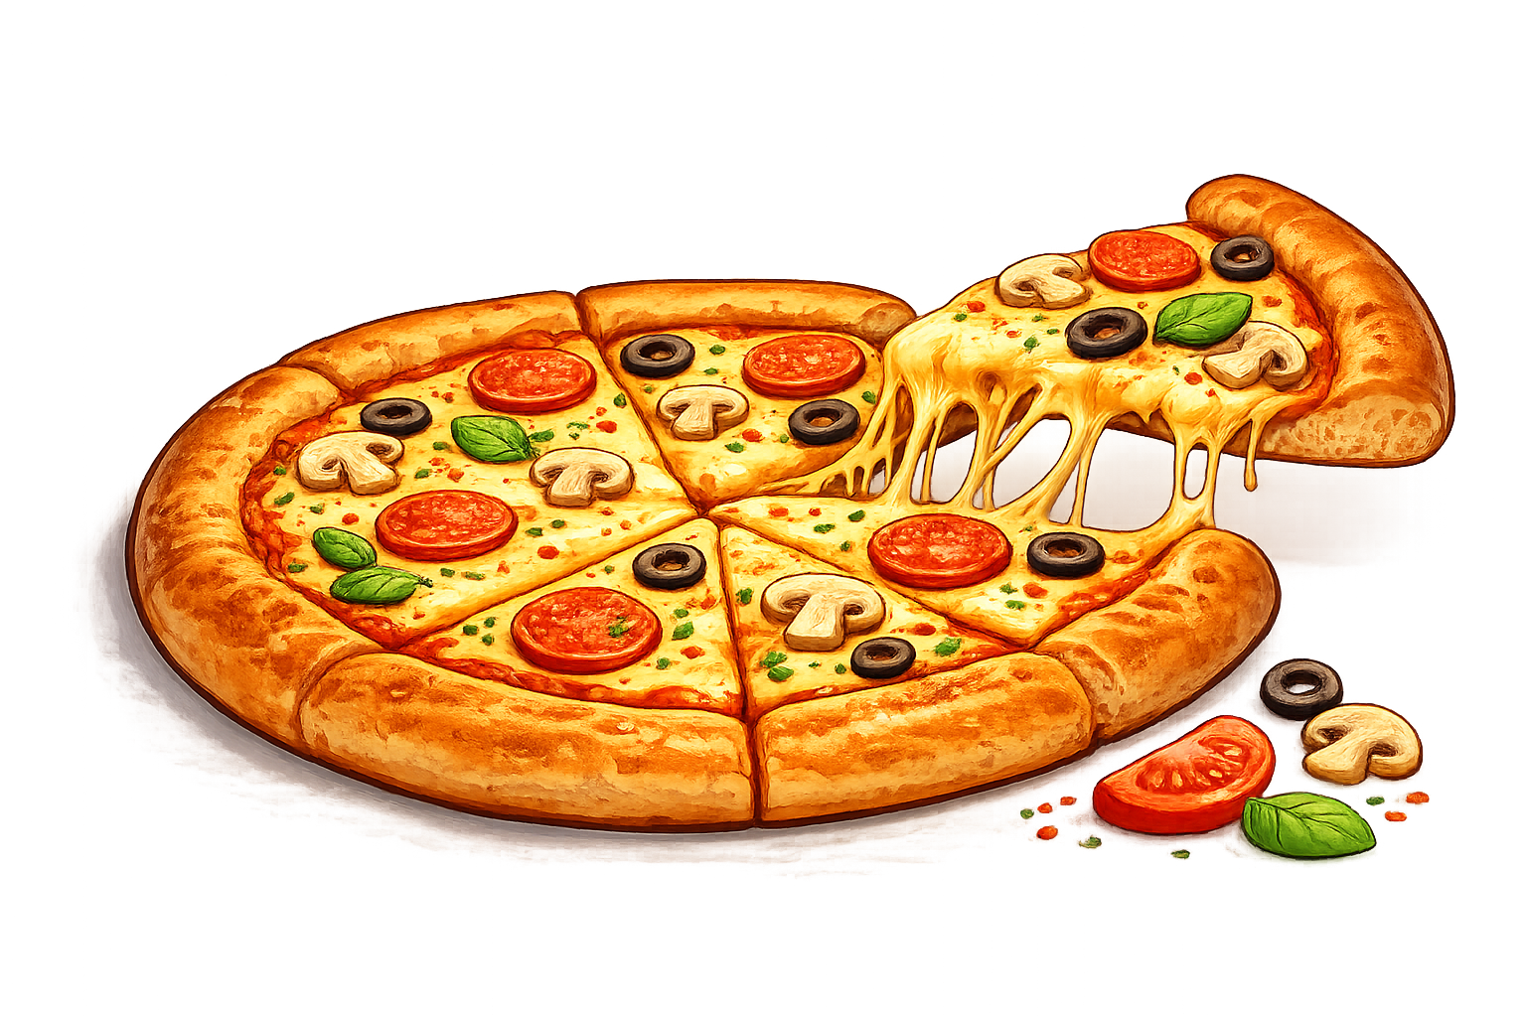
Ali eats 2/5 of a pizza. Amy eats 45% of the same pizza.
Who eats more?
45% > 2/5
Amy eats more

Slide 4

Leo scores 7/10 on a test. Zara scores 68%.
Who scores higher?
7/10 > 68%
Leo scores higher

Slide 5


Recap:
Fraction | Decimal | Percentage
3/4
2/5
 |  | 38%
 | 0.9
0.75
75%
0.4
40%
38/100
0.38
9/10
90%

Slide 6

True or False
10/10 = 100%
True: Can you explain why?

