Slide 1


Lesson 4:
Applying percentages in word problems
www.arithmagicians.com

Slide 2

A class has 24 pupils.
75% of them have brought a packed lunch.
How many pupils brought a packed lunch?
24 Pupils
6
6
6
6
Packed Lunch

Slide 3
A jacket costs £80.
It is reduced by 25%.
What is the new price?
£80
£20
£20
£20
£20
Reduced
New Price

Slide 4


Your Turn
A book costs £30.
It is reduced by 40%.
What is the new price?
£30
3
3
3
3
3
3
3
3
3
3
Reduced
New Price

Slide 5
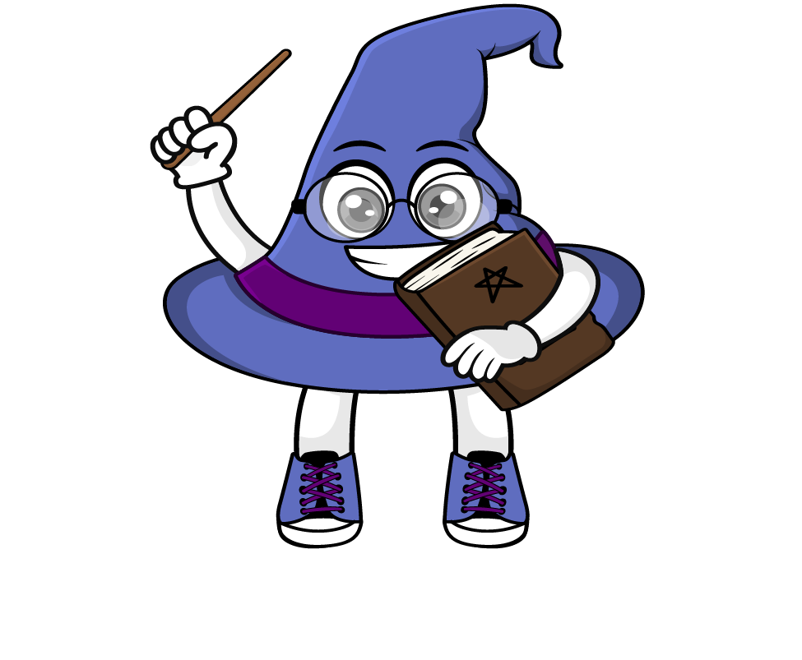
True or False
60% is the same as three fifths.
True

