Slide 1


Lesson 5:
Assess and Review
www.arithmagicians.com

Slide 2


Harry eats 3/4 of a chocolate bar.
Tom eats 80% of the same size bar.
Who eats more?
Explain how you know
80% > 3/4
Harry eats more

Slide 3
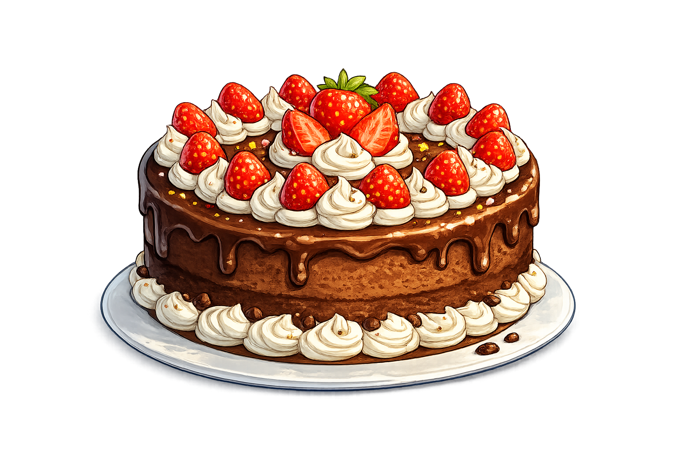
James eats 4/5 of a cake.
Amy eats 45% of the same cake.
Who eats more?
Explain how you know
4/5 > 45%
James eats more

Slide 4



Your Turn
Put the following numbers in
descending order.
Make your own example for a friend to complete.
First, convert decimals to percentages.
Next, order the percentages from largest to smallest.
Finally, write out the new order correctly.
1/10
0.05
4/5
40%
10%
5%
80%
40%
4/5
40%
1/10
0.05

