Slide 1
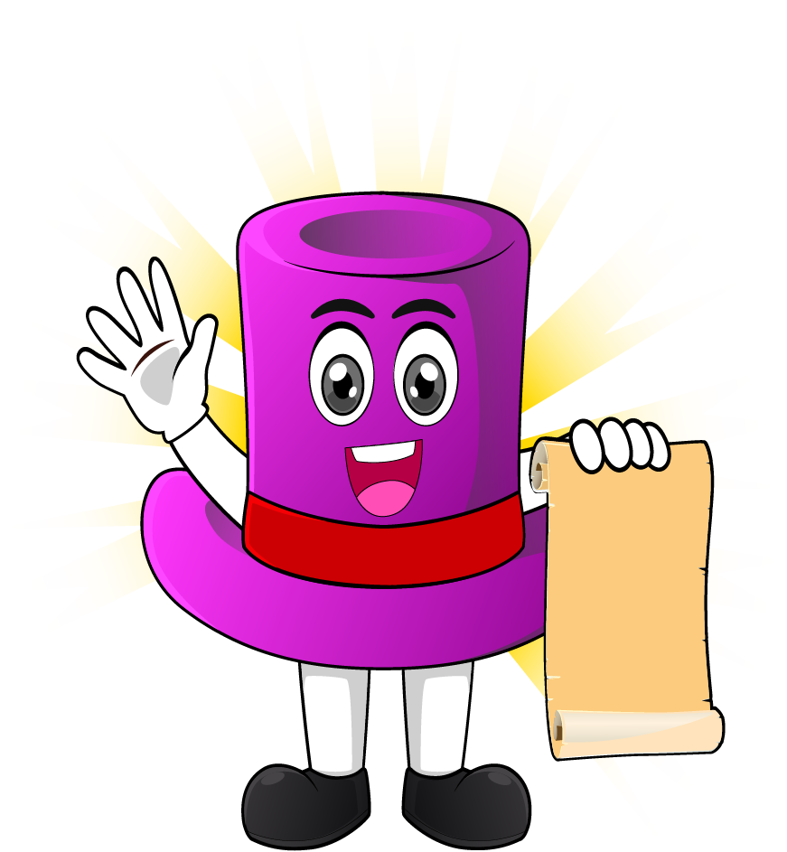

Lesson 1:
Recap: Double, then
double again strategy
www.arithmagicians.com

Slide 2

+4
+4
+4
+4
+4
+4
+4
+4
+4
+4
0
4
8
12
16
20
24
28
32
36
40
Get ready to count up in 4s

Slide 3
-4
-4
-4
-4
-4
-4
-4
-4
-4
4
8
12
16
20
24
28
32
36
40
Get ready to count back in 4s

Slide 4


True or False
Multiplying a number by 4 is the same as doubling and doubling again.
True:
Let’s see how we can prove it

Slide 5
3 $×$ 2 $=$ 6
3 $×$ 2 $=$ 6
3
4
2
2
3 $×$ 4 $=$ 3 $×$ ___ $×$ ___
2
3 $×$ 4 $=$ 6 $×$___
12
3 $×$ 4 $=$ ___

Slide 6
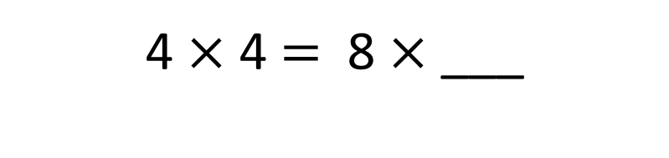
4 $×$ 2
4 $×$ 2
4 $×$ 4
+
=
8
8
16
2
2
4 $×$ 4 $=$ 4 $×$ ___ $×$ ___
2
4 $×$ 4 $=$ 8 $×$ ___
16
4 $×$ 4 $=$ ___

Slide 7


Your Turn
6 x 4 =
6
double
12
double
24
8 x 4 =
8
double
16
double
32
5 x 4 =
5
double
10
double
20
12 x 4 =
12
double
24
double
48

