Slide 1
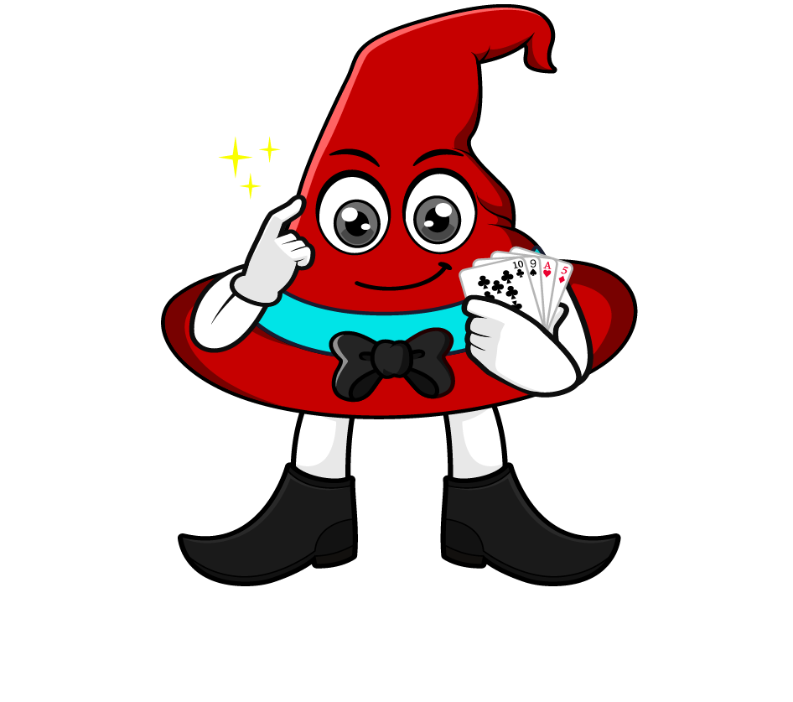

Lesson 1:
Recap: Understanding Percentages As Fraction
www.arithmagicians.com

Slide 2

Imagine we take this square and
split it into 100 equal parts.
If I shade 100 parts, I have 100%
There are now 100 equal parts
If I shade 50 parts, I have 50%
If I shade 25 parts, I have 25%

Slide 3

What’s the same and what’s different?
50
____ % is the same as one half.
___% =
1/2
50

Slide 4
What’s the same and what’s different?
25
____ % is the same as one quarter.
___% =
1/4
25

Slide 5
What’s the same and what’s different?
75
____ % is the same as three quarter.
___% =
3/4
75

Slide 6
What’s the same and what’s different?
20
____ % is the same as one fifth.
___% =
1/5
20

Slide 7
What’s the same and what’s different?
100
____ % is the same as one whole.
100
1
___% =

Slide 8


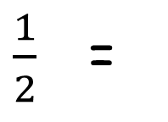
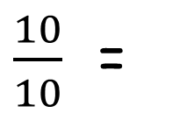
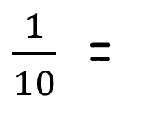
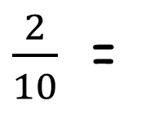
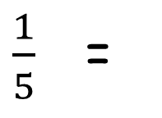
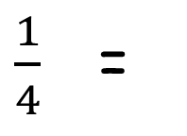
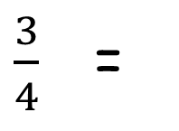
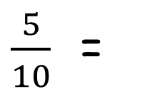
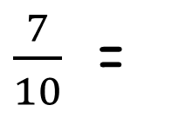
Your Turn
Convert the following fractions into percentages.
$\frac{5}{10}$ =
50%
1 =
100%
$\frac{1}{2}$ =
50%
$\frac{10}{10}$ =
100%
$\frac{1}{10}$ =
10%
$\frac{2}{10}$ =
20%
$\frac{1}{4}$ =
25%
$\frac{1}{5}$ =
20%
$\frac{3}{4}$ =
75%
$\frac{7}{10}$ =
70%

