Slide 1
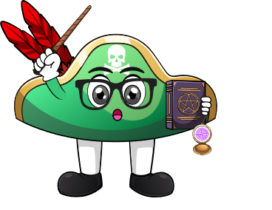

Lesson 1:
Recap: Known facts about zero
www.arithmagicians.com

Slide 2



-
=
4
-
0
=
4

Slide 3


-
=
6
-
0
=
6

Slide 4

What do you notice?
2
-
0
=
2
4
-
0
=
4
0
When we subtract _____ from a number, the number remains the ______.
same

Slide 5

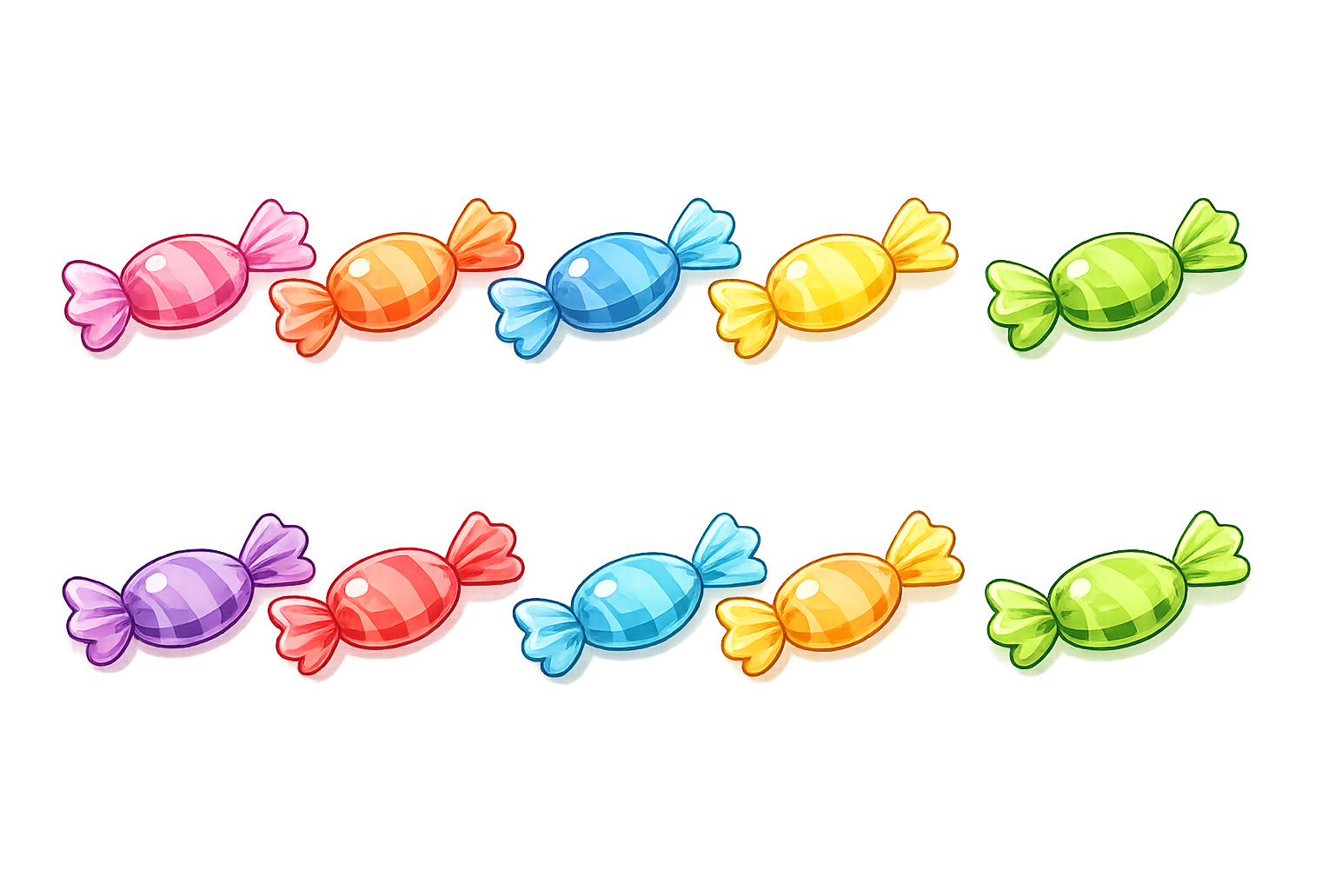

How many sweets do I have left?
I eat all 10 sweets
I have 10 sweets
Zero sweets left

Slide 6
I take away 3 cookies
How many cookies do I have left?
I have 3 cookies
I have 3 cookies
3 - 3
= 0

Slide 7
What do you notice?
5
-
5
=
0
10
-
10
=
0
same
When we subtract the ______
number, the answer is always ____.
0

Slide 8


Your Turn
2 - 2 = ?
0
4
2) 4 - 0 = ?
5
3) 5 - 0 = ?
0
4) 9 - 9 = ?
0
5) 0 - 0 = ?

