Slide 1
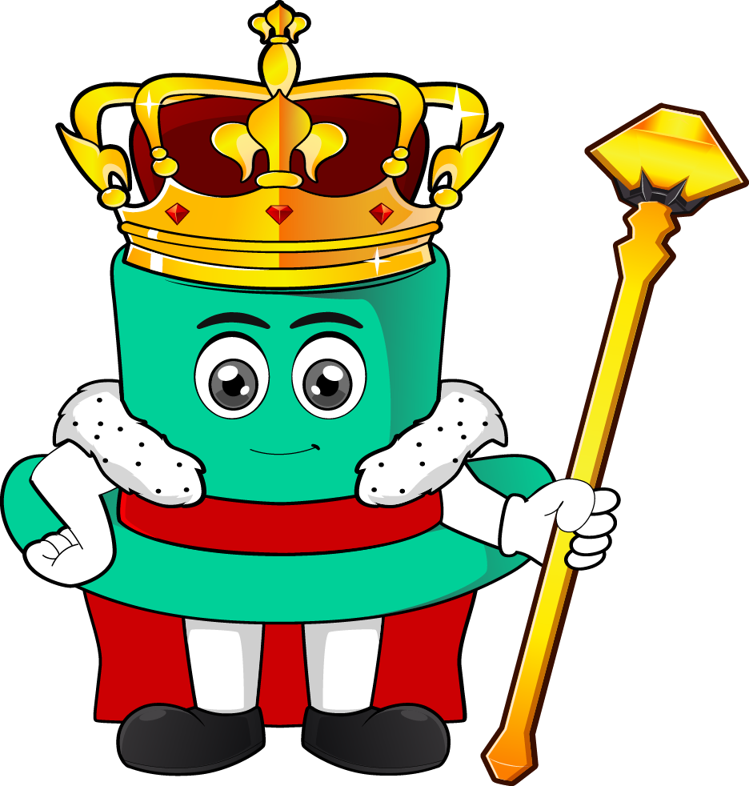

Lesson 3:
Recap: x11 & x12
Missing Numbers
www.arithmagicians.com

Slide 2



11 x ? = 22
11 × 2 = 22 So ? = 2
It took 2 rounds, so each group has 2.
This means 11 groups of the same number makes 22 altogether.
Put 1 in each group, again and again, until you have no more left
All the groups together
must add up to 22.
Imagine 11 empty groups.

Slide 3

11 x 4 = 44
11 x ? = 44
44
44
4
4
4
4
4
4
4
4
4
4
4
?
?
?
?
?
?
?
?
?
?
?
44
11
The whole is ___. There are ___ equal parts.
4
I know that 11 × ___ = 44 so each part must be ___.
4
Therefore, the missing number is ____.
4

Slide 4
5 x 11 = 55
5 x ? = 55
55
55
11
11
11
11
11
?
?
?
?
?
55
5
The whole is ___. There are ___ equal parts.
11
I know that 5 × ___ = 55 so each part must be ___.
11
Therefore, the missing number is ____.
11

Slide 5
4 x 12 = 48
4 x ? = 48
48
48
?
?
?
?
12
12
12
12
48
4
The whole is ___. There are ___ equal parts.
12
I know that 4 × ___ = 48 so each part must be ___.
12
Therefore, the missing number is ____.
12

Slide 6


Your Turn
12
9
1) 6 x ? = 72
5) 12 x ? = 108
5
10
2) ? x 11 = 55
6) 12 x ? = 120
8
12
3) ? x 12 = 96
7) ? x 12 = 144
7
12
4) ? x 11 = 77
8) ? x 11 = 132

