Slide 1


Lesson 3:
Recap: Equivalent Fractions, Decimals & Percentages
www.arithmagicians.com

Slide 2

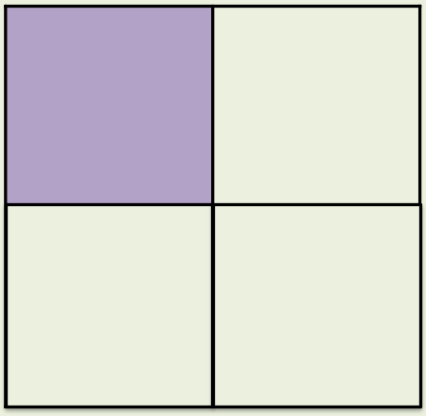
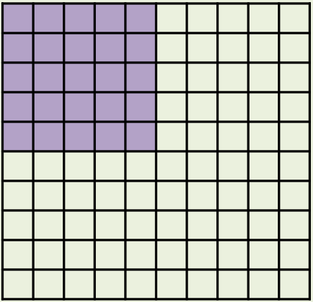
What’s the same and what’s different?
Fraction
Decimal
Percentage
¼
0.25
25%
_____
_____
_____

Slide 3
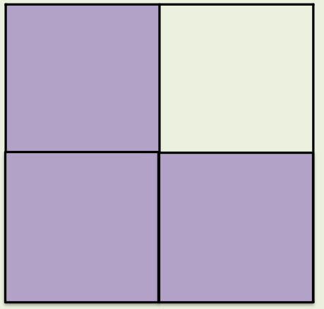
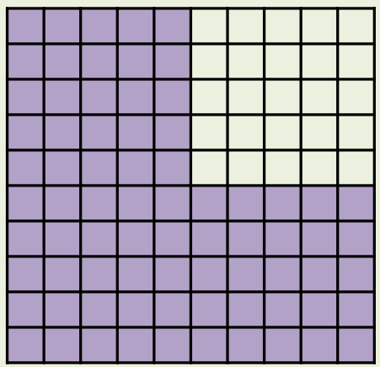
What’s the same and what’s different?
Fraction
Decimal
Percentage
3/4
0.75
75%
_____
_____
_____

Slide 4
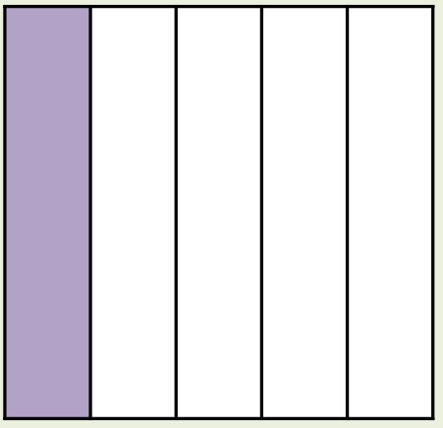
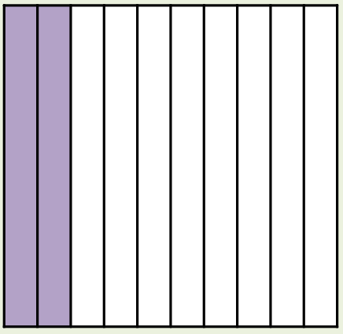
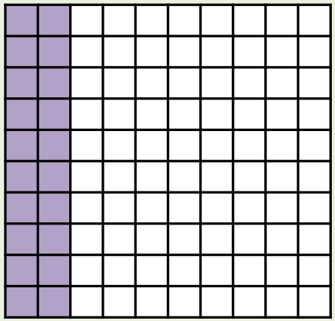
What’s the same and what’s different?
Fraction
Decimal
Percentage
1/5
0.2
20%
_____
_____
_____

Slide 5
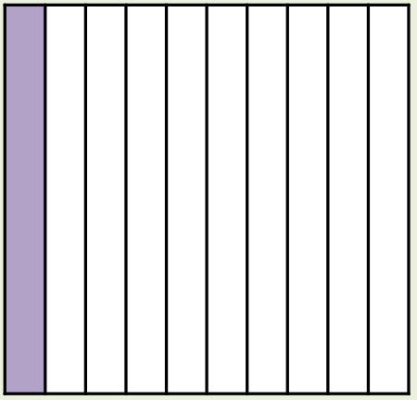
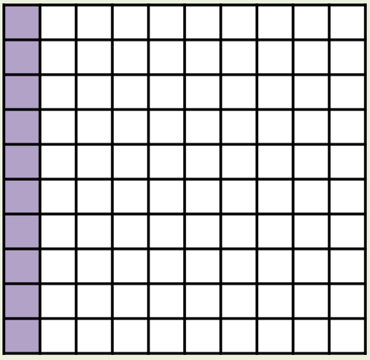
What’s the same and what’s different?
Fraction
Decimal
Percentage
1/10
0.1
10%
_____
_____
_____

Slide 6
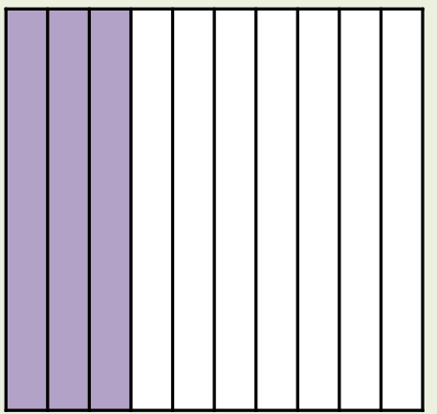
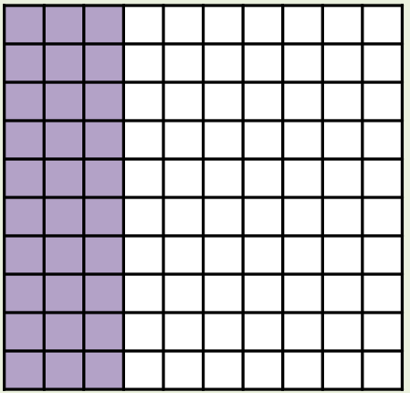
What’s the same and what’s different?
Fraction
Decimal
Percentage
3/10
0.3
30%
_____
_____
_____

Slide 7
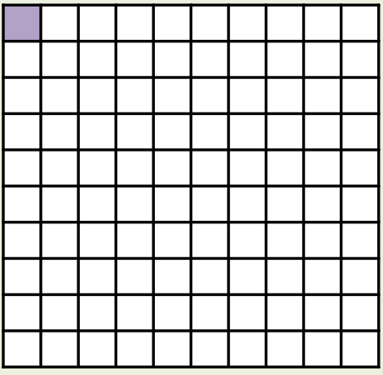
What’s the same and what’s different?
Fraction
Decimal
Percentage
1/100
0.01
1%
_____
_____
_____

Slide 8
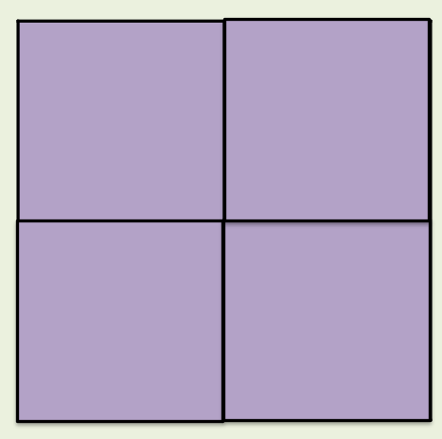
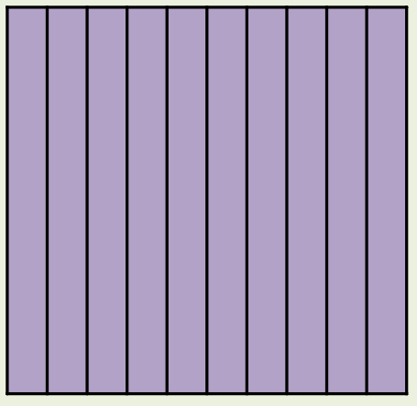
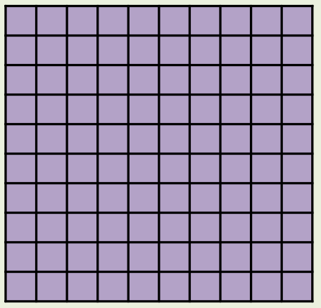
What’s the same and what’s different?
Fraction
Decimal
Percentage
4/4 or 1 whole
1
100%
_____
_____
_____

Slide 9


Your Turn
You should know these by heart
Fraction | Decimal | Percentage
2/100
 |  | 70%
3/4
 | 0.8
0.02
2%
7/10
0.7
0.75
75%
4/5
80%

