Slide 1


Lesson 5:
Assess and Review
www.arithmagicians.com

Slide 2


Your Turn
Match the fraction to the percentage
$$\frac{3}{5}$$
40%
$$\frac{4}{10}$$
75%
$$\frac{99}{100}$$
60%
$$\frac{3}{4}$$
99%

Slide 3



Your Turn
Which is the greater amount?
1) 61% or $\frac{\text{29}}{\text{100}}$
2) 28% or $\frac{\text{76}}{\text{100}}$
3) 99% or 0.9
4) 8% or $\frac{\text{5}}{\text{100}}$

Slide 4
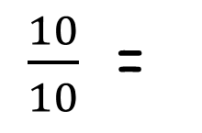
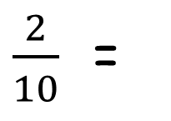
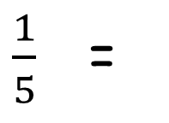
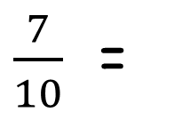
Your Turn
Convert the following decimals to percentages
1) 0.8 =
80%
6)
1 =
100%
2) 0.08 =
8%
7)
$\frac{10}{10}$ =
100%
3) 0.5 =
50%
8)
$\frac{2}{10}$ =
20%
4) 0.05 =
5%
9)
$\frac{1}{5}$ =
20%
5) 0.55 =
55%
10)
$\frac{7}{10}$ =
70%

