Slide 1


Lesson 1:
Identify Doubles
www.arithmagicians.com

Slide 2


What are doubles?
A double is when we add the same number twice.
It means: The number + the same number again.
Put up 3 fingers on one hand ✋
Put up 3 fingers on the other hand ✋
Now count them all up…
6
Double 3 is ___

Slide 3

4 + 4 = 8
So…Double 4 is 8!
Count them all together.
Here are 4 more cubes
Here are 4 cubes
=
4
+
4
=
8

Slide 4

Match the doubles to
the additions
Double 5
7 + 7
Double 7
5 + 5
Double 10
10 + 10

Slide 5


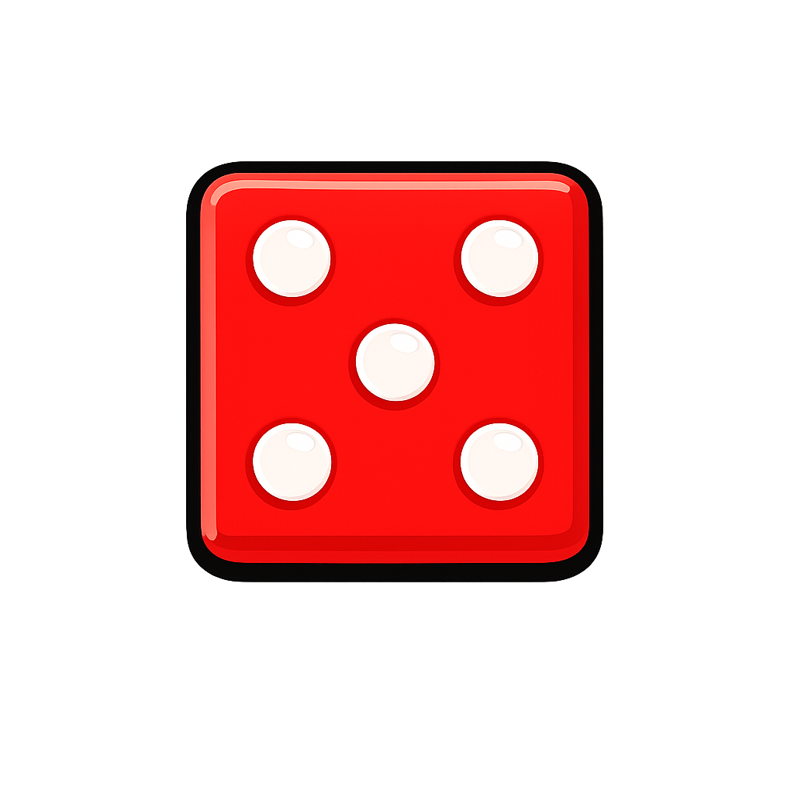

Your Turn
10
Double 5 is ___
12
Double 6 is ___

Slide 6
True or False
Double 0 is 0
True

