Slide 1
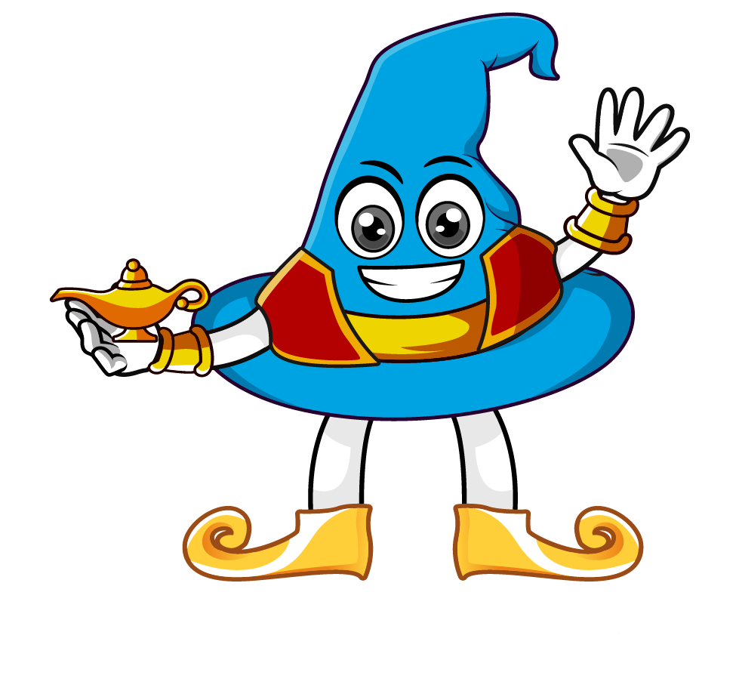

Lesson 2:
Multiply by 10 & 100
www.arithmagicians.com

Slide 2

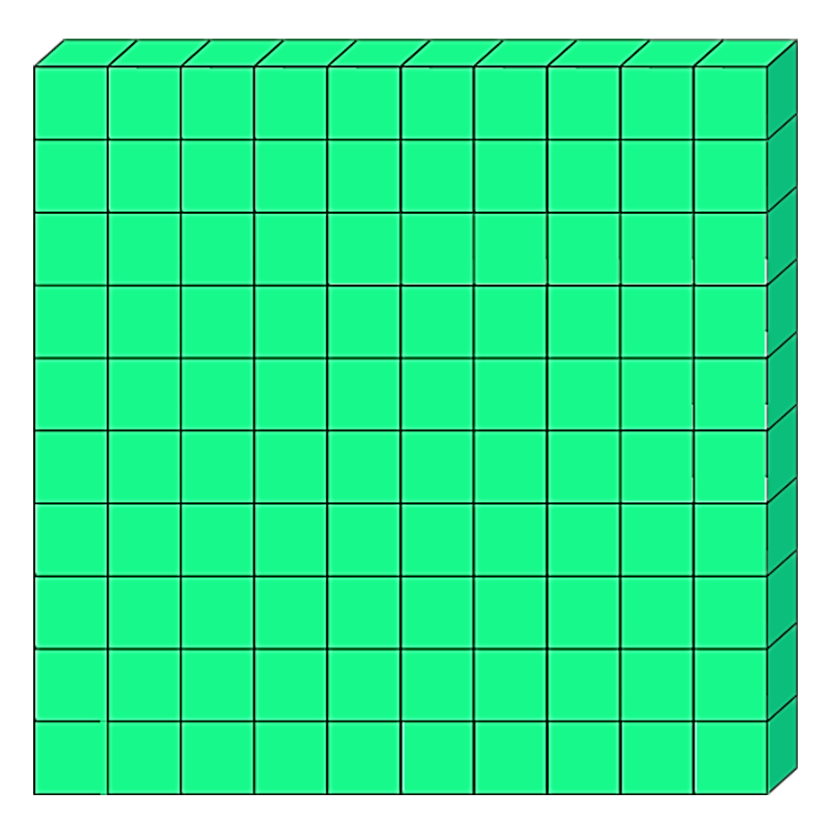
4
4 hundred
__ × 1 hundred =
100
4 × ______ =
400
4
100 × __ =
400

Slide 3
Which number is bigger?
45
45.0
45.00
They are all the same. Can you explain why?

Slide 4


The place value chart shows the number 27
When we multiply by 100, every digit moves two place to the left.
So we now have 2700
27 x 100 = 2700
.
Th
H
T
O
t
h
.
2
2
7
7
0
0
0
0

Slide 5
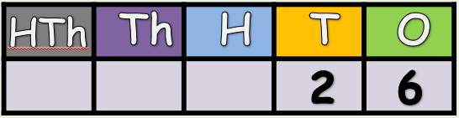

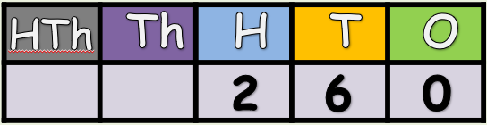
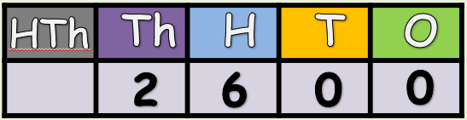
x10
What do
you notice?
x10

Slide 6


Your Turn
36
52,000
1) 36 x 1 =
5) 520 x 100 =
2) 36 x 10 =
360
6) 100 x 90 =
9000
3600
7) 990 x 100 =
99,000
3) 36 x 100 =
4) 360 x 100 =
36,000
8)101 x 100=
10100

Slide 7
True or False
45 x 100 = 45 x 10 x 10
True: Can you explain why?

