Slide 1
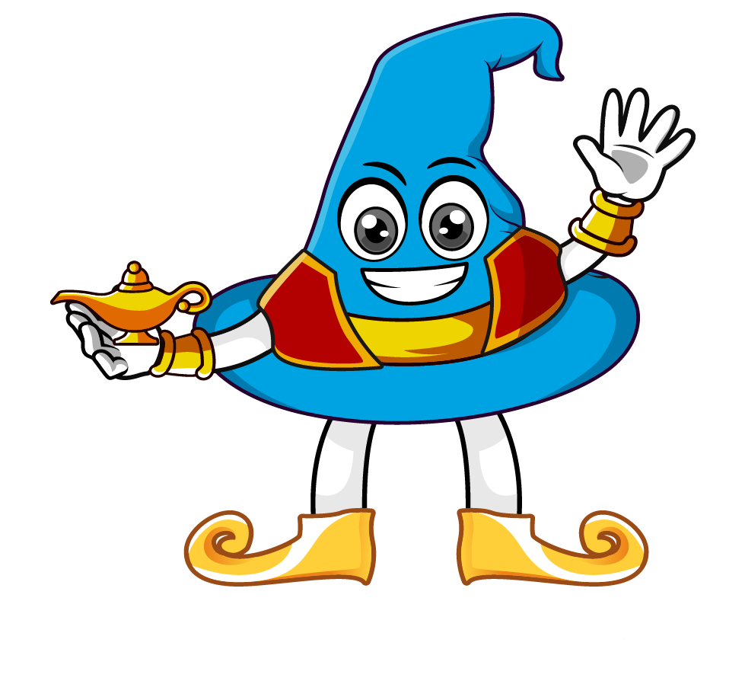

Lesson 2:
Multiply decimals
by 10, 100
www.arithmagicians.com

Slide 2

Which number is bigger?
.
T
O
t
h
th
.
2
6
.
2
6
0
.
2
6
0
0
They are all the same. Can you explain why?

Slide 3


The place value chart shows the number 17.245
When we multiply by 10, every digit moves one place to the left.
So we now have 172.45
17.245 x 10 = 172.45
.
H
T
O
t
h
th
.
1
7
2
4
5

Slide 4
The place value chart shows the number 52.345
When we multiply by 100, every digit moves two place to the left.
So we now have 5234.5
52.345 x 100 = 5234.5
.
Th
H
T
O
t
h
th
.
5
5
2
2
3
3
4
4
5
5

Slide 5
The place value chart shows the number 25.3
When we multiply by 100, every digit moves two place to the left.
Don’t forget to add a
place value holder
So we now have 2530
25.3 x 100 = 2530
.
Th
H
T
O
t
h
th
.
2
2
5
5
3
3
0

Slide 6


Your Turn
1) 2.84 x 10 =
28.4
51.42
5) 5.142 x 10 =
2) 12.72 x 100 =
1272
6) 0.954 x 100 =
95.4
3) 4.912 x 10 =
49.12
7) 2.4 x 100 =
240
4) 5.177 x 100 =
517.7
8) 15.1 x100 =
1510

Slide 7
True or False
4.52 x 100 = 45.2 x 10
True

