Slide 1


Lesson 3:
Double numbers to 15
www.arithmagicians.com

Slide 2

🎵 Let’s Chant
Our Doubles to 10!
Double 1 is 2
Double 2 is 4
Double 3 is 6
Double 4 is 8
Double 5 is 10
Double 6 is 12
Double 7 is 14
Double 8 is 16
Double 9 is 18
Double 10 is 20

Slide 3
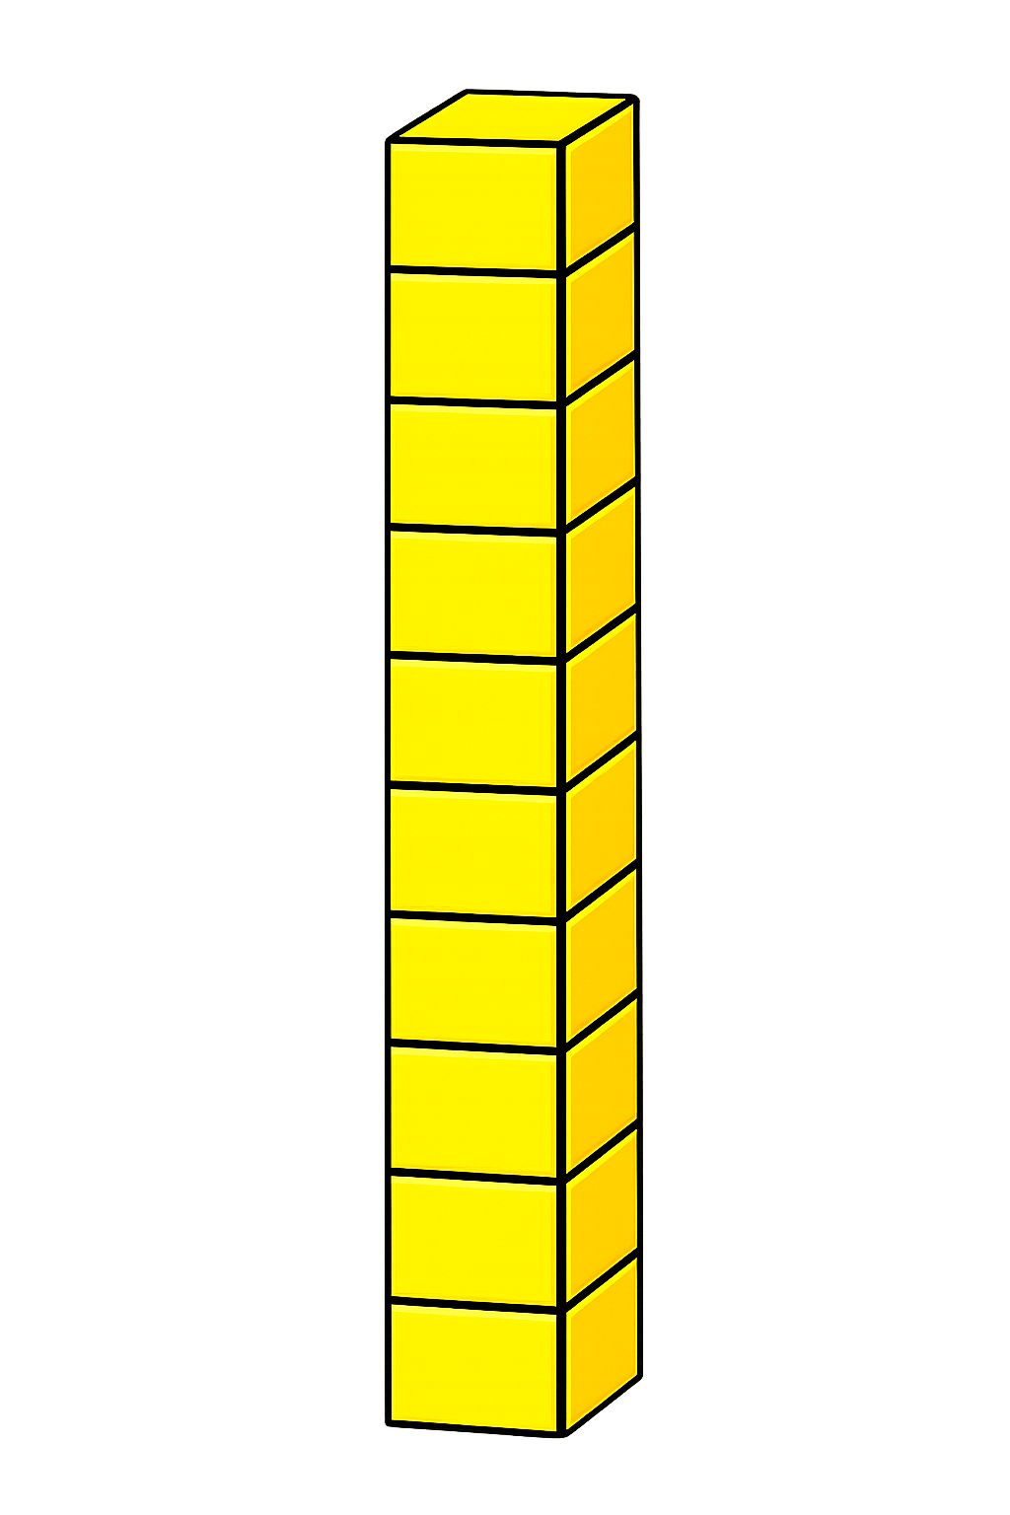

+
11
11
+
+
20
+
2
22

Slide 4
+
12
12
+
+
20
+
4
24

Slide 5
+
13
13
+
+
20
+
6
26

Slide 6
+
14
14
+
+
20
+
8
28

Slide 7
+
15
15
+
+
20
+
10
30

Slide 8


Your Turn
24
12 + 12 = ?
28
2) 14 + 14 = ?
22
3) 11 + 11 = ?
30
4) 15 + 15 = ?
26
5) 13 + 13 = ?

Slide 9


True or False
Doubling means adding the same number to itself.
True

