Slide 1


Lesson 3:
x8 Table
(Focus 6 x 8)
www.arithmagicians.com

Slide 2

+8
+8
+8
+8
+8
+8
+8
+8
+8
+8
0
8
16
24
32
40
48
56
64
72
80
Get ready to count up in 8s

Slide 3
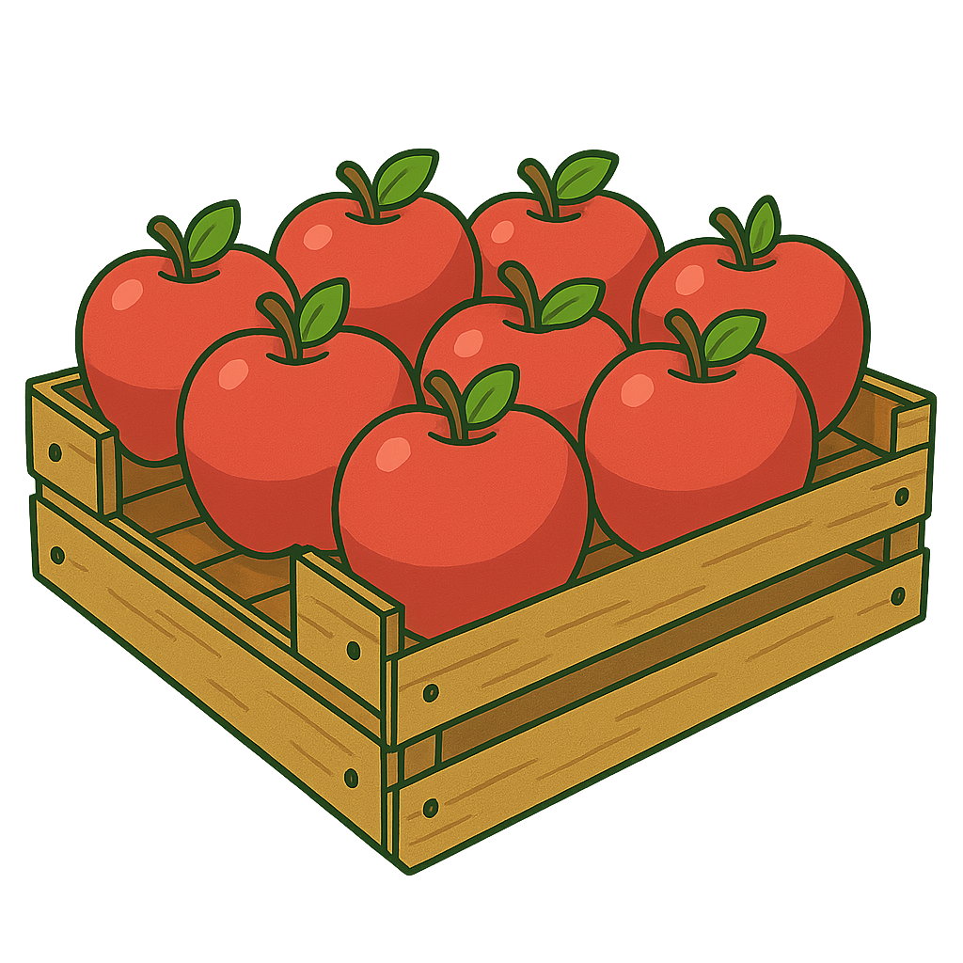

6
There are ____ groups.
8
There are ____ in each group.
48
There are ____ altogether.
48
____ $×$ ____ $=$ ____
6
8

Slide 4
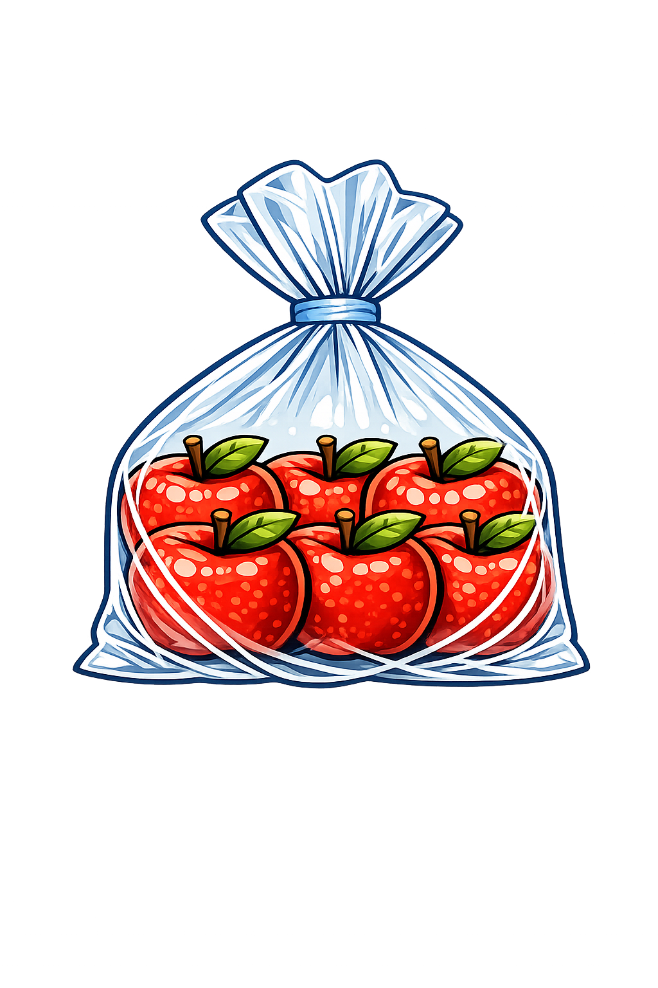
8
There are ____ groups.
6
There are ____ in each group.
48
There are ____ altogether.
48
____ $×$ ____ $=$ ____
8
6

Slide 5

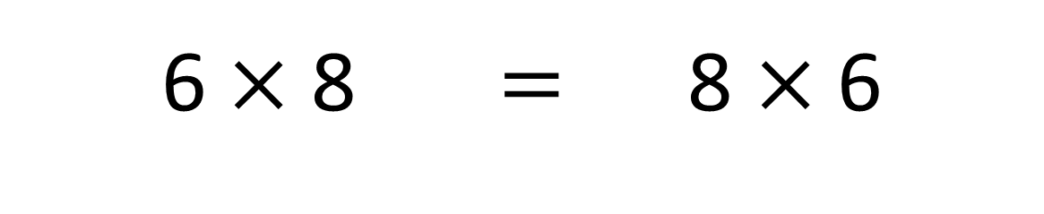
True
True or False
6 $×$ 8 $=$ 8 $×$ 6

Slide 6
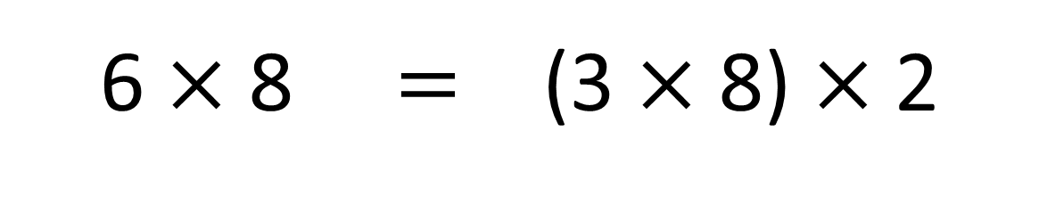
True
True or False
6 $×$ 8 $=$ (3 $×$ 8) $×$ 2

Slide 7


Solve: 6 x 8
Ben:
I am going to skip count in 8s, six times.
+8
+8
+8
+8
+8
+8
0
8
16
24
32
40
48
Amy:
I am going to double 3 x 8
3 x 8 = 24
double
48
Which method do you prefer – why?

Slide 8



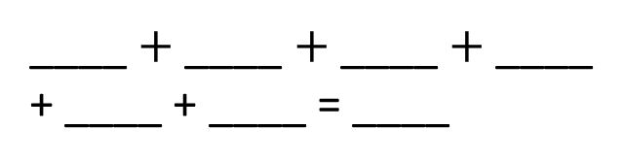
Your Turn
There are 8 bags of bananas.
Each bag contains 6 bananas.
How many bananas are there altogether?
Write an addition sentence for 6 x 8
8
8
8
8
____ $+$ ____ $+$ ____ $+$ ____ + ____ + ____ = ____
8 x 6 = 48
8
8
48
6 x 8 = 48
8 x 6 = 48
Represent this question anyway you like:
There are 6 pots of flowers.
There are 8 flowers in each pot.
What times table does this represent?
6 x 8 = 48

Slide 9

True or False
6 × 8 = 6 × 4 × 2
True

