Slide 1
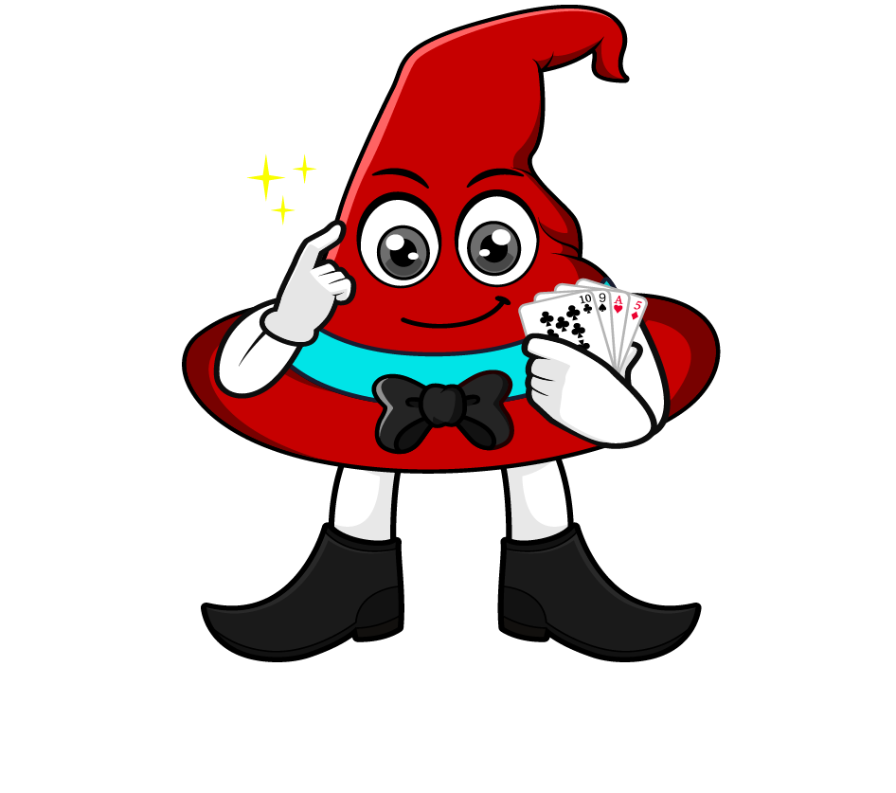
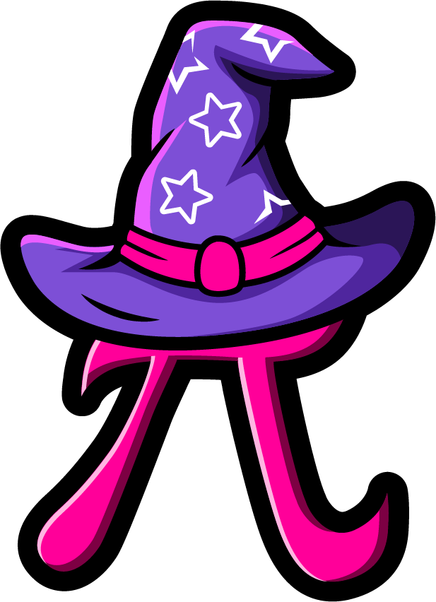
Lesson 3:
Repeated multiplication by 10
( x 10 x 10 )
www.arithmagicians.com

Slide 2


Each time we multiply by 10, the digits move one place to the left.
That’s why multiplying by 100 is the same as multiplying by 10 twice.
Let’s look at an example.
When we multiply by 100, we are really
multiplying by 10 twice.
That’s because: 100 = 10 × 10
So: ×100 = ×10, then ×10 again
Why is multiplying by 100
the same as multiplying by
10, then by 10 again?

Slide 3
43 x 10 x 10
.
Th
H
T
O
.
t
h
4
3
4
0
3
0
0
0
x10
x10
x10
x10
x10
x10
x10
x10
43 x 100
.
Th
H
T
O
.
t
h
4
3
0
0
x100

Slide 4

Write three different calculations that all equal 3200 using ×10 and ×100
32 x 10 x 10
32 x 100
320 x 10

Slide 5


Your Turn
Write at least three different calculations that all equal the target number using only ×10 and ×100
(you can use them more than once)
5600
92000
56 x 10 x 10
56 x 100
560 x 10
92 x 10 x 10 x 10
92 x 100 x 10
920 x 10 x 10
920 x 100
9200 x 10

Slide 6
True or False
35 x 100 = 35 x 10 x 10 x 10
False: Can you explain why?

