Slide 1


Lesson 4:
Double numbers to 15
www.arithmagicians.com

Slide 2

🎵 Let’s Chant
Our Doubles to 10!
Double 1 is 2 Double 2 is 4 Double 3 is 6 Double 4 is 8 Double 5 is 10
Double 6 is 12 Double 7 is 14 Double 8 is 16 Double 9 is 18 Double 10 is 20

Slide 3

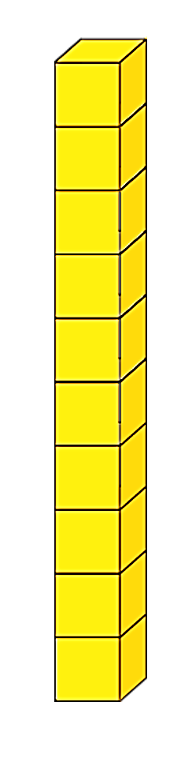

Double 11
+
= 22
2
+
20

Slide 4
Double 12
+
= 24
4
+
20

Slide 5
Double 13
+
= 26
6
+
20

Slide 6
Double 14
+
= 28
8
+
20

Slide 7


Double 15
+
= 30
10
+
20

Slide 8


Your Turn
14
Double ? = 28
11
2) Double ? = 22
15
3) Double ? = 30
4) Double ? = 24
12
13
5) Double ? = 26

Slide 9


True or False
19 + 19 is a double.
True

