Slide 1
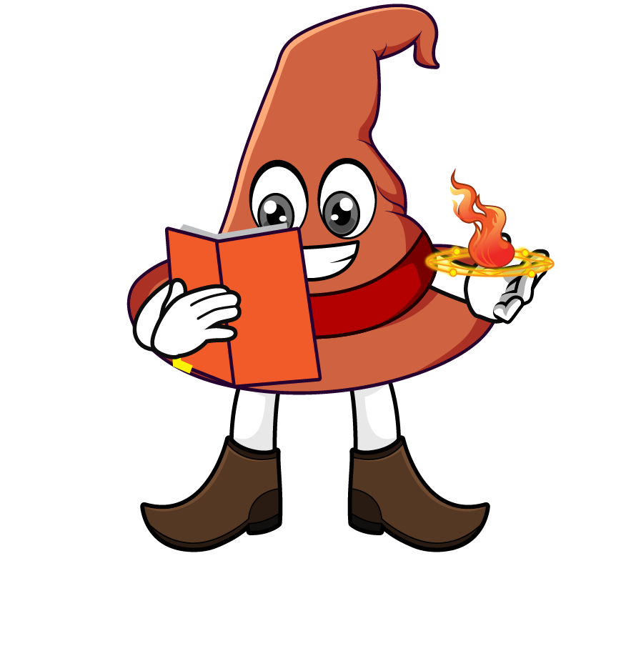

Lesson 4:
Repeated multiplication by 10
( x 10 x 10 )
www.arithmagicians.com

Slide 2

Let’s recap what we have learnt so far?
1) To multiply a number by 10 each digit moves
to the left on a place value grid.
1
2) To multiply a number by 100 each digit moves
to the left on a place value grid.
2

Slide 3
Same or Different?
56 × 100 = 5600
560 × 10 = 5600
56 × 10 × 10 = 5600
56 × 100
560 × 10
56 × 10 × 10
Are they the same or different?
How do you know?

Slide 4
Write different calculations that all equal 8500 using
×10 and ×100
85 x 10 x 10
85 x 100
850 x 10

Slide 5


Your Turn
10
1) 63 x 100 = 63 x ___ x 10
29
2) 29 x 100 = ___ x 10 x 10
10
10
3) 270 x 10 = 27 x ___ x ___
100
4) 270 x 10 = 27 x ____
3200
5) ______ = 32 x 10 x 10
6) 45 x 100 x 10 =
45000

Slide 6

True or False
45 x 100 = 45 x 10 x 10
True

