Slide 1


Lesson 5:
Assess and Review
www.arithmagicians.com

Slide 2

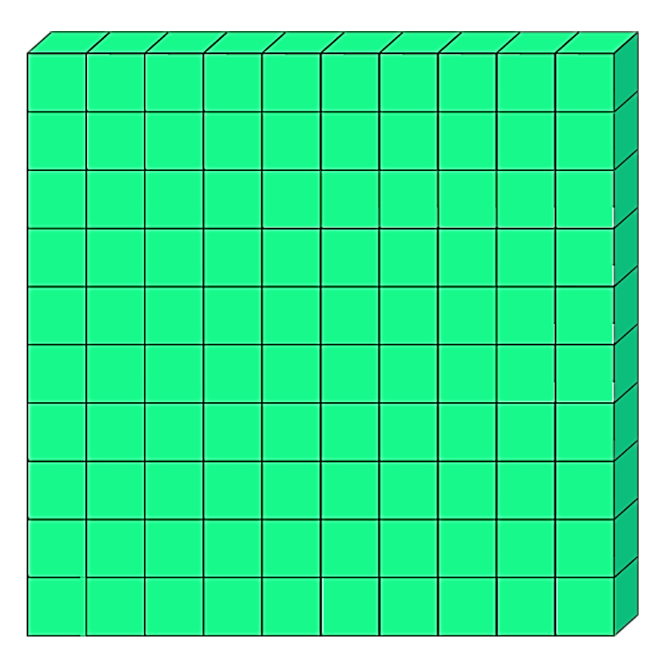
5
5 hundred
__ × 1 hundred =
100
5 × ______ =
500
5
100 × __ =
500

Slide 3
Which number is bigger?
.
Th
H
T
O
t
h
.
1
6
.
1
6
0
.
1
6
0
0
They are all the same. Can you explain why?

Slide 4


When we multiply by 10, every digit moves one place to the left.
The place value chart shows the number 72
So we now have 720
72 x 10 = 720
.
Th
H
T
O
t
.
7
2
0

Slide 5
The place value chart shows the number 43
When we multiply by 100, every digit moves two place to the left.
So we now have 4300
43 x 100 = 4300
.
Th
H
T
O
t
h
.
4
3
4
0
3
0
0
0

Slide 6

2
4,400
656
65,600
44
200
____ multiplied by 100 is equal to _______

Slide 7


Your Turn
8700
1) 87 x 100 = _____
29
2) 29 x 100 = ___ x 10 x 10
100
3) 27 x 10 x 10 = 27 x ___
3400
4) 340 x 10 = ______
34,000
4) 340 x 100 = ______
8200
5) ______ = 82 x 10 x 10

