Slide 1


Week 1:
Assess & Review
www.arithmagicians.com

Slide 2

🎵 Let’s Chant
Our Doubles to 10!
Double 1 is 2
Double 2 is 4
Double 3 is 6
Double 4 is 8
Double 5 is 10
Double 6 is 12
Double 7 is 14
Double 8 is 16
Double 9 is 18
Double 10 is 20

Slide 3

Match the doubles to
the additions
Double 12
14 + 14
Double 14
12 + 12
Double 11
11 + 11

Slide 4
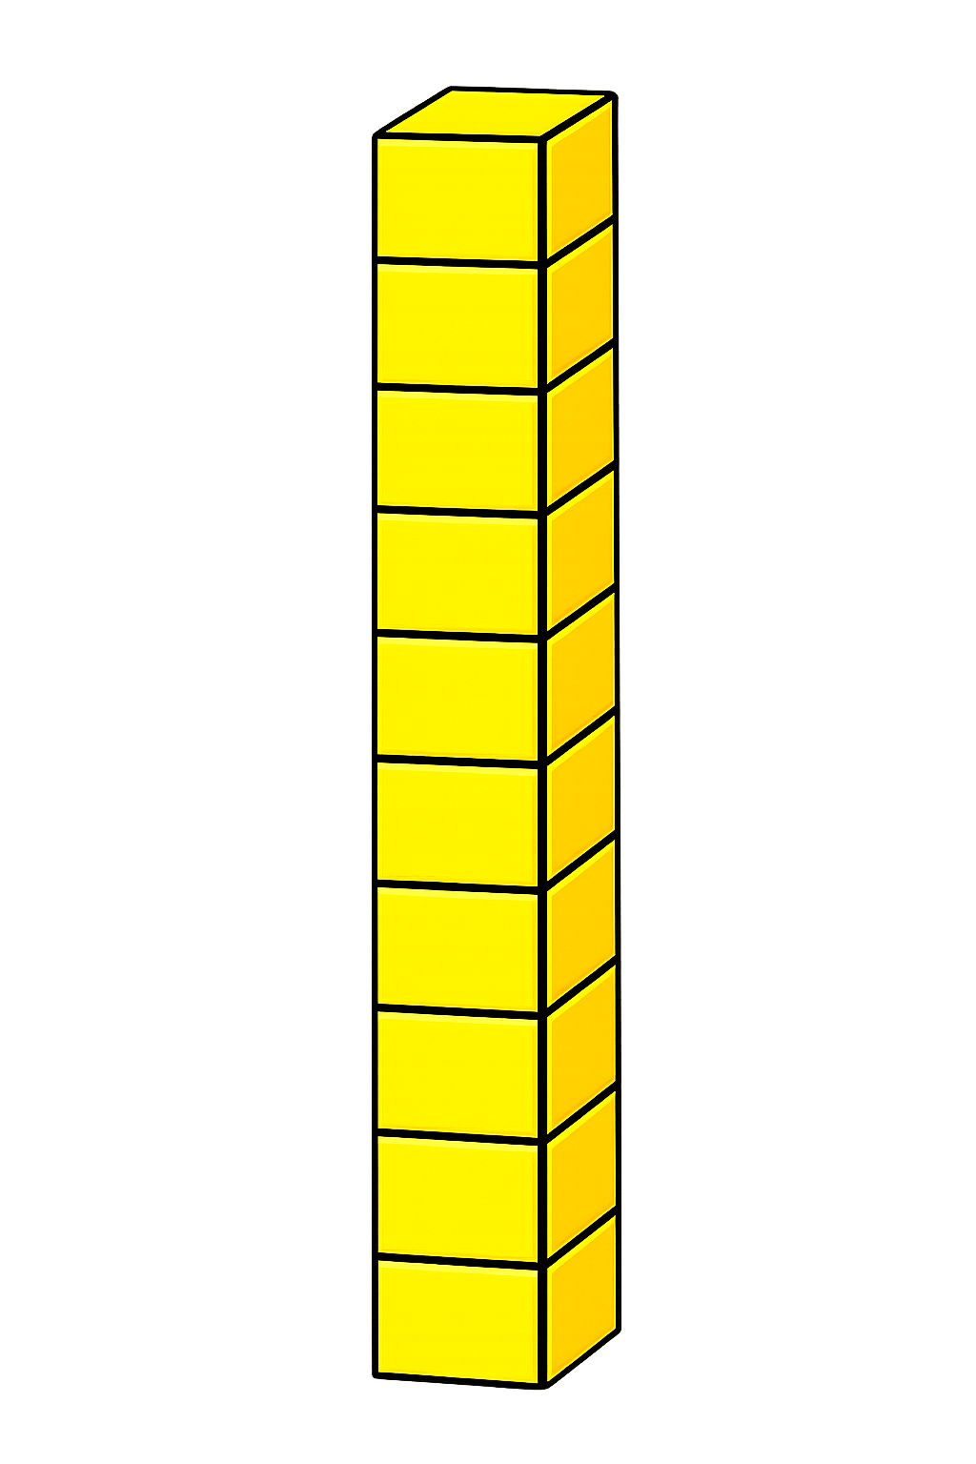

+
11
11
+
+
20
+
2
22

Slide 5
+
12
12
+
+
20
+
4
24

Slide 6

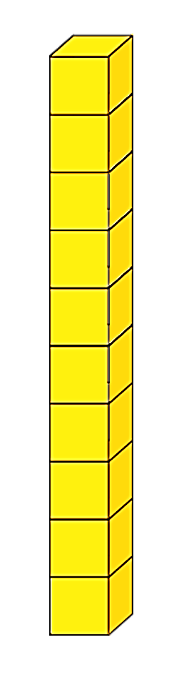
Double 13
+
= 26
6
+
20

Slide 7
Double 14
+
= 28
8
+
20

Slide 8


Double 15
+
= 30
10
+
20

Slide 9


Your Turn
28
1) 14 + 14 = ?
2) 11 + 11 = ?
22
30
3) Double 15 = ?
4) Double ? = 24
12
13
5) Double ? = 26

