Slide 1


Lesson 1:
Double numbers to 20
www.arithmagicians.com

Slide 2

🎵 Let’s Chant
Our Doubles!
Double 11 is 22
Double 12 is 24
Double 13 is 26
Double 14 is 28
Double 15 is 30

Slide 3
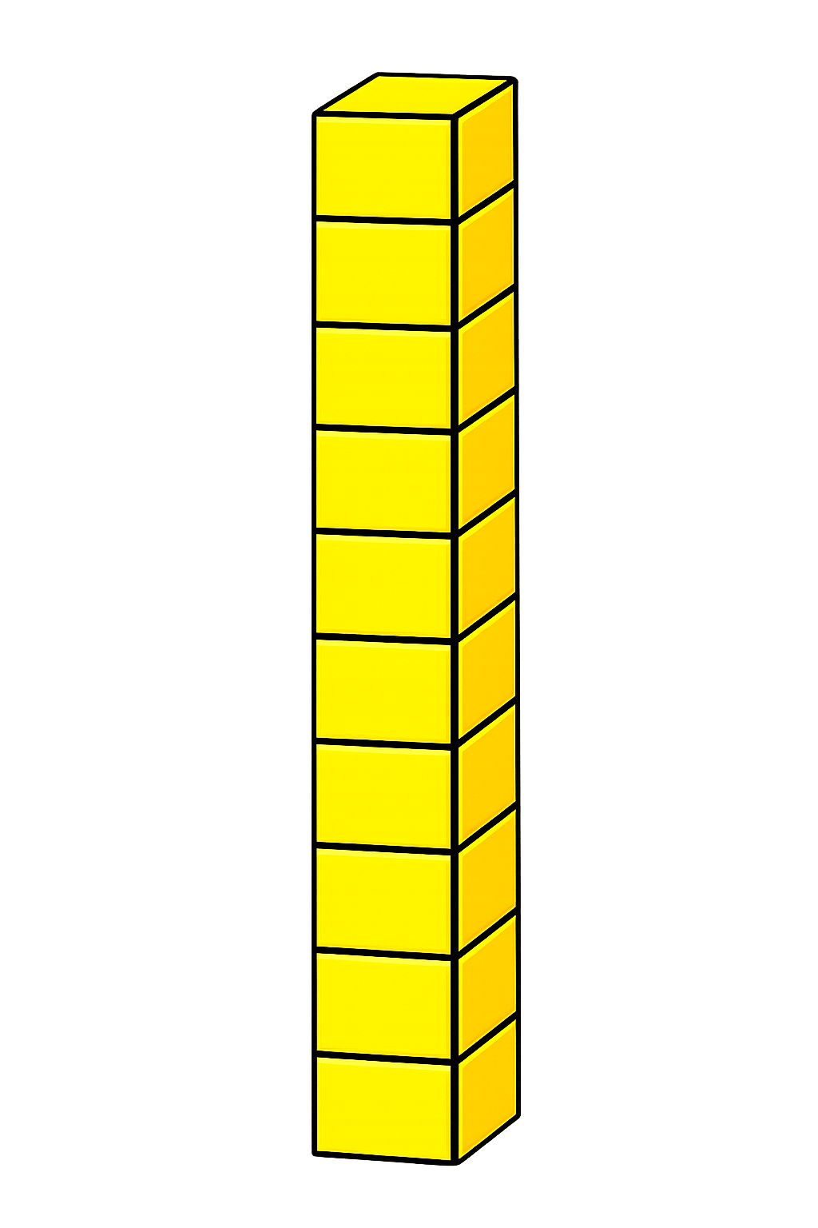

+
16
16
+
+
20
+
12
32

Slide 4
+
17
17
+
+
20
+
14
34

Slide 5
+
18
18
+
+
20
+
16
36

Slide 6
+
19
19
+
+
20
+
18
38

Slide 7


Your Turn
Double 16 = ?
32
2) Double 18 = ?
36
3) Double 17 = ?
34
40
4) Double 20 = ?
38
5) Double 19 = ?

Slide 8

Always / Sometimes / Never
All doubles are even numbers.
Always

