Slide 1


Lesson 2:
Double numbers to 20
www.arithmagicians.com

Slide 2

🎵 Let’s Chant
Our Doubles!
Double 11 is 22
Double 12 is 24
Double 13 is 26
Double 14 is 28
Double 15 is 30

Slide 3
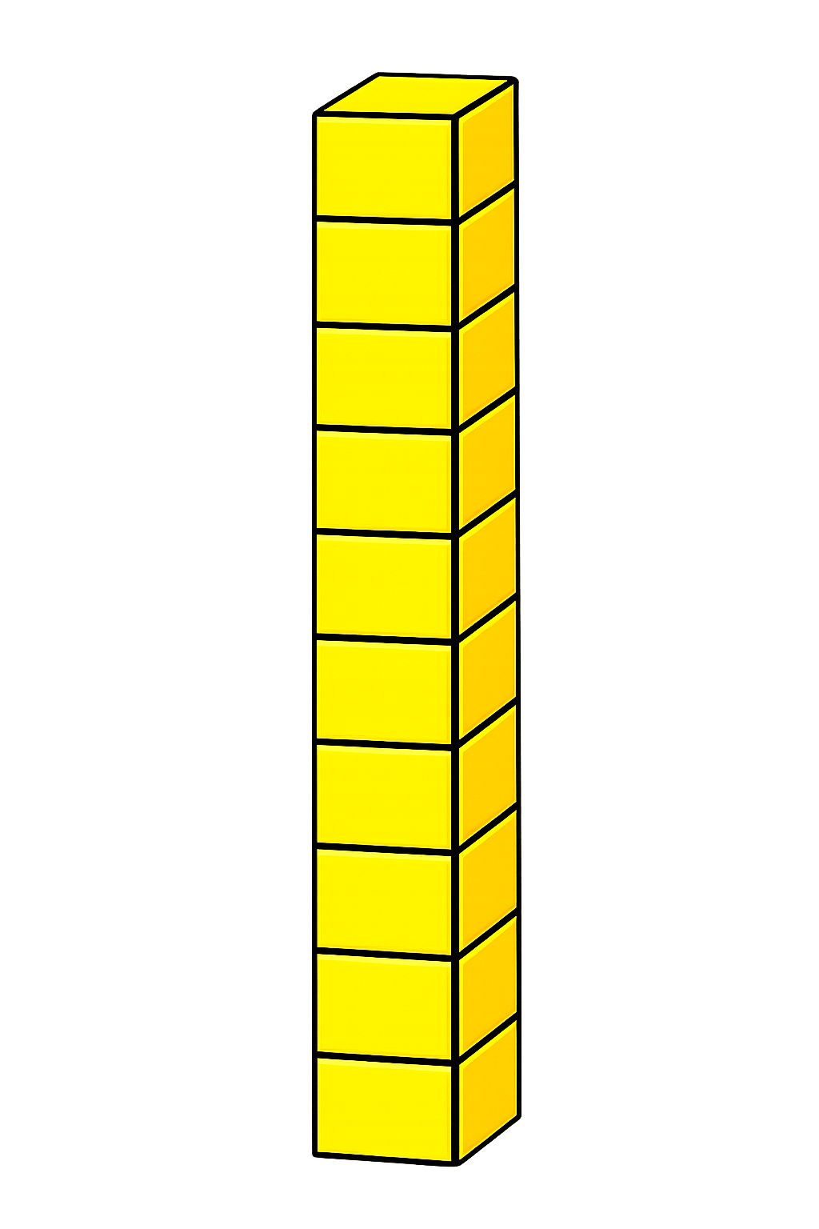

+
18
18
+
+
20
+
16
36

Slide 4
+
16
16
+
+
20
+
12
32

Slide 5
+
19
19
+
+
20
+
18
38

Slide 6
+
17
17
+
+
20
+
14
34

Slide 7


Your Turn
34
17 + 17 = ?
38
2) 19 + 19 = ?
32
3) 16 + 16 = ?
36
4) 18 + 18 = ?
40
5) 20 + 20 = ?

Slide 8


True or False
36 + 36 is a double
True

