Slide 1


Lesson 2:
x8 Table
(Focus 9 x 8)
www.arithmagicians.com

Slide 2

+8
+8
+8
+8
+8
+8
+8
+8
+8
+8
0
8
16
24
32
40
48
56
64
72
80
Get ready to count up in 8s

Slide 3


9
There are ____ groups.
8
There are ____ in each group.
72
There are ____ altogether.
72
____ $×$ ____ $=$ ____
9
8

Slide 4


8
There are ____ groups.
9
There are ____ in each group.
72
There are ____ altogether.
72
____ $×$ ____ $=$ ____
8
9

Slide 5


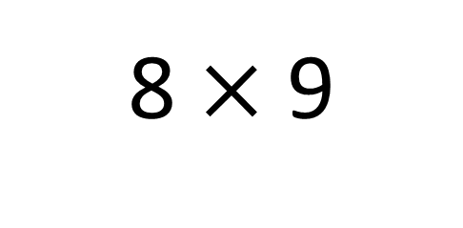
True
True or False
8 $×$ 9
=
8 $×$ 10 - 8 x 1
=
8
___ groups of 9 is the same as 8 groups
of ____ minus one group of ___
10
8

Slide 6


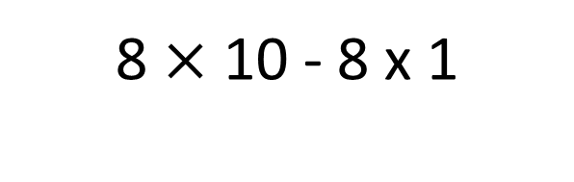
Solve: 8 x 9
Jasmin:
I am going to skip count in 9s, eight times.
+9
+9
+9
+9
+9
+9
+9
0
9
18
27
36
45
54
72
Amy:
I will find 8 groups of 10, then subtract 1 group of 8.
8 $×$ 10 - 8 x 1
80 - 8
72
Which method do you prefer – why?

Slide 7


Your Turn
Answer the questions below and be ready
to explain which strategy you used.
0
6) 8 x 9 =
72
1) 8 x 0 =
48
7) 5 x 8 =
40
2) 8 x 6 =
3) 2 x 8 =
16
8) 6 x 8 =
48
4) 4 x 8 =
32
9) 7 x 8 =
56
5) 8 x 3 =
24
10) 8 x 8 =
64

Slide 8

True or False
9 x 8 = 9 x 4 x 2
True

