Slide 1
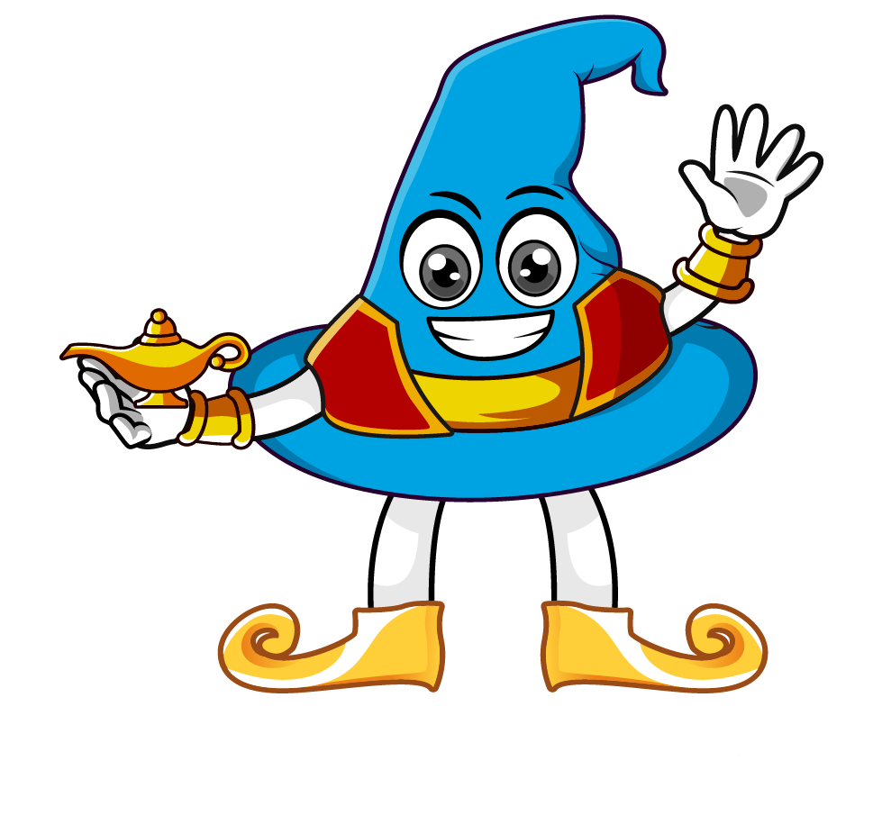

Lesson 2:
To find missing numbers when
multiplying by 10 or 100
www.arithmagicians.com

Slide 2

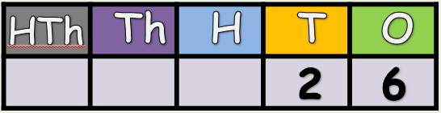

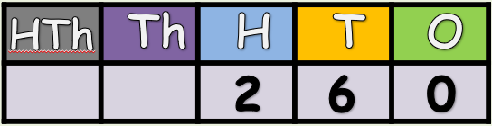
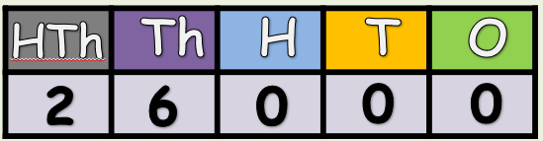
What is the missing number:
x 10
x ?
x 100
x ?

Slide 3
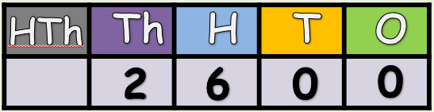
What is the missing number:
5
x ?
x 100
5

Slide 4
Solve:
99 x 100 = 9900
Solve:
99 x ? = 9900
I know that multiplying 99 by _____ gives 9900,
so the missing number is _____.
100
100

Slide 5
Solve:
16 x 100 = 1600
Solve:
16 x ? = 1600
I know that multiplying 16 by _____ gives 1600,
so the missing number is _____.
100
100

Slide 6


Your Turn
10
1) 73 x ? = 730
100
2) 99 x ? = 9900
100
3) ? x 85 = 8500
93
4) ? x 100 = 9300
10
5) 66 x 100 x ? = 66000
100
6) 83 x ? x 10 = 83000

Slide 7

True or False
550 x 10 = 55 x 10 x 10
True: Can you explain why?

