Slide 1
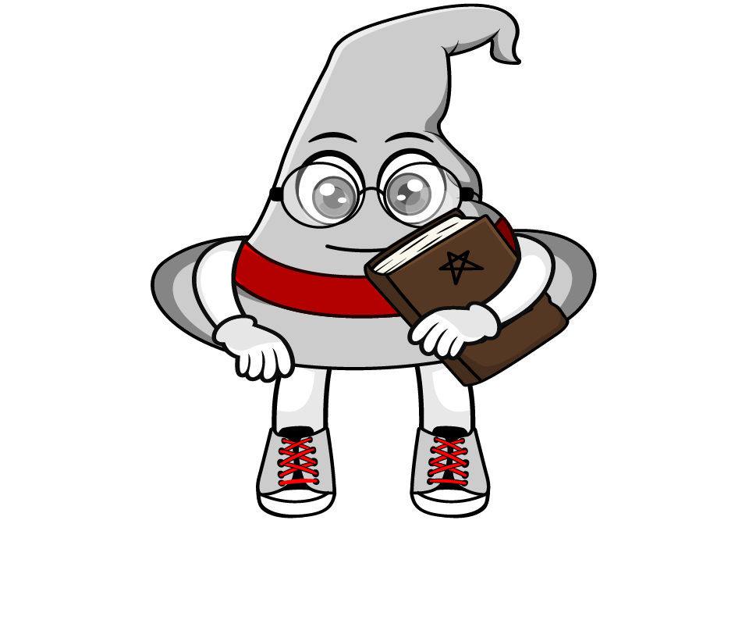
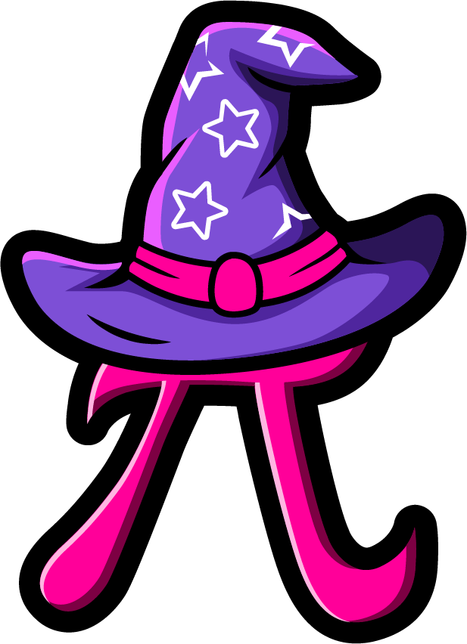
Lesson 2:
Repeated multiplication by 10
(x10 x 10 x 10)
www.arithmagicians.com

Slide 2


Each time we multiply by 10, the digits move one place to the left.
That’s why multiplying by 1000 is the same as multiplying by 10 three times.
Let’s look at an example.
When we multiply by 1000, we are really
multiplying by 10 three times.
That’s because: 1000 = 10 x 10 x 10
So: ×1000 = x10, then x10 and x10 again
Why is multiplying by 1000
the same as multiplying by
10, then by 10 and 10 again?

Slide 3
38.125 x 10 x 10 x 10
.
HTh
Th
H
T
O
t
h
th
.
3
3
8
8
1
1
2
2
3
8
1
2
5
5
5
38.125 x 1000
x10
x10
x10
x10
x10
x10
x10
x10
x10
x10
x10
x10
x10
x10
x10
.
Th
H
T
O
t
h
th
HTh
.
3
8
1
2
5
x1000

Slide 4

Write different calculations that all equal 65.232 using
only ×10 and ×1000
6.5232 x 10
0.065232 x 1000
0.065232 x 10 x 10 x 10
0.0065232 x 1000 x 10
Notes:
6.5232 × 10 = 65.232 0.065232 × 1000 = 65.232 0.0065232 × 1000 × 10 = 65.232

Slide 5


Your Turn
63
1) 6.3 x 10 =
2) 6.3 x 10 x 10 =
630
3) 6.3 x 100 =
630
4) 6.3 x 10 x 10 x 10 =
6300
5) 6.3 x 100 x 10 =
6300
6) 6.3 x 1000 =
6300

Slide 6
True or False
2.4 x 1000 = 2.4 x 100 x 10
True

