Slide 1

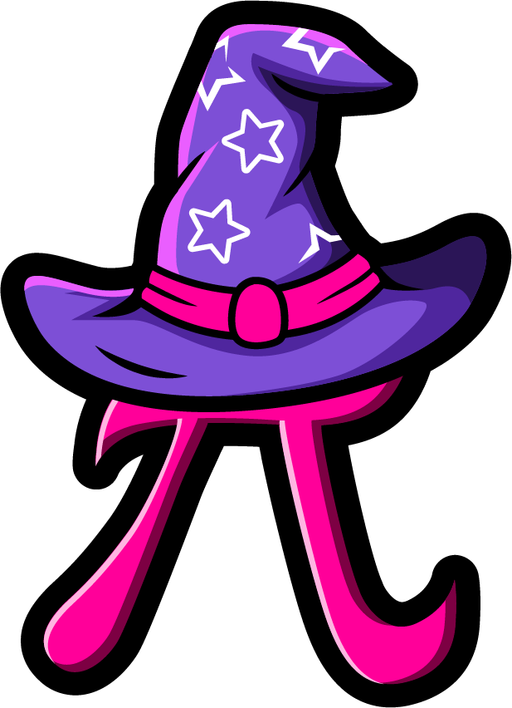
Lesson 3:
Double numbers to 20
www.arithmagicians.com

Slide 2

🎵 Let’s Chant
Our Doubles!
Double 11 is 22 Double 12 is 24 Double 13 is 26 Double 14 is 28 Double 15 is 30

Slide 3

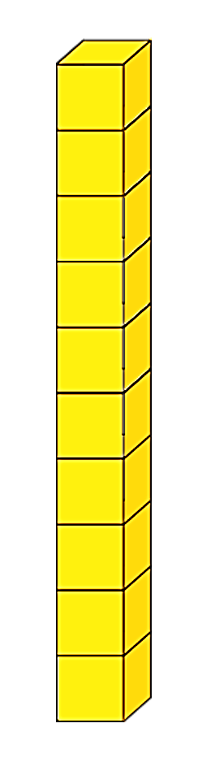
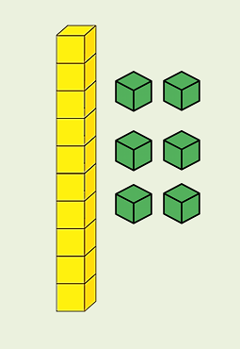

Double 18
+
= 36
16
+
20

Slide 4
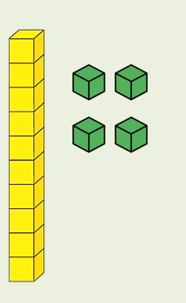
Double 17
+
= 34
14
+
20

Slide 5
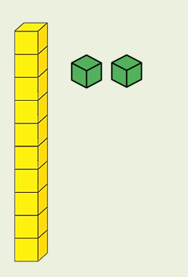
Double 16
+
= 32
12
+
20

Slide 6


Your Turn
38
19 + 19 = ?
34
2) 17 + 17 = ?
36
3) Double 18 = ?
32
4) Double 16 = ?
40
5) 20 + 20 = ?

Slide 7


True or False
Doubling means “two of the same number.”
True

