Slide 1


Lesson 3:
x8 Table
(Focus 11 x 8)
www.arithmagicians.com

Slide 2

+8
+8
+8
+8
+8
+8
+8
+8
+8
+8
0
8
16
24
32
40
48
56
64
72
80
Get ready to count up in 8s

Slide 3


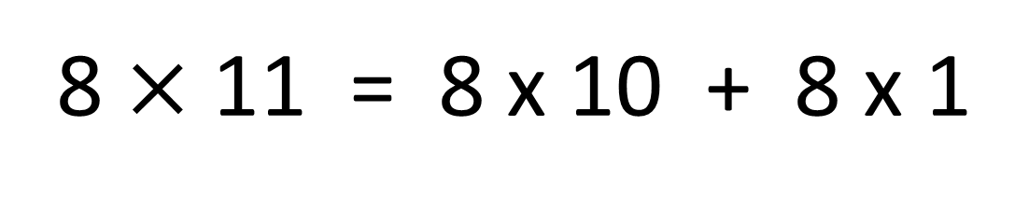
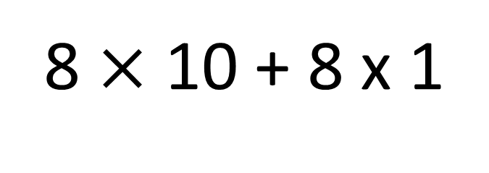
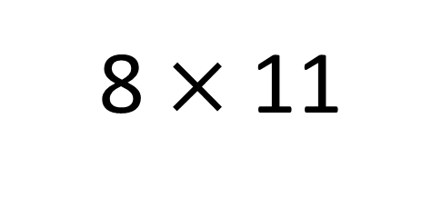
True
True or False
8 $×$ 11 = 8 x 10 + 8 x 1
8 $×$ 11
=
8 $×$ 10 + 8 x 1
=
8
___ groups of 11 is the same as 8 groups
of ____ plus one group of ___
10
8

Slide 4


Your Turn
Answer the questions below and be ready
to explain which strategy you used.
16
6) 8 x 11 =
88
1) 8 x 2 =
32
7) 5 x 8 =
40
2) 8 x 4 =
3) 3 x 8 =
24
8) 12 x 8 =
96
4) 6 x 8 =
48
9) 7 x 8 =
56
5) 8 x 8 =
64
10) 8 x 0 =
0

Slide 5

True or False
8 x 11 = 8 x 10 + 8
True

