Slide 1


Lesson 3:
Missing numbers
(multiplication word problems)
www.arithmagicians.com

Slide 2

Recap:
10
1) 24 x ? = 240
100
2) 73 x ? = 7300
100
3) ? x 46 = 4600
100
4) ? x 100 = 10,000

Slide 3

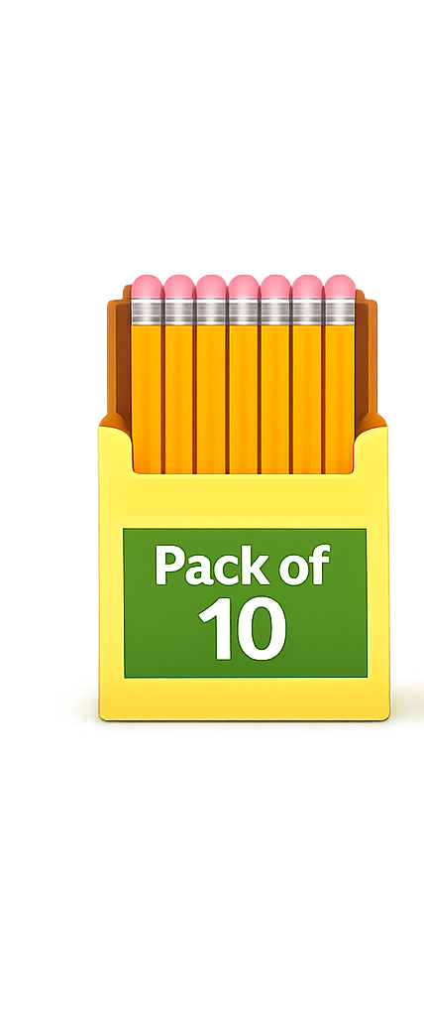
A shop sells pencils in packs of 10. Mia buys some packs and gets 80 pencils. How many packs did she buy?
?
8
10 x ___ = 80

Slide 4
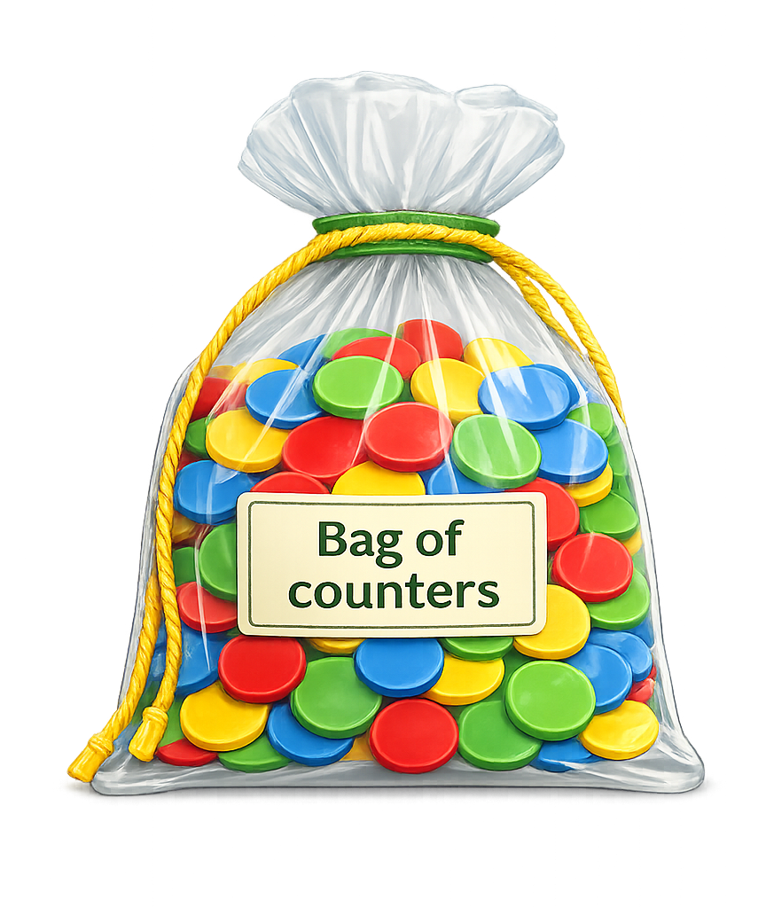
There are 5 equal groups of counters.
Altogether there are 500 counters. How many counters in each group?
?
100
5 x ___ = 500

Slide 5
9
?
A teacher has ___ boxes of pens.
Each box has 10 pens.
There are 90 pens altogether.
How many boxes?

Slide 6
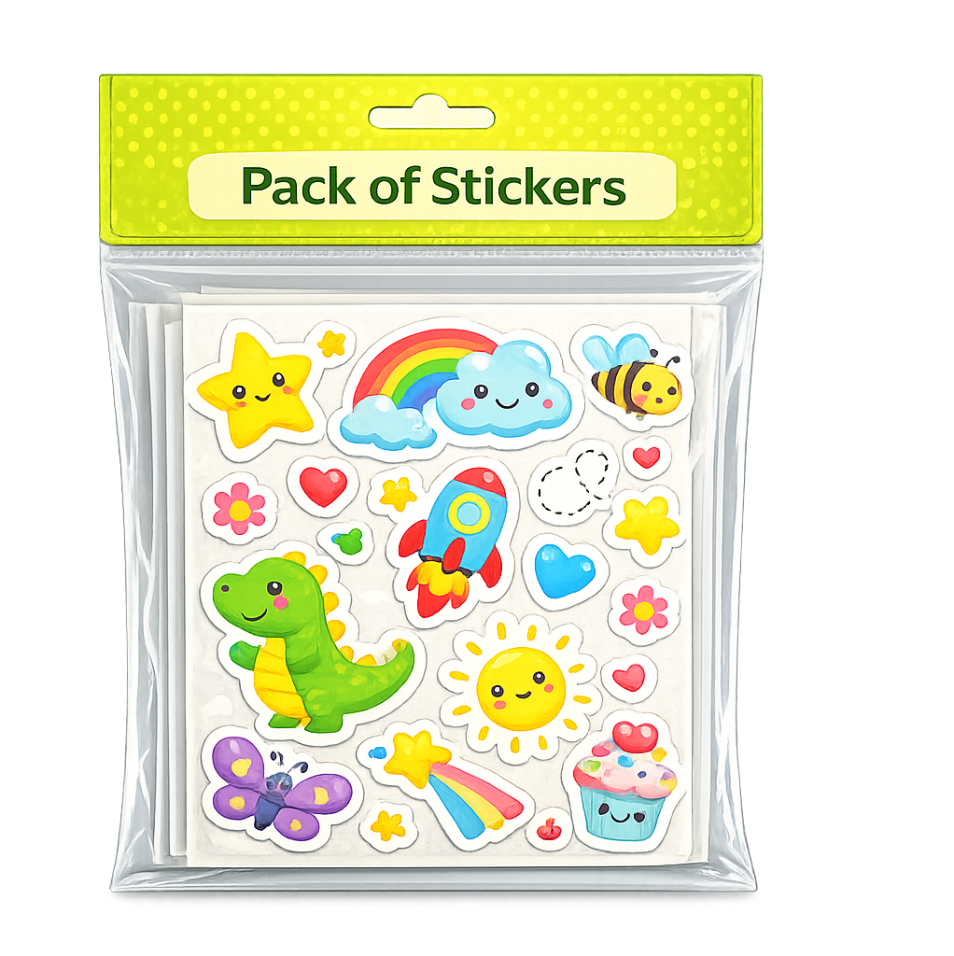
Each pack contains 100 stickers. A school has 900 stickers. How many packs is that?
?
9
100 x ___ = 900

Slide 7
A shop has 32 boxes of 100 pens.
How many pens is this?
?
3200
32 x 100 =

