Slide 1

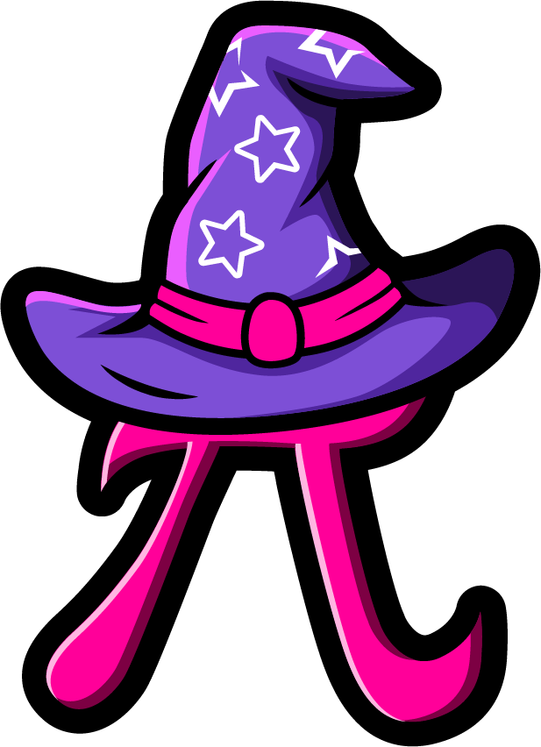
Lesson 3:
Double numbers to 10
www.arithmagicians.com

Slide 2

🎵 Let’s Chant
Our Doubles to 5!
Double 1 is 2 Double 2 is 4 Double 3 is 6 Double 4 is 8 Double 5 is 10

Slide 3


5 + 5 =
10

Slide 4
8 + 8 =
10
+ 6 =
16

Slide 5
6 + 6 =
10
+ 2 =
12

Slide 6
10 + 10 =
20

Slide 7
7 + 7 =
10
+ 4 =
14

Slide 8
9 + 9 =
10
+ 8 =
18

Slide 9


Your Turn
6
Double ? = 12
8
2) Double ? = 16
3) Double ? = 20
10
9
4) Double ? = 18
7
5) Double ? = 14

Slide 10


True or False
Doubling means “two of the same number.”
True

