Slide 1
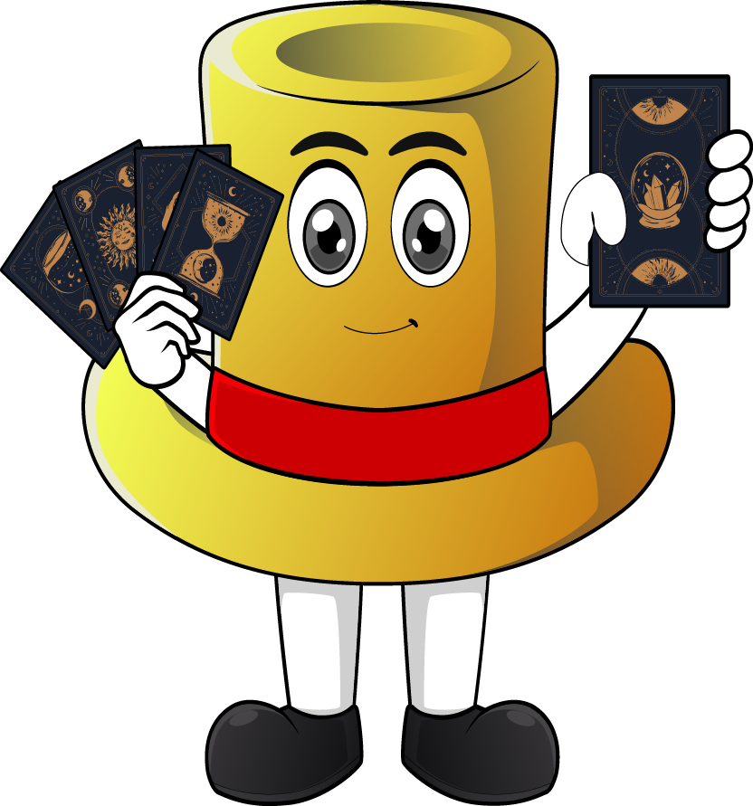

Lesson 4:
x8 Table
(Focus 12 x 8)
www.arithmagicians.com

Slide 2

+8
+8
+8
+8
+8
+8
+8
+8
+8
+8
0
8
16
24
32
40
48
56
64
72
80
Get ready to count up in 8s

Slide 3



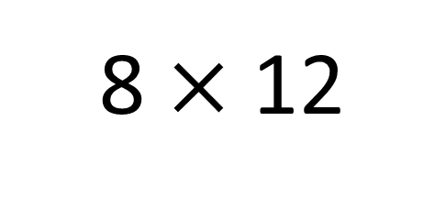
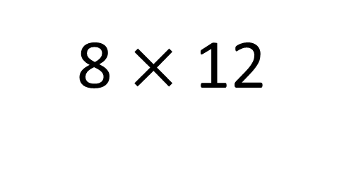
True
True or False
96
8 $×$ 12
=
8 $×$ 12
= 8 $×$ 10 + 8 x 2
8 x 10 + 8 x 2
=
80
16
8
___ groups of 12 is the same as 8 groups
of ____ plus 8 group of ___
10
2

Slide 4


Your Turn
Answer the questions below and be ready
to explain which strategy you used.
48
6) 8 x 11 =
88
1) 8 x 6 =
40
7) 12 x 8 =
96
2) 8 x 5 =
3) 2 x 8 =
16
8) 0 x 8 =
0
4) 4 x 8 =
32
9) 7 x 8 =
56
5) 8 x 9 =
72
10) 8 x 8 =
64

Slide 5

True or False
8 x 12 = 8 x 10 + 8 + 8
True

