Slide 1
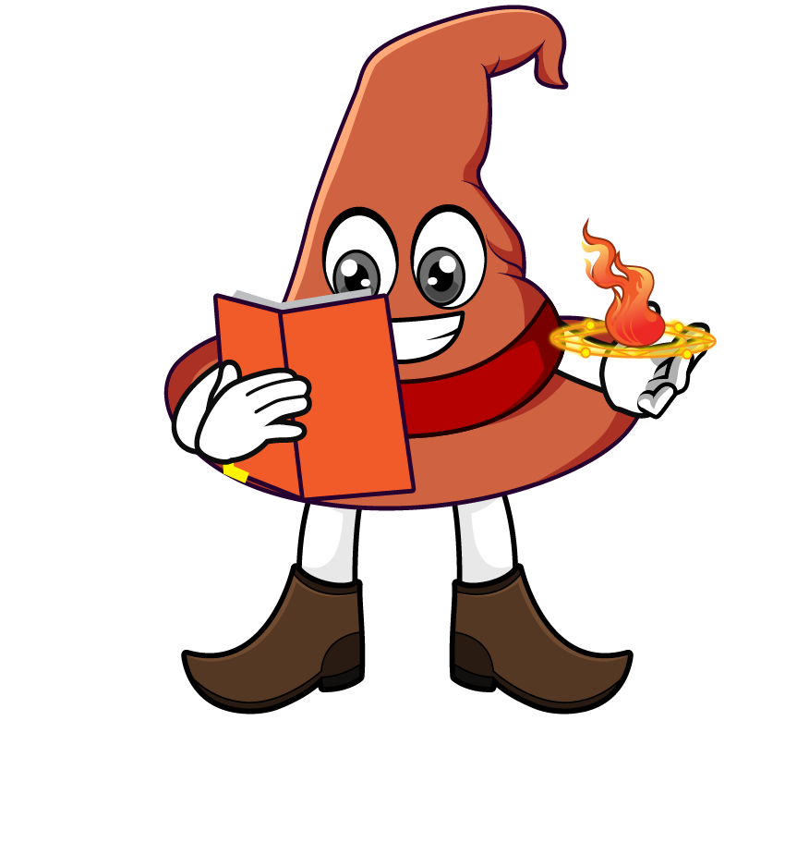

Lesson 4:
Missing numbers
(multiplication word problems)
www.arithmagicians.com

Slide 2

Recap:
10
1) 78 x ? = 780
100
2) 63 x ? = 6300
100
3) ? x 29 = 2900
99
4) ? x 100 = 9900

Slide 3

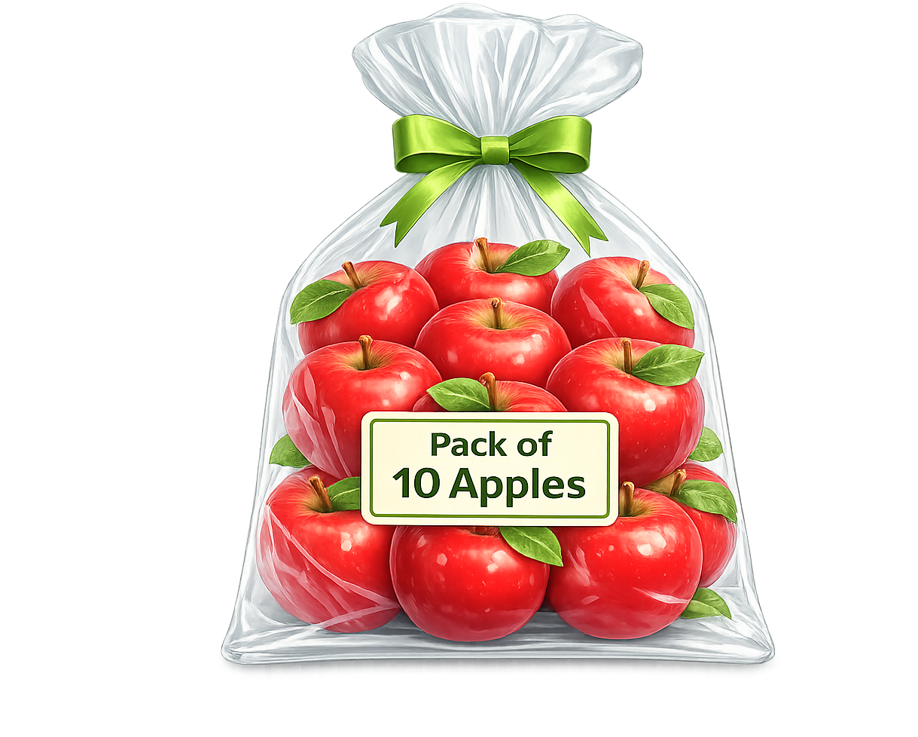
A shop sells apples in packs of 10. Amy buys some packs and gets 90 apples. How many packs did she buy?
?
9
10 x ___ = 90

Slide 4

There are 12 equal groups of cubes.
Altogether there are 1200 cubes. How many cubes in each group?
?
100
12 x ___ = 1200

Slide 5
16
?
A teacher has ____ packs of pens.
Each pack has 10 pens.
There are 160 pens altogether.
How many packs of pens?

Slide 6

A shop has 48 boxes of 100 books.
How many books is this?
?
4800
48 x 100 =

Slide 7

Each pack contains 100 stickers. A school has 1500 stickers. How many packs is that?
?
15
100 x ___ = 1500

