Slide 1
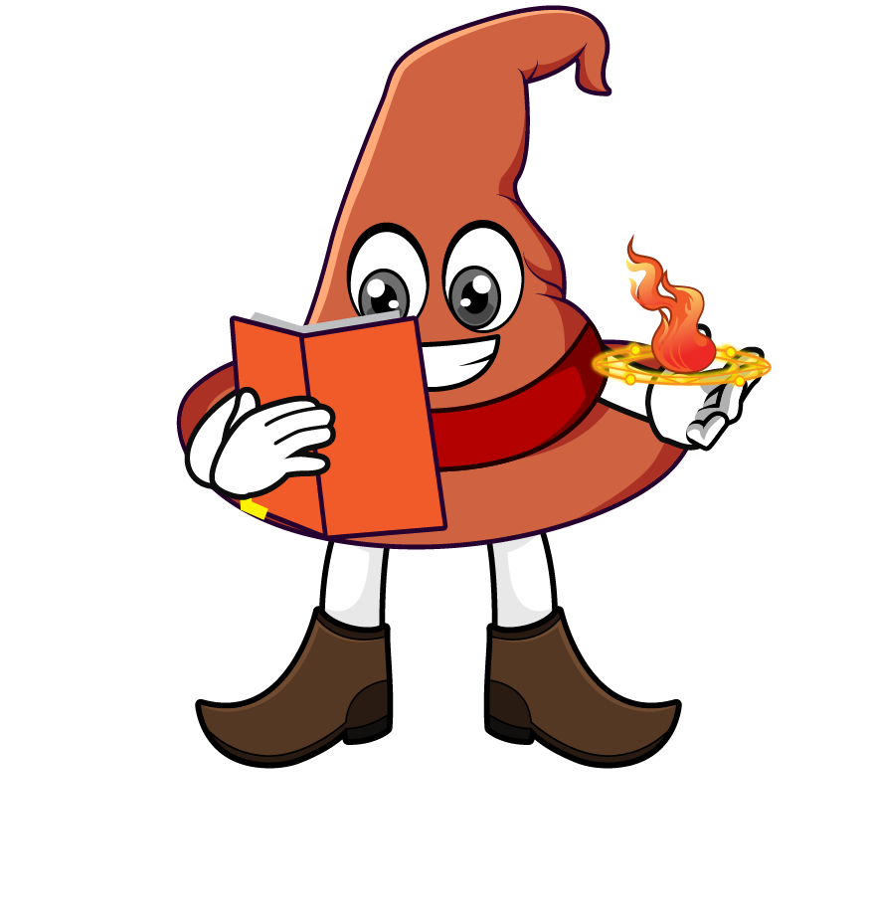

Lesson 4:
To find missing numbers when
multiplying by 10, 100 or 1000
www.arithmagicians.com

Slide 2

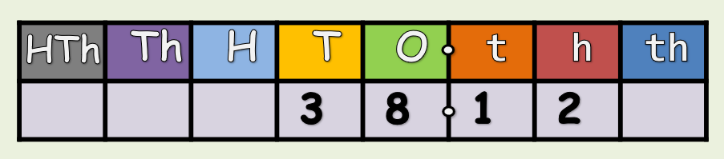
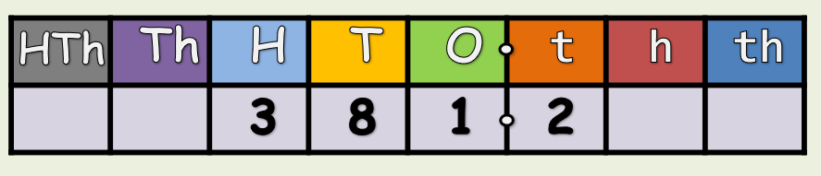
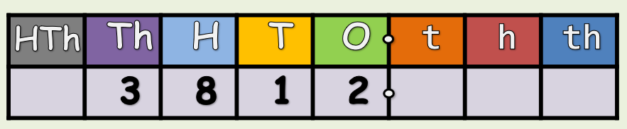
What is the missing number:
x 10
x ?
x ?
x 10

Slide 3
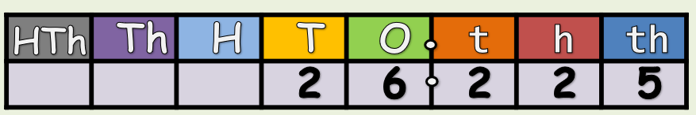
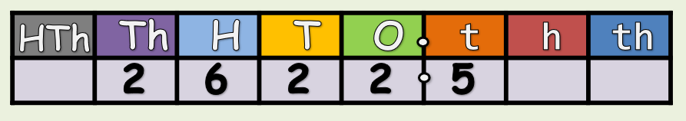
What is the missing number:
x 1000
x ?

Slide 4
Solve:
4.7 x 1000 = 4700
Solve:
4.7 x ? = 4700
I know that multiplying 4.7 by _____
gives 4700 so the missing number is _____
1000
1000

Slide 5
Solve:
1.454 x 1000 = 1454
Solve:
1.454 x ? = 1454
I know that multiplying 1.454 by _____
gives 1454 so the missing number is _____
1000
1000

Slide 6


Your Turn
10
1) 1.5 x ? = 15
100
2) 1.7 x ? = 170
1000
3) ? x 4.9 = 4900
3.2
4) ? x 1000 = 3200
10
10
5) 7.5 x ? x ? = 750
10
10
10
6) 8.2 x ? x ? x ? = 8200

Slide 7

True or False
45 x 1000 = 45 x 10 x 10 x 10
True

