Slide 1


Week 2:
Assess & Review
www.arithmagicians.com

Slide 2

🎵 Let’s Chant
Our Doubles!
Double 11 is 22 Double 12 is 24 Double 13 is 26 Double 14 is 28 Double 15 is 30

Slide 3

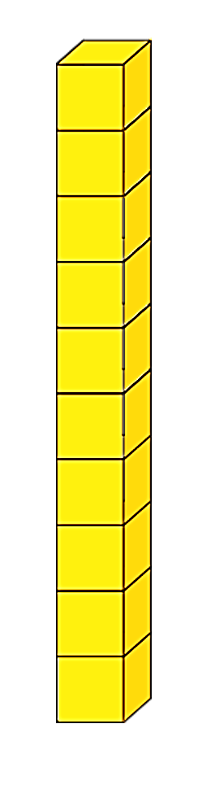
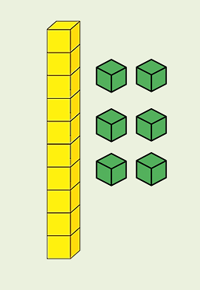

Double 18
+
= 36
16
+
20

Slide 4
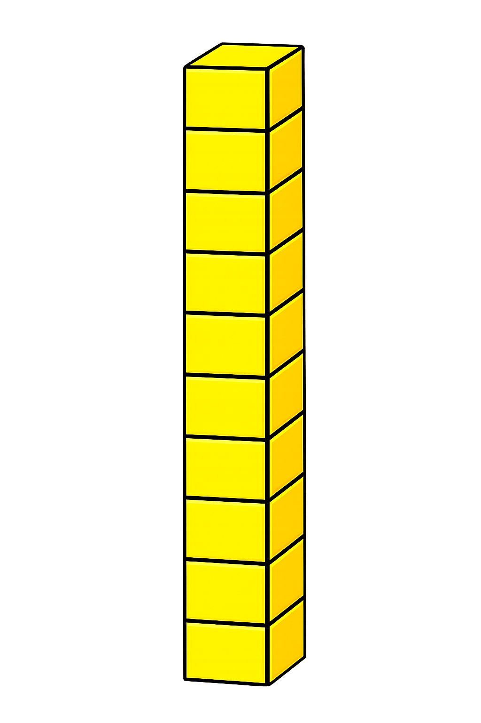
+
19
19
+
+
20
+
18
38

Slide 5
+
16
16
+
+
20
+
12
32

Slide 6
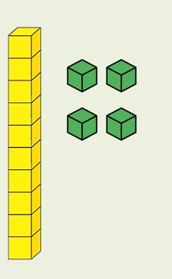
Double 17
+
= 34
14
+
20

Slide 7


Your Turn
34
Double 17 = ?
38
2) Double 19 = ?
32
3) 16 + 16 = ?
36
4) 18 + 18 = ?
20
5) Double ? = 40

