Slide 1
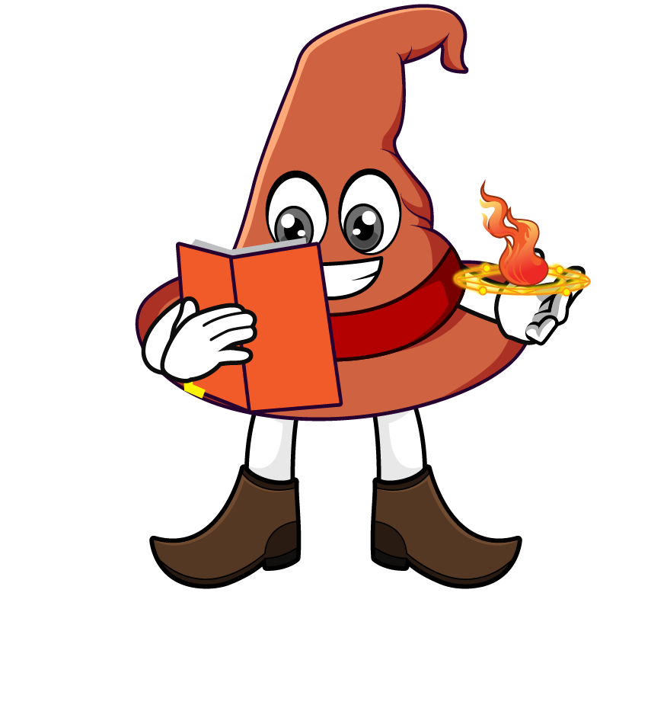

Lesson 4:
Repeated division by 10
(÷ 10 ÷ 10)
www.arithmagicians.com

Slide 2

Complete the sequence
3300
_________
÷ 10
330
_________
÷ 10
33
_________
What do you notice?

Slide 3

Dividing by ____ is the
same as dividing by
___ and then dividing by ___ again.
100
10
10

Slide 4
10
10
1) 1900 ÷ ___ ÷ ___ = 19
100
2) 1900 ÷ ___ = 19
100
3) 7400 ÷ ____ = 74
10
10
4) 7400 ÷ ___ ÷ ___ = 74

Slide 5


Your Turn
63
1) 6300 ÷ 10 ÷ 10 =
2) 6300 ÷ 100 =
63
3) 74,000 ÷ 10 ÷ 10 =
740
4) 74,000 ÷ 100 =
740
2500
5) _____ ÷ 10 ÷ 10 = 25

Slide 6

True or False
5 = 500 ÷ 10 ÷ 10
True

