Slide 1
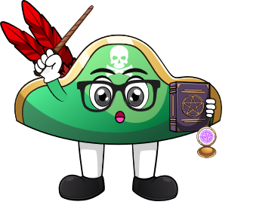

Lesson 1:
Doubles Within 20 – Word Problems
www.arithmagicians.com

Slide 2

🎵 Let’s Chant
Our Doubles!
Double 11 is 22 Double 12 is 24 Double 13 is 26 Double 14 is 28 Double 15 is 30
Double 16 is 32 Double 17 is 34 Double 18 is 36 Double 19 is 38 Double 20 is 40

Slide 3

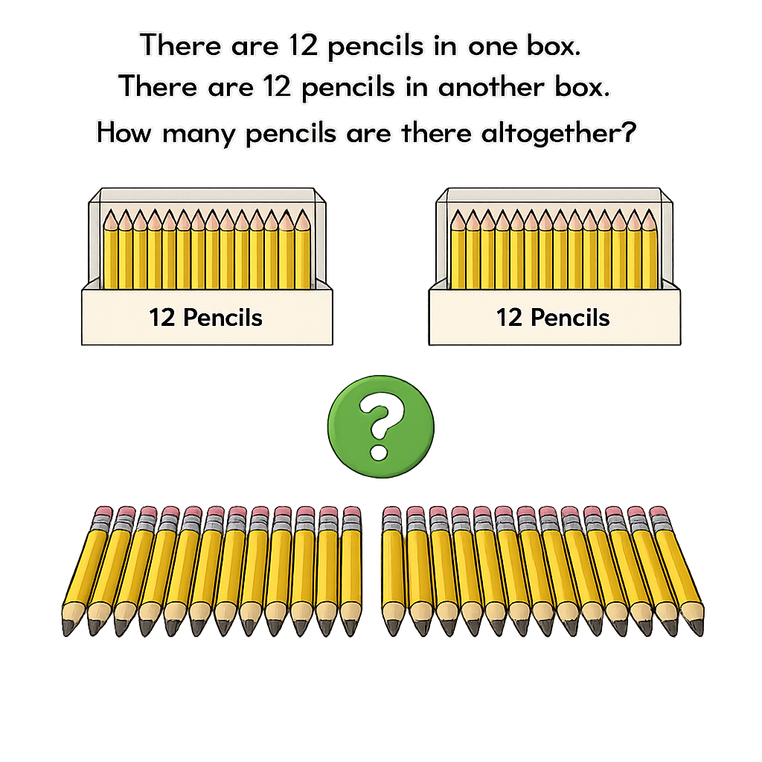
24
12
12

Slide 4
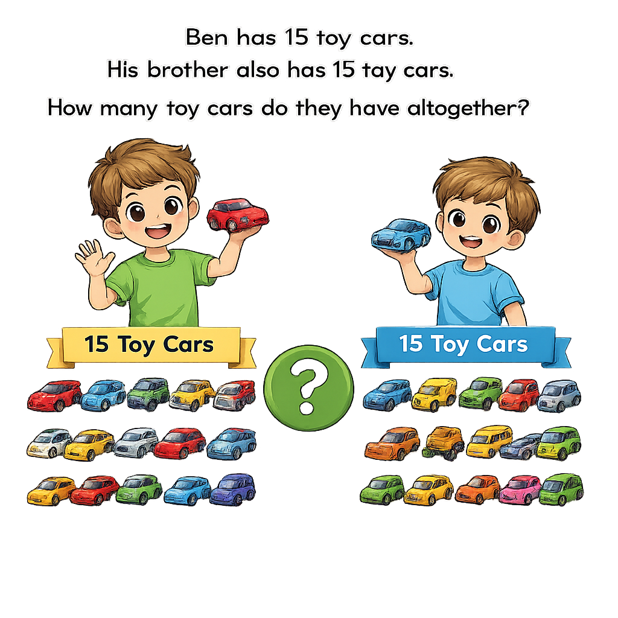

30
15
15

Slide 5
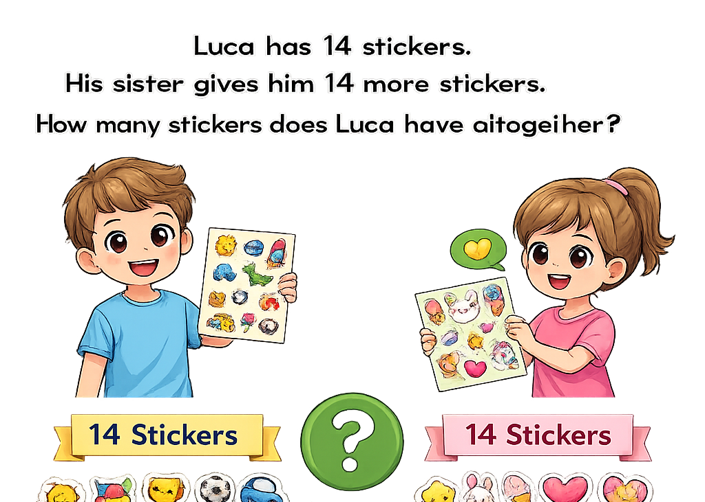

Luca has 14 stickers.
His sister gives him 14 more stickers.
How many stickers does Luca have altogether?
28
14
14

Slide 6


Your Turn
Sam has 11 marbles. His friend gives him 11 more marbles. How many marbles does Sam have now?
?
22
11
11

Slide 7
Your Turn
A party has 18 balloons on one table. There are 18 balloons on another table. How many balloons are there in total?
?
36
18
18

