Slide 1
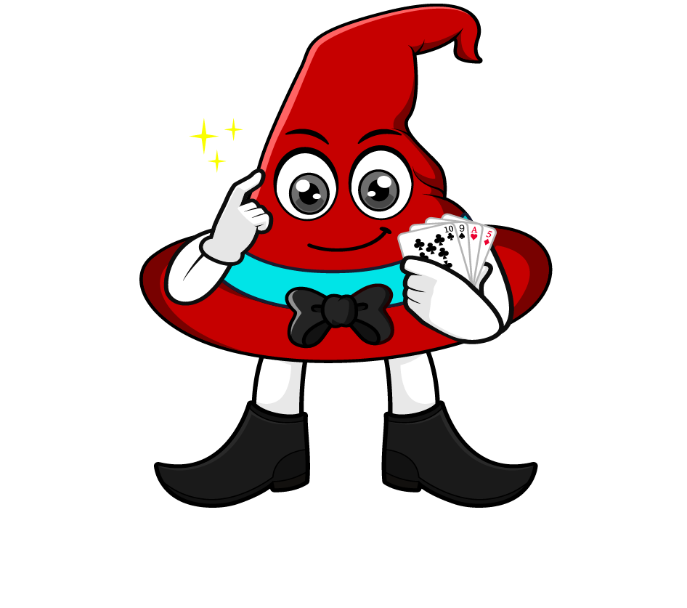

Lesson 1:
Repeated division by 10
www.arithmagicians.com

Slide 2

Complete the sequence
450
________
÷ 10
45
_________
÷ 10
4.5
_________
What do you notice?

Slide 3
Are these equal? Explain why.
80 ÷ 100
= 0.8
80 ÷ 10 ÷ 10
= 0.8

Slide 4

Dividing by ____ is the
same as dividing by
___ and then dividing by ___ again.
100
10
10

Slide 5


Your Turn
10
1) 12 ÷ ___ = 1.2
10
10
2) 12 ÷ ___ ÷ ___ = 0.12
100
3) 12 ÷ ____ = 0.12
10
10
4) 1200 ÷ ___ ÷ ___ = 12

Slide 6

True or False
740 ÷ 100 = 740 ÷ 10 ÷ 10
True: Can you explain why?

