Slide 1
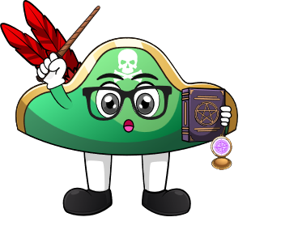

Lesson 1:
Doubles Within 10 – Word Problems
www.arithmagicians.com

Slide 2

🎵 Let’s Chant
Our Doubles to 10!
Double 1 is 2
Double 2 is 4
Double 3 is 6
Double 4 is 8
Double 5 is 10
Double 6 is 12
Double 7 is 14
Double 8 is 16
Double 9 is 18
Double 10 is 20

Slide 3

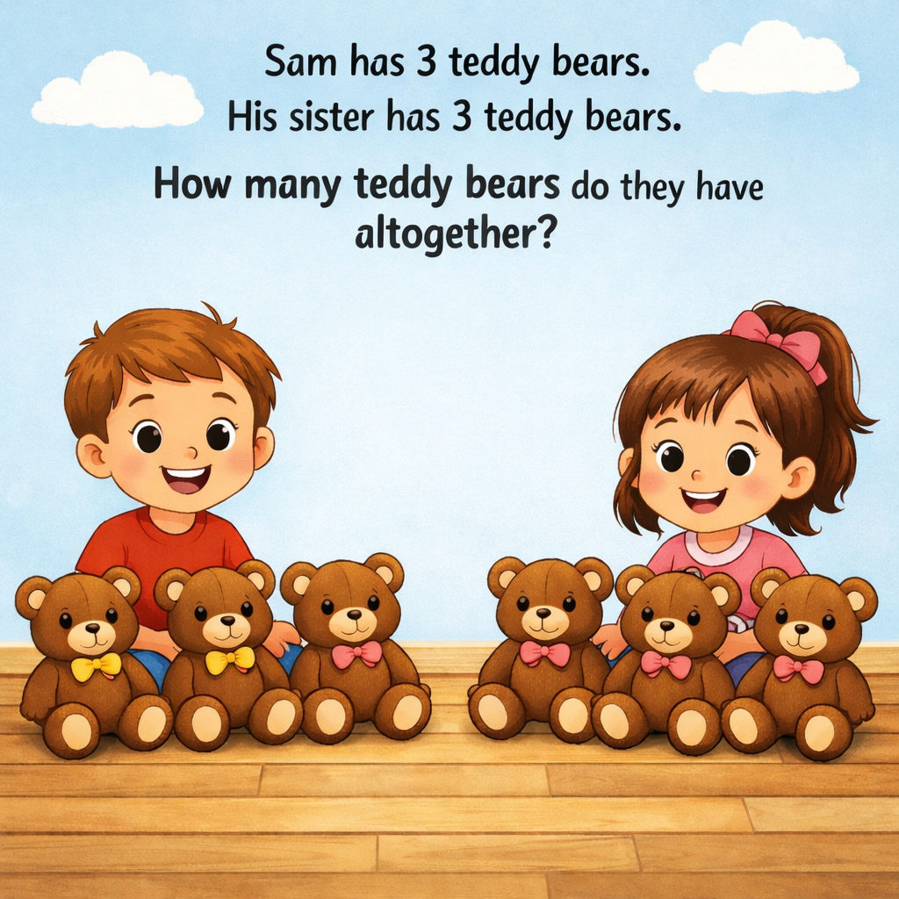
6
3
3

Slide 4
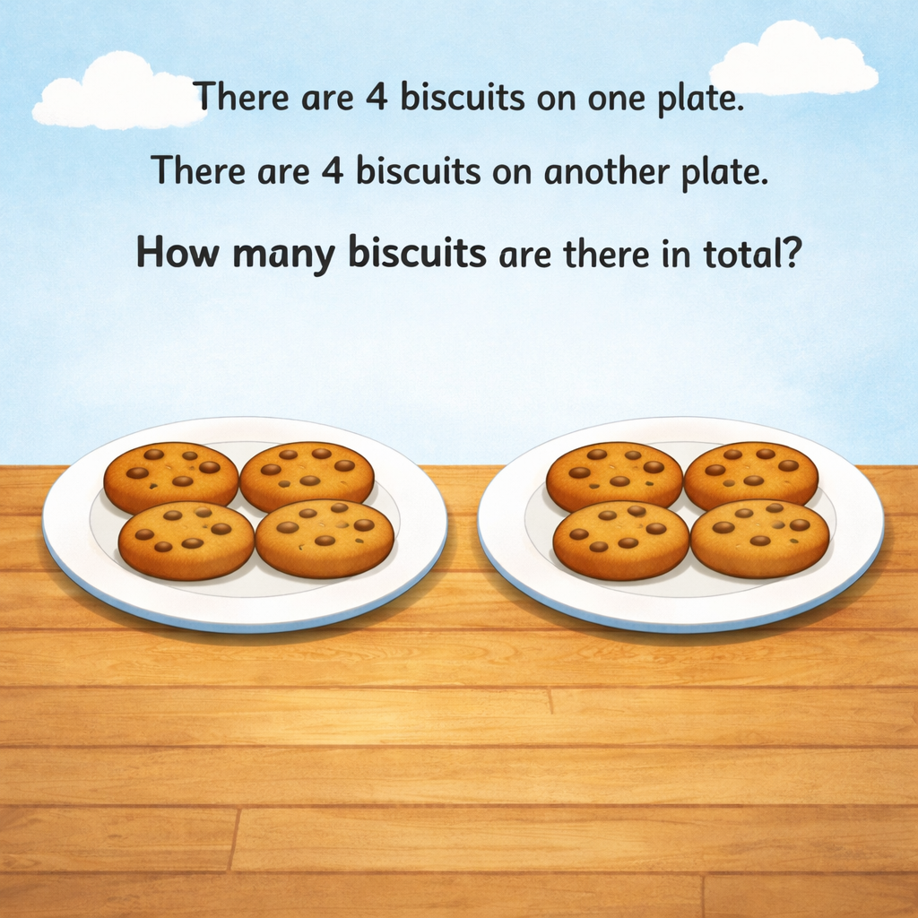
8
4
4

Slide 5
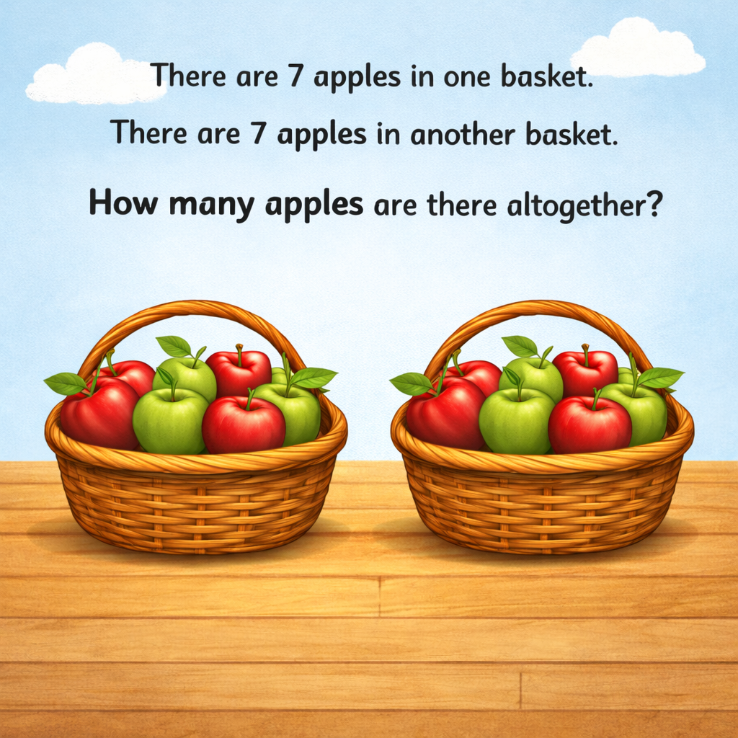
14
7
7

Slide 6


Your Turn
Ben has 6 toy cars.
He gets 6 more toy cars for his birthday.
How many toy cars does he have now?
?
12
6
6

Slide 7
Your Turn
There are 9 ducks in the pond.
Another 9 ducks swims over.
How many ducks are there now?
?
18
9
9

