Slide 1

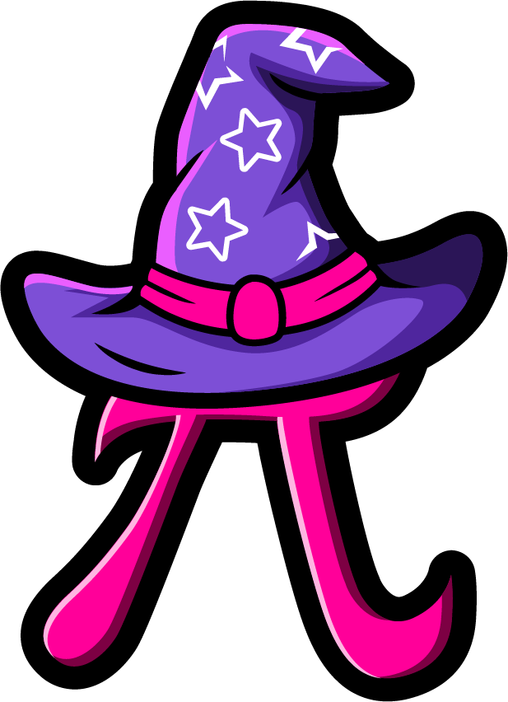
Lesson 2:
Doubles Within 20 – Word Problems
www.arithmagicians.com

Slide 2

🎵 Let’s Chant
Our Doubles!
Double 11 is 22 Double 12 is 24 Double 13 is 26 Double 14 is 28 Double 15 is 30
Double 16 is 32 Double 17 is 34 Double 18 is 36 Double 19 is 38 Double 20 is 40

Slide 3

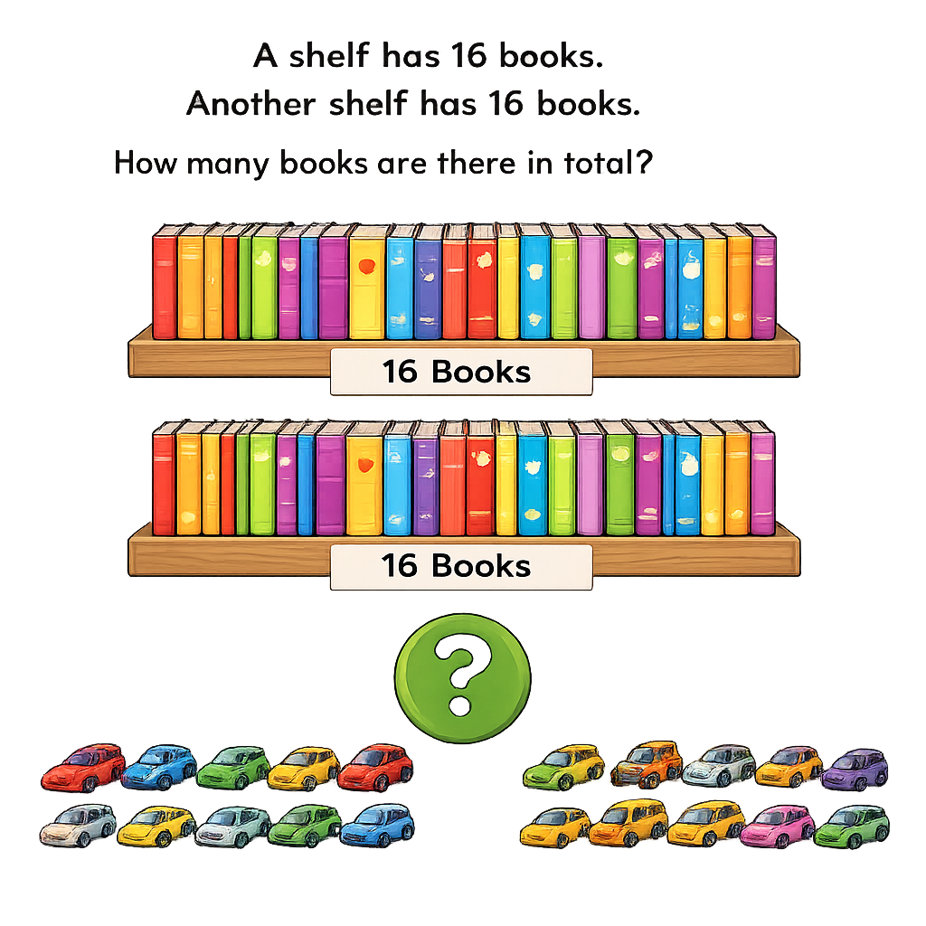

32
16
16

Slide 4
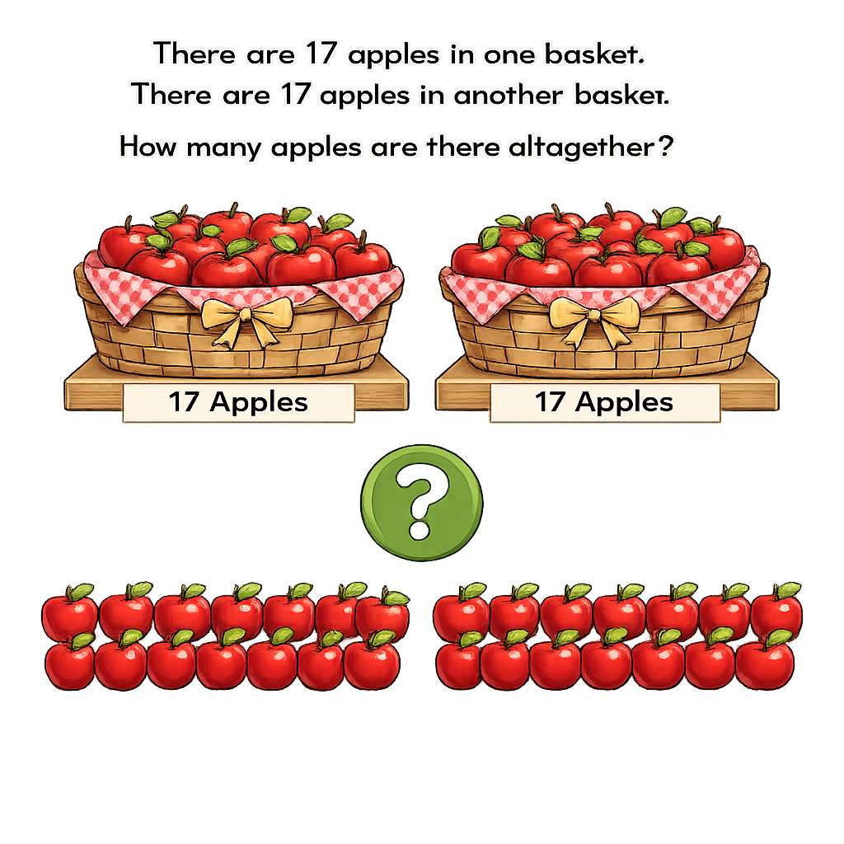

34
17
17

Slide 5
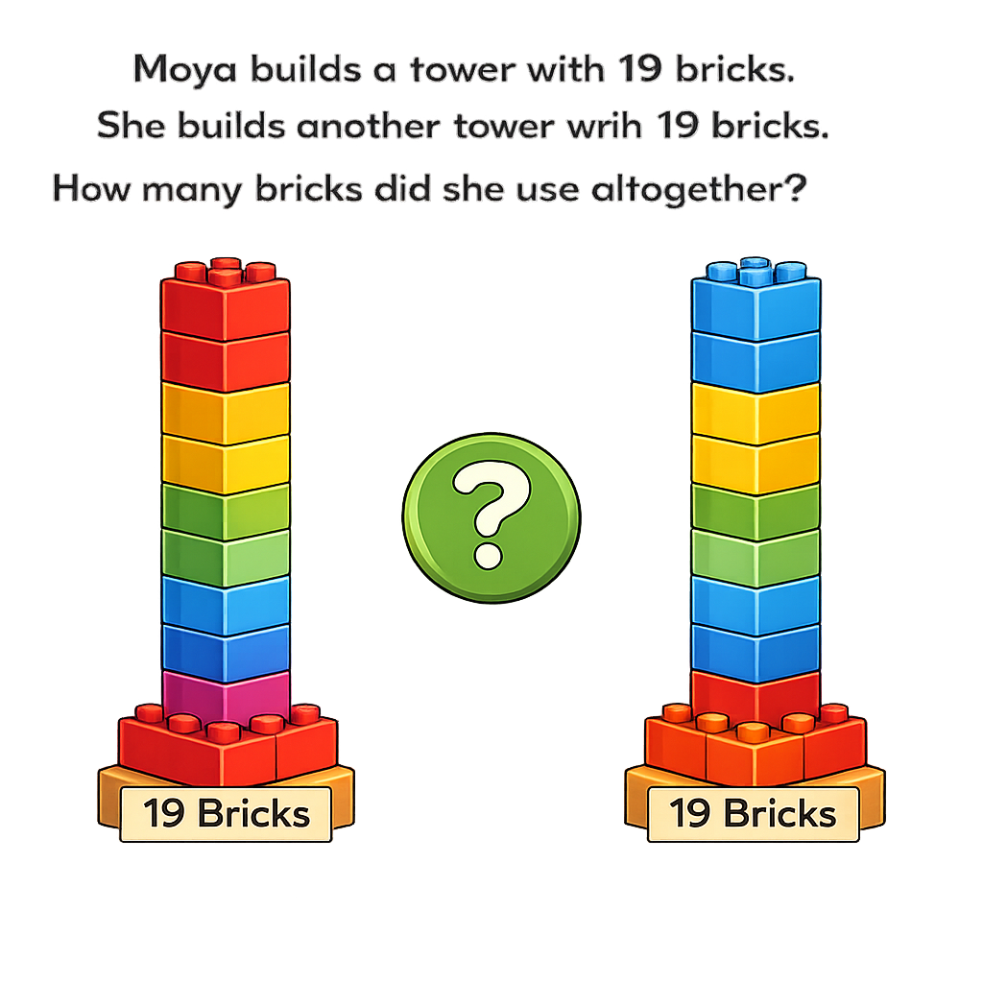
Amy builds a tower with 19 bricks. She builds another tower with 19 bricks. How many bricks did she use altogether?
38
19
19

Slide 6


Your Turn
There are 13 flowers in one vase. There are 13 flowers in another vase. How many flowers are there altogether?
?
26
13
13

Slide 7
Your Turn
A bracelet uses 18 beads. Another bracelet uses 18 beads. How many beads are used altogether?
?
36
18
18

