Slide 1


Lesson 2:
Doubles Within 10 – Word Problems
www.arithmagicians.com

Slide 2

🎵 Let’s Chant
Our Doubles to 10!
Double 1 is 2 Double 2 is 4 Double 3 is 6 Double 4 is 8 Double 5 is 10
Double 6 is 12 Double 7 is 14 Double 8 is 16 Double 9 is 18 Double 10 is 20

Slide 3

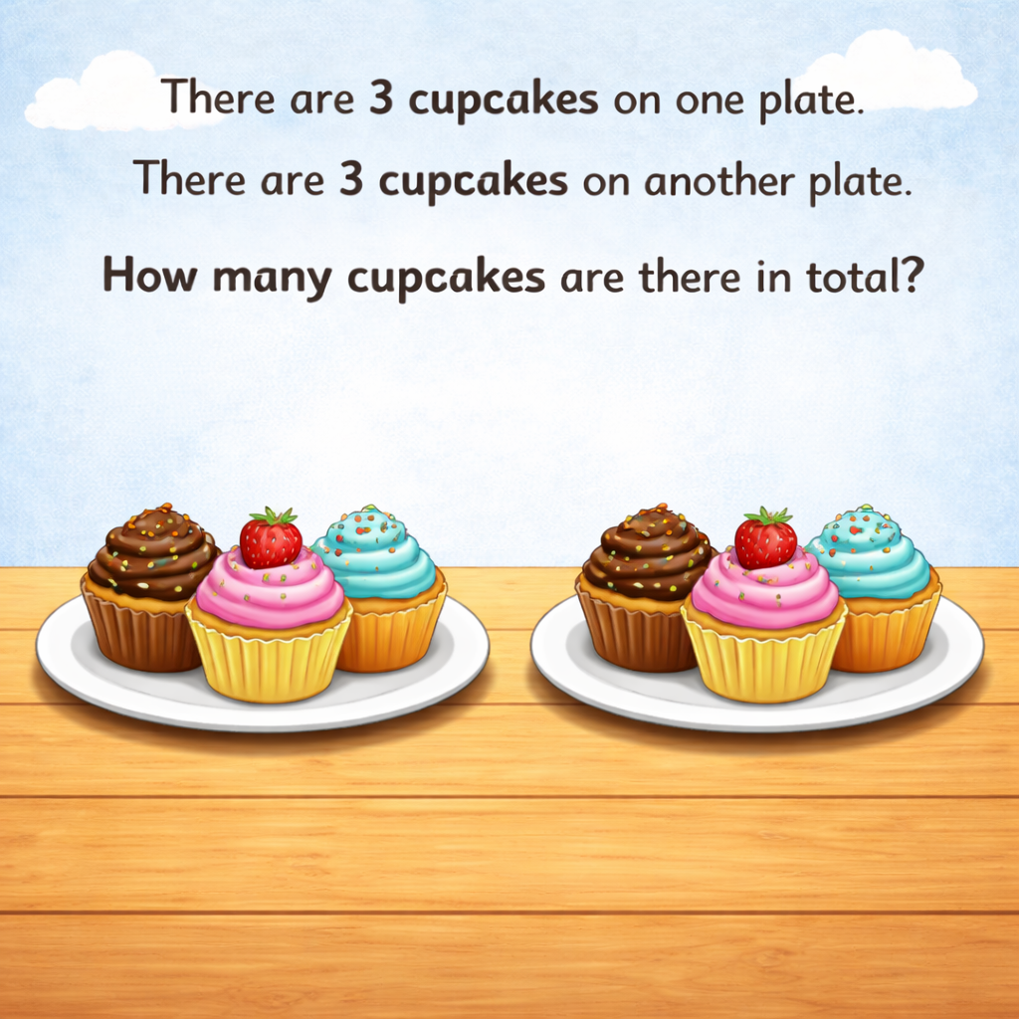
6
3
3

Slide 4
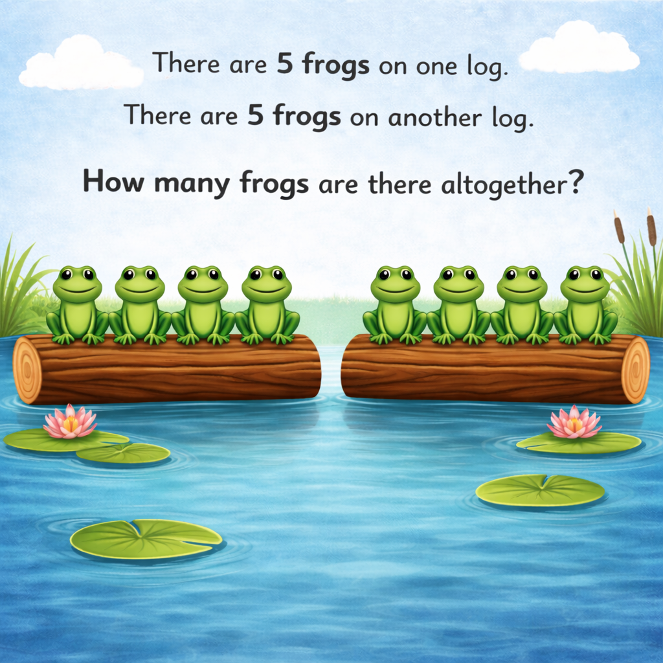
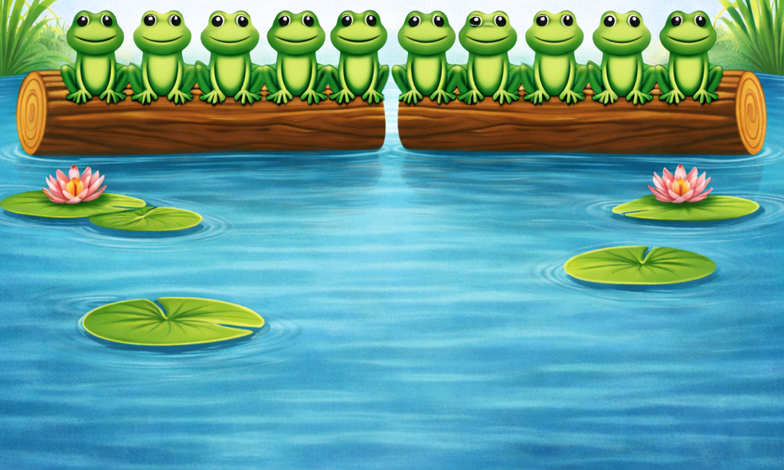
10
5
5

Slide 5
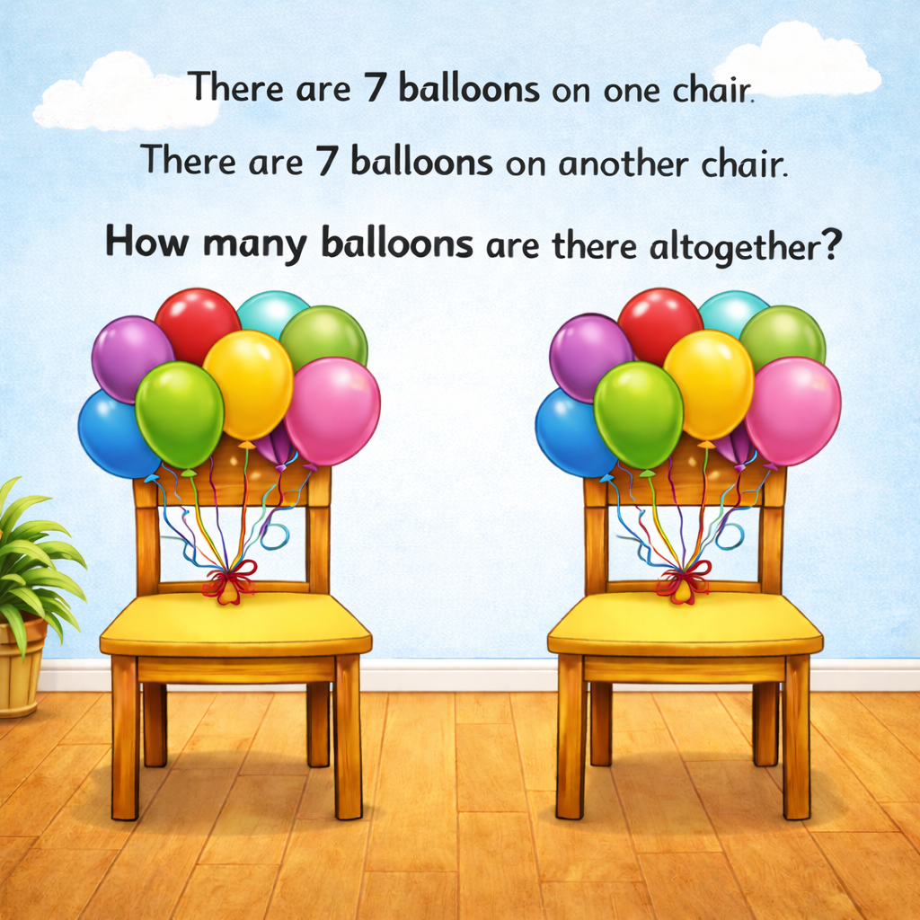
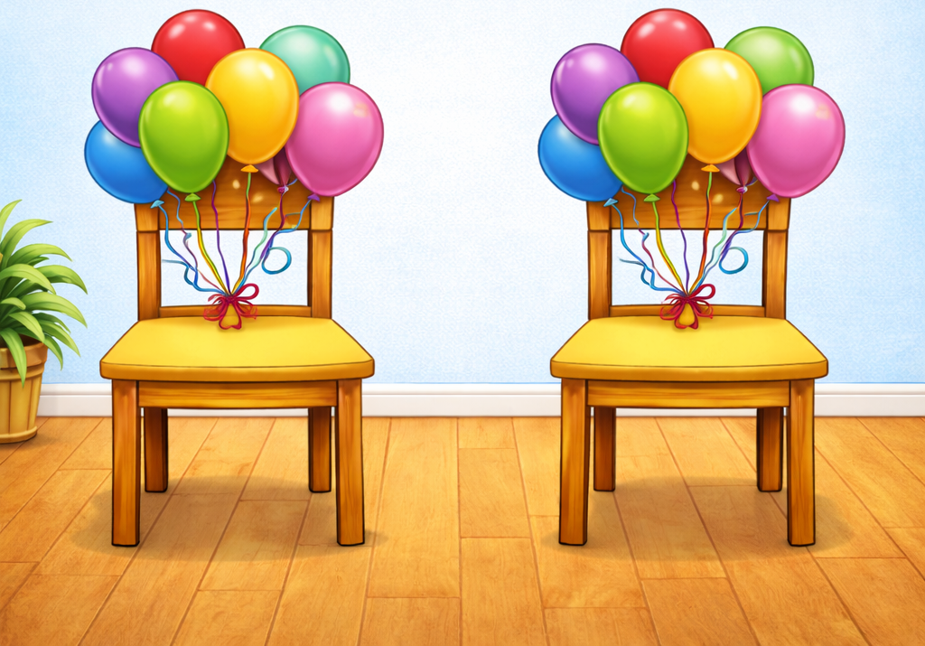
14
7
7

Slide 6


Your Turn
There are 8 teddies on one shelf. There are 8 teddies on another shelf. How many teddies are there altogether?
?
16
8
8

Slide 7
Your Turn
There are 6 pencils in one pot. There are 6 pencils in another pot. How many pencils are there in total?
?
12
6
6

