Slide 1

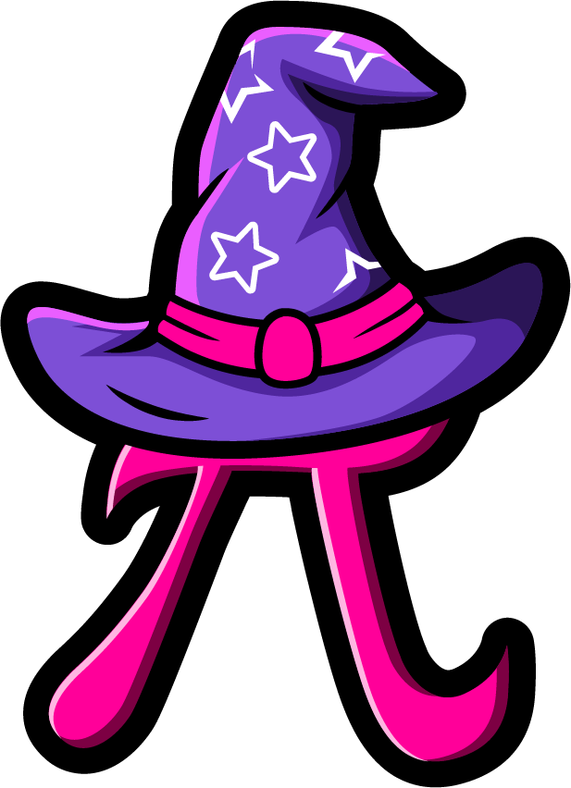
Lesson 3:
Doubles Within 20 – Word Problems
www.arithmagicians.com

Slide 2

🎵 Let’s Chant
Our Doubles!
Double 11 is 22
Double 12 is 24
Double 13 is 26
Double 14 is 28
Double 15 is 30
Double 16 is 32
Double 17 is 34
Double 18 is 36
Double 19 is 38
Double 20 is 40

Slide 3

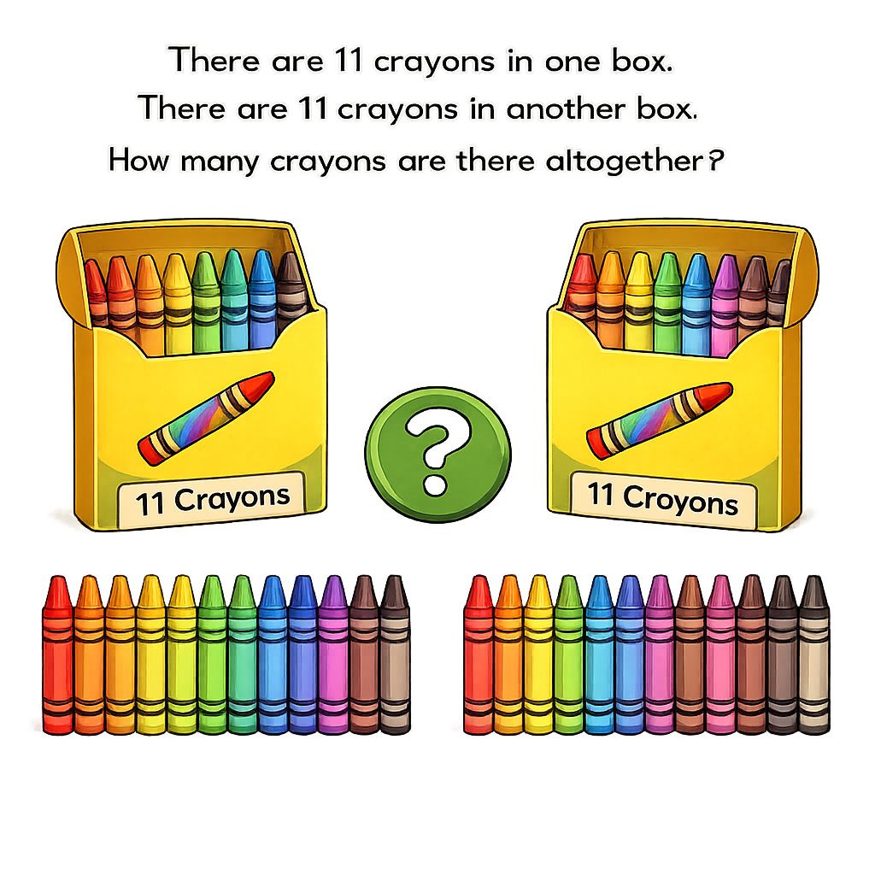

?
22
11
11

Slide 4
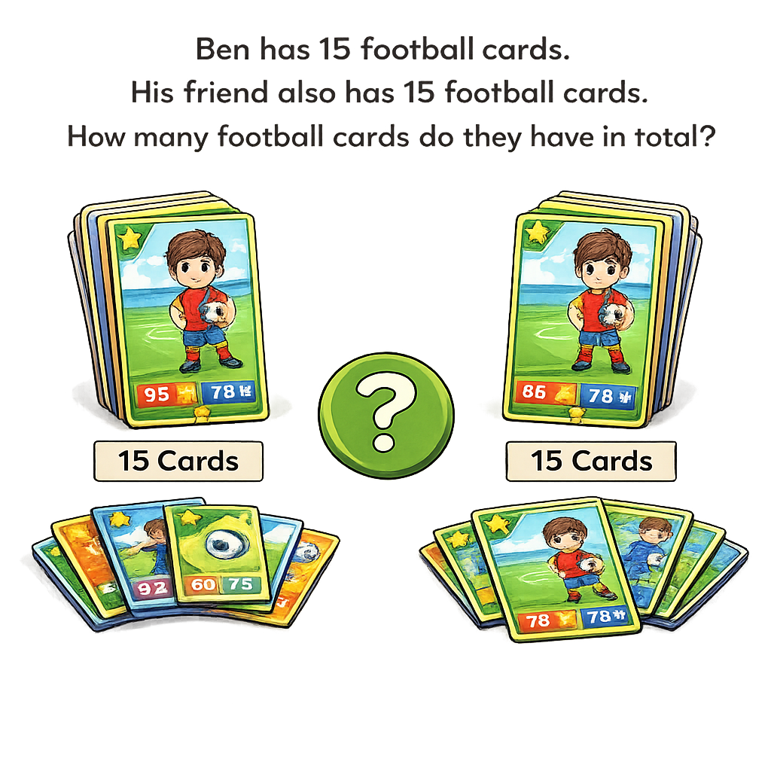
30
15
15

Slide 5
There are 14 flowers in one vase.
There are 14 flowers in another vase.
How many flowers are there altogether?
?
28
14
14

Slide 6


Your Turn
There are 17 cupcakes on one tray.
There are 17 cupcakes on another tray.
How many cupcakes are there in total?
34
17
17

Slide 7
Your Turn
There are 19 cars in one car park.
There are 19 cars in another car park.
How many cars are there in total?
38
19
19

