Slide 1


Lesson 3:
Missing numbers
(division word problems)
www.arithmagicians.com

Slide 2

Recap:
10
1) 3300 ÷ ? = 330
100
2) 7800 ÷ ? = 78
5500
3) ? ÷ 100 = 55
260
4) ? ÷ 10 = 26

Slide 3


A shop has 480 apples.
They pack them into bags of ___ apples.
There are 48 bags.
How many apples in each bag?
?
?
10
480 ÷ ___ = 48

Slide 4
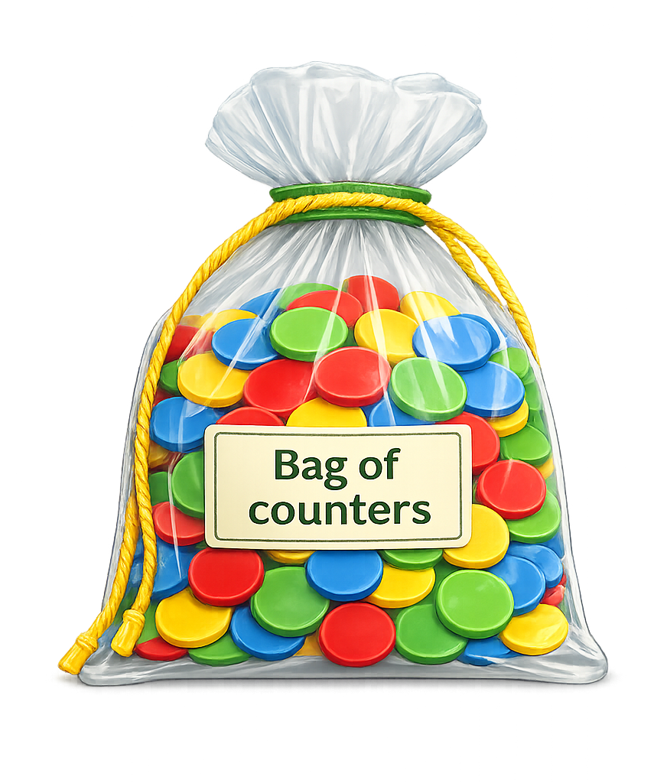
A teacher has 6300 counters. She shares them equally between ___ groups. Each group gets 63 counters.
How many groups are there?
?
?
100
6300 ÷ ___ = 63

Slide 5

A school orders 270 pencils.
They are shared equally so each
class gets 27 pencils. How many classes are there?
?
10
270 ÷ ___ = 27

Slide 6

A shop has 5400 stickers.
They are shared so each
pack has 54 stickers. How many packs are there?
?
100
5400 ÷ ___ = 54

