Slide 1
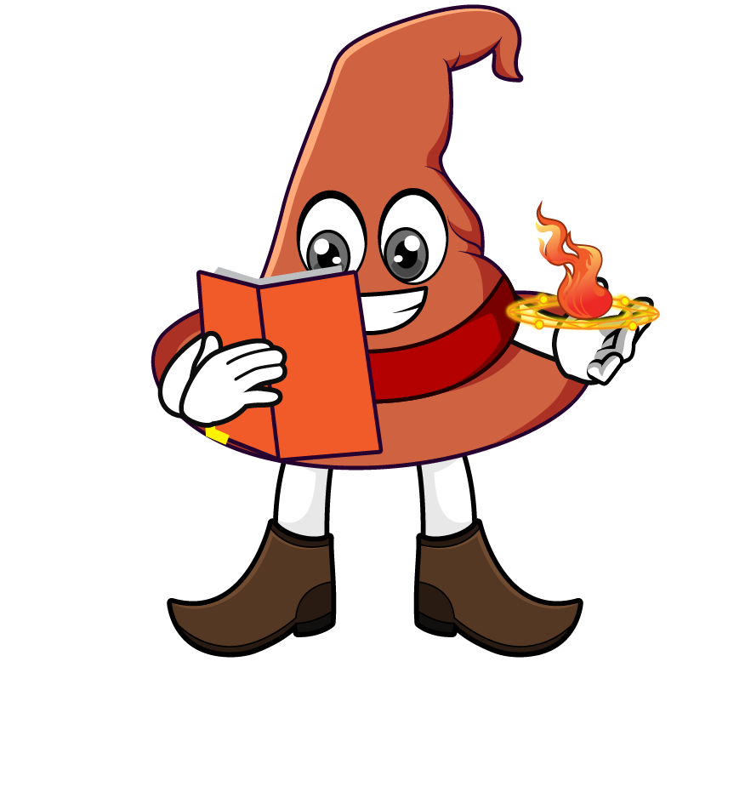

Lesson 4:
Missing numbers
(division word problems)
www.arithmagicians.com

Slide 2

Recap:
10
1) 8600 ÷ ? = 860
100
2) 9900 ÷ ? = 99
4400
3) ? ÷ 100 = 44
740
4) ? ÷ 10 = 74

Slide 3


A school orders 230 pencils.
They are shared equally so each class gets 23 pencils. How many classes are there?
?
10
230 ÷ ___ = 23

Slide 4

A library has 2800 books.
Each shelf holds 28 books. How many shelves are there?
?
100
2800 ÷ ___ = 28

Slide 5
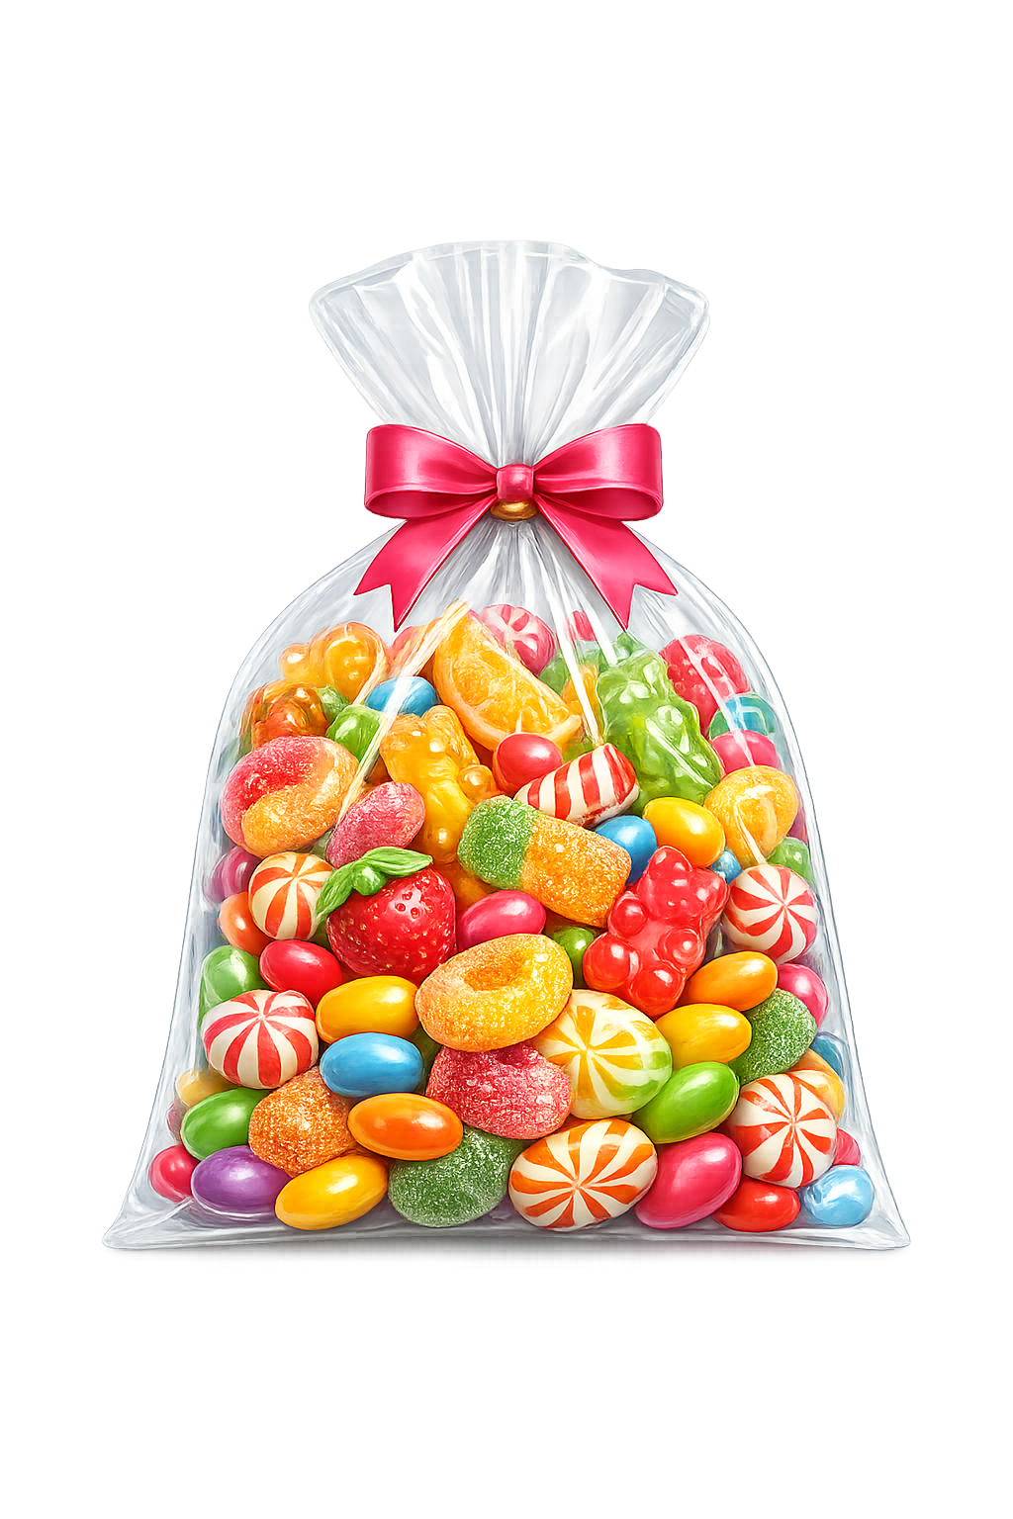
A shop packs 4500 sweets into bags. Each bag contains 45 sweets. How many bags are made?
?
100
4500 ÷ ___ = 45

Slide 6
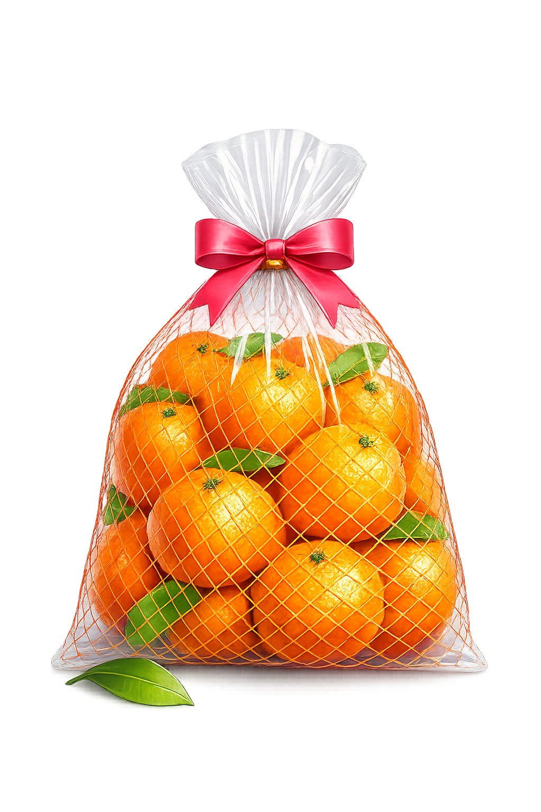
A shop packs 8400 oranges into bags. Each bag contains 84 oranges. How many bags are made?
?
100
8400 ÷ ___ = 84

