Slide 1
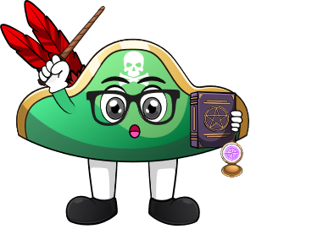

Lesson 4:
Doubles Within 10 – Word Problems
www.arithmagicians.com

Slide 2

🎵 Let’s Chant
Our Doubles to 10!
Double 1 is 2
Double 2 is 4
Double 3 is 6
Double 4 is 8
Double 5 is 10
Double 6 is 12
Double 7 is 14
Double 8 is 16
Double 9 is 18
Double 10 is 20

Slide 3

There are 4 hats on one peg.
There are 4 hats on another peg.
How many hats are there altogether?
?
8
4
4

Slide 4
There are 7 books on one shelf.
There are 7 books on another shelf.
How many books are there altogether?
?
14
7
7

Slide 5
There are 6 shells on one beach.
There are 6 shells on another beach.
How many shells are there altogether?
?
12
6
6

Slide 6


Your Turn
There are 9 cars in one car park.
There are 9 cars in another car park.
How many cars are there altogether?
18
9
9

Slide 7
Your Turn
There are 8 ducks in one pond.
There are 8 ducks in another pond.
How many ducks are there altogether?
16
8
8

