Slide 1
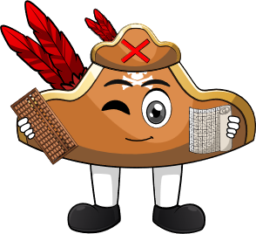

Week 4:
Assess & Review
www.arithmagicians.com

Slide 2

🎵 Let’s Chant
Our Doubles!
Double 11 is 22
Double 12 is 24
Double 13 is 26
Double 14 is 28
Double 15 is 30
Double 16 is 32
Double 17 is 34
Double 18 is 36
Double 19 is 38
Double 20 is 40

Slide 3

There are 13 kittens in one basket.
There are 13 kittens in another basket.
How many kittens are there altogether?
?
26
13
13

Slide 4
There are 18 buttons on one shirt.
There are 18 buttons on another shirt.
How many buttons are there altogether?
?
36
18
18

Slide 5
There are 16 bricks in one pile.
There are 16 bricks in another pile.
How many bricks are there altogether?
?
32
16
16

Slide 6


Your Turn
There are 19 sweets in one jar.
There are 19 sweets in another jar.
How many sweets are there altogether?
38
19
19

Slide 7
Your Turn
There are 17 socks in one drawer.
There are 17 socks in another drawer.
How many socks are there altogether?
34
17
17

