Slide 1
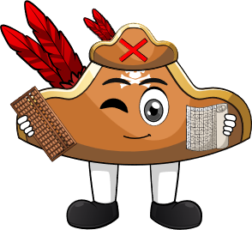

Week 4:
Assess & Review
www.arithmagicians.com

Slide 2

🎵 Let’s Chant
Our Doubles to 10!
Double 1 is 2 Double 2 is 4 Double 3 is 6 Double 4 is 8 Double 5 is 10
Double 6 is 12 Double 7 is 14 Double 8 is 16 Double 9 is 18 Double 10 is 20

Slide 3

There are 3 kittens in one basket. There are 3 kittens in another basket. How many kittens are there altogether?
?
6
3
3

Slide 4
There are 8 buttons on one shirt. There are 8 buttons on another shirt. How many buttons are there altogether?
?
16
8
8

Slide 5
There are 6 bricks in one pile. There are 6 bricks in another pile. How many bricks are there altogether?
?
12
6
6

Slide 6


Your Turn
There are 9 sweets in one jar. There are 9 sweets in another jar. How many sweets are there altogether?
18
9
9

Slide 7
Your Turn
There are 7 socks in one drawer. There are 7 socks in another drawer. How many socks are there altogether?
14
7
7

