Slide 1


Lesson 1:
Halving Word Problems (Within 20)
www.arithmagicians.com

Slide 2

🎵 Let’s Say
Our Halves!
Halve 12 is 6 Halve 14 is 7 Halve 16 is 8 Halve 18 is 9 Halve 20 is 10

Slide 3

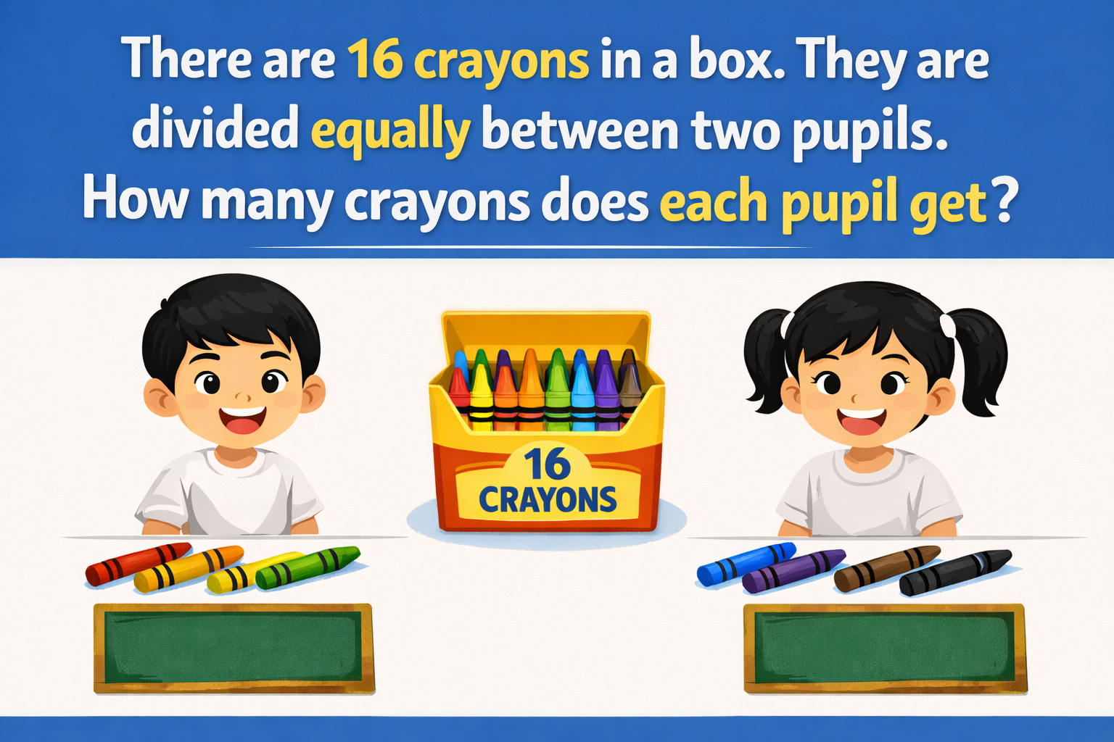
8
8

Slide 4
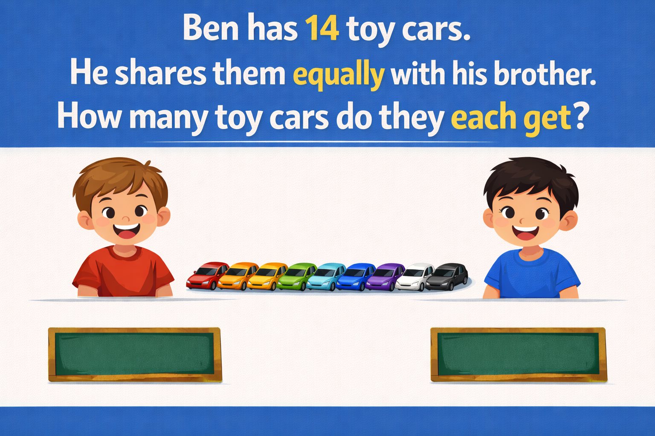
7
7

Slide 5
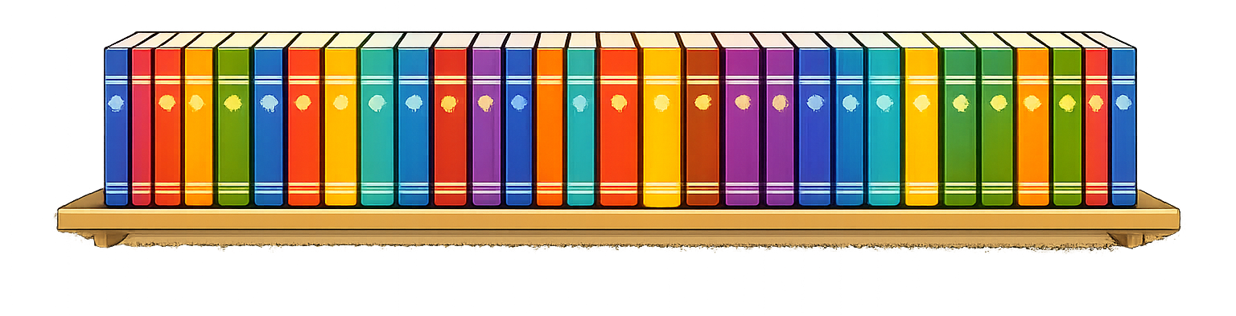
The teacher splits 20 books into 2 equal groups. How many books are in each group.
10
10

Slide 6


Your Turn
There are 12 counters. They are shared equally between 2 children. How many counters does each child get?
12
?
?
6
6

Slide 7
Your Turn
There are 18 cupcakes. They are shared equally between 2 plates. How many cupcakes are on each plate?
18
?
?
9
9

