Slide 1


Lesson 1:
Word problems involving x10 & x100
www.arithmagicians.com

Slide 2

Recap:
10
1) 36 x ? = 360
100
2) 91 x ? = 9100
100
3) ? x 64 = 6400
100
4) ? x 100 = 10,000

Slide 3

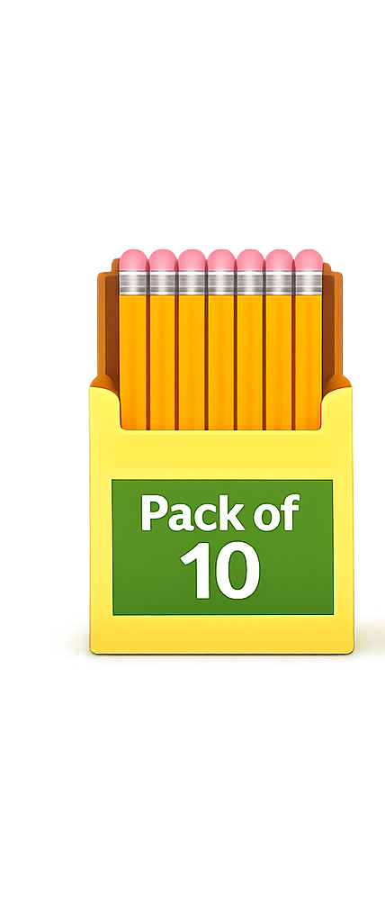
A shop sells pencils in packs of 10. If you buy 18 packs, how many pencils do you have?
180
?
10 x 18 =

Slide 4
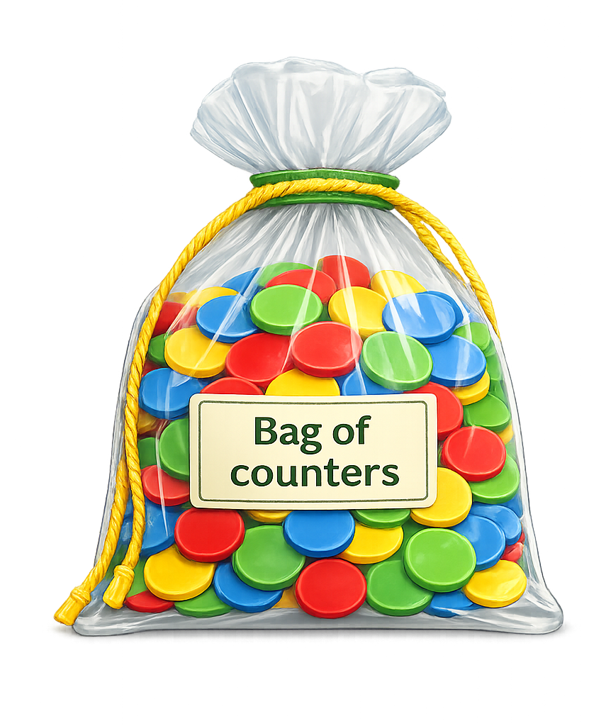
A teacher gives each group 100 counters. There are 22 groups. How many counters are used altogether?
2200
?
100 x 22 =

Slide 5
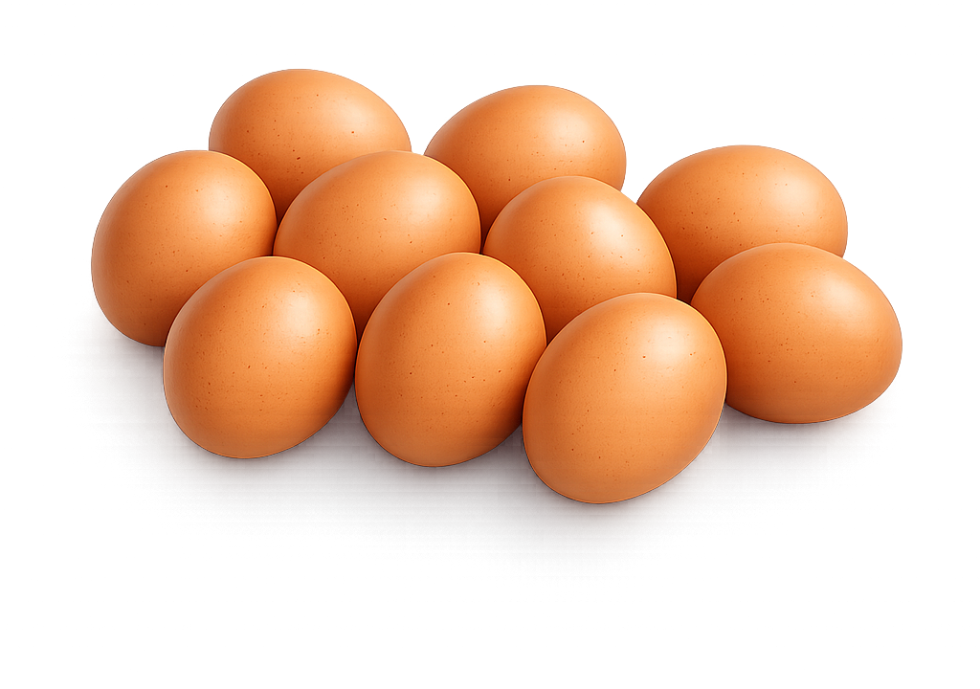
A farm packs 10 eggs in each box. There are 97 boxes. How many eggs are there in total?
970
?
10 x 97 =

Slide 6
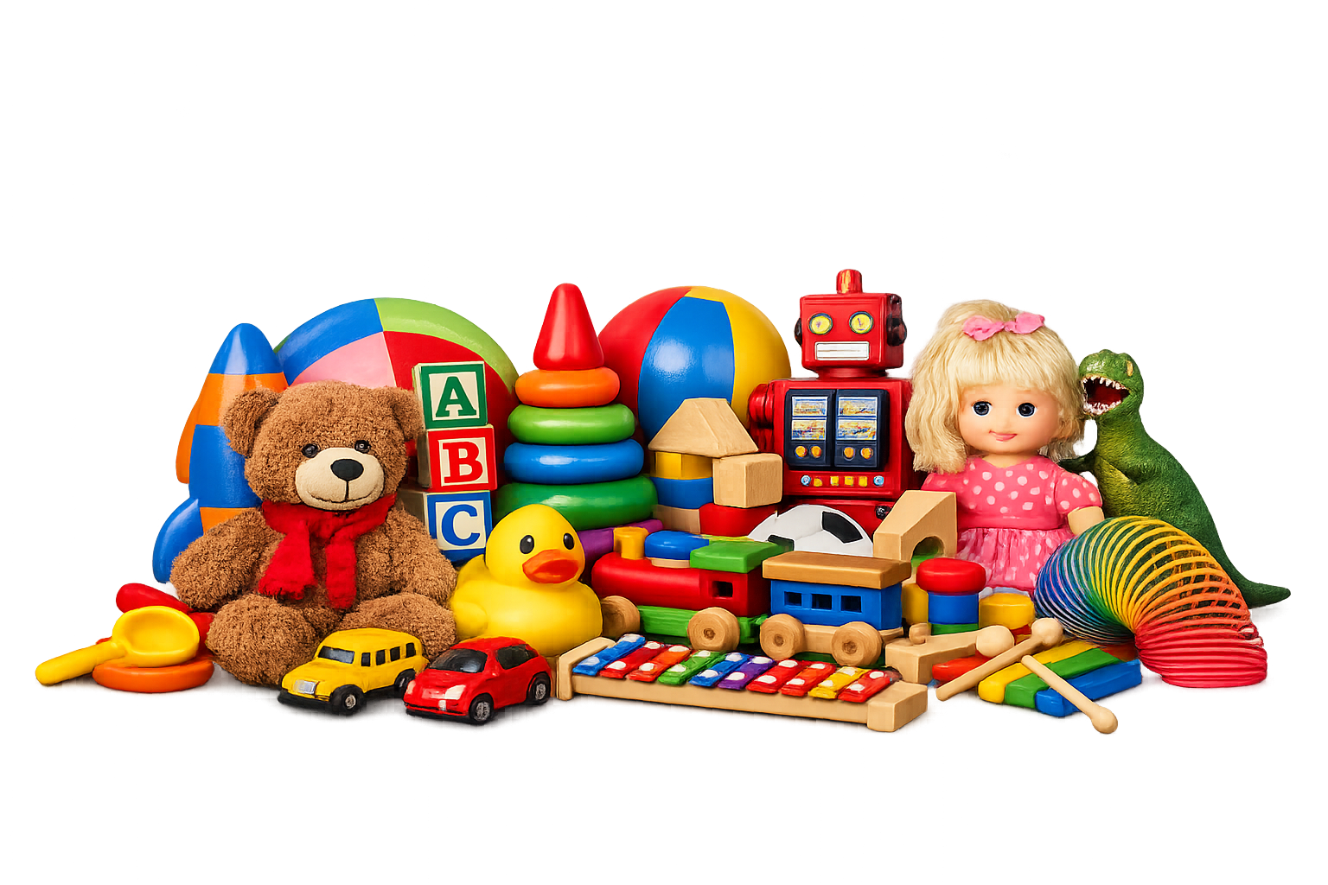
A factory makes 100 toys each day. It runs for 46 days. How many toys are made?
4600
?
100 x 46 =

