Slide 1
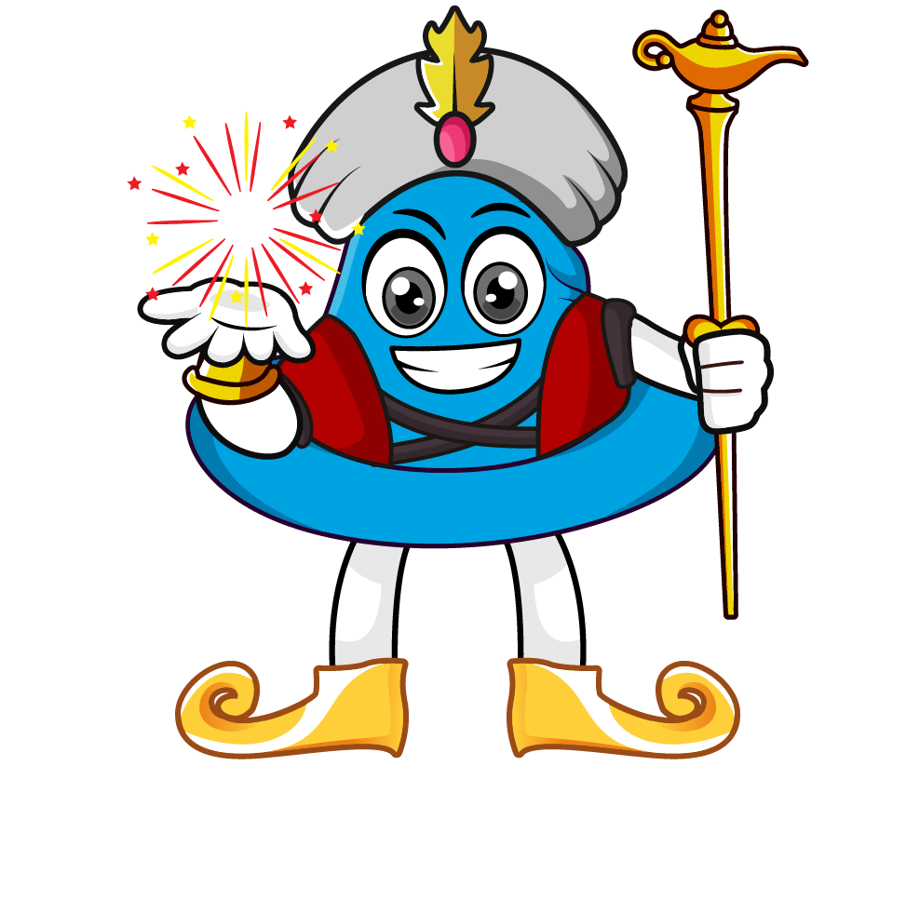
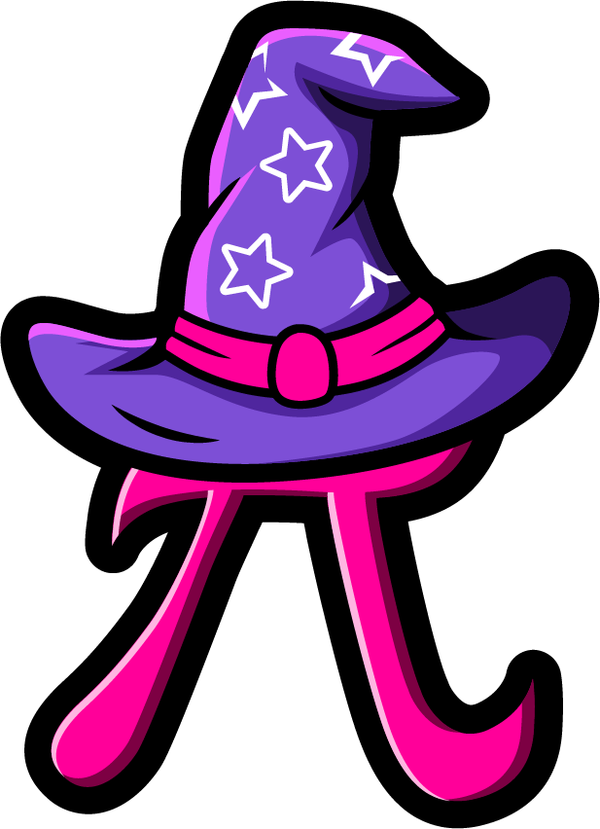
Lesson 1:
Word problems involving x10, x 100 & x1000
www.arithmagicians.com

Slide 2

Recap:
10
1) 3.6 x ? = 36
100
2) 9.1 x ? = 910
1000
3) ? x 6.4 = 6400
100
4) ? x 0.1 = 10

Slide 3

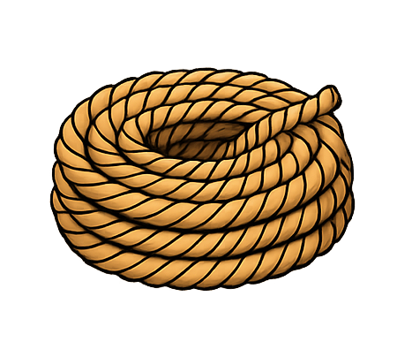
A rope is 3.4 metres long.
10 ropes are joined together.
What is the total length?
?
34
3.4 x 10 =

Slide 4

A piece of ribbon is 0.85 metres long.
There are 100 pieces.
What is the total length?
85
?
0.85 x 100 =

Slide 5

A small bottle contains 0.75 litres
of water. A warehouse stores 100 bottles. How many litres of water is that?
75
?
0.75 x 100 =

Slide 6
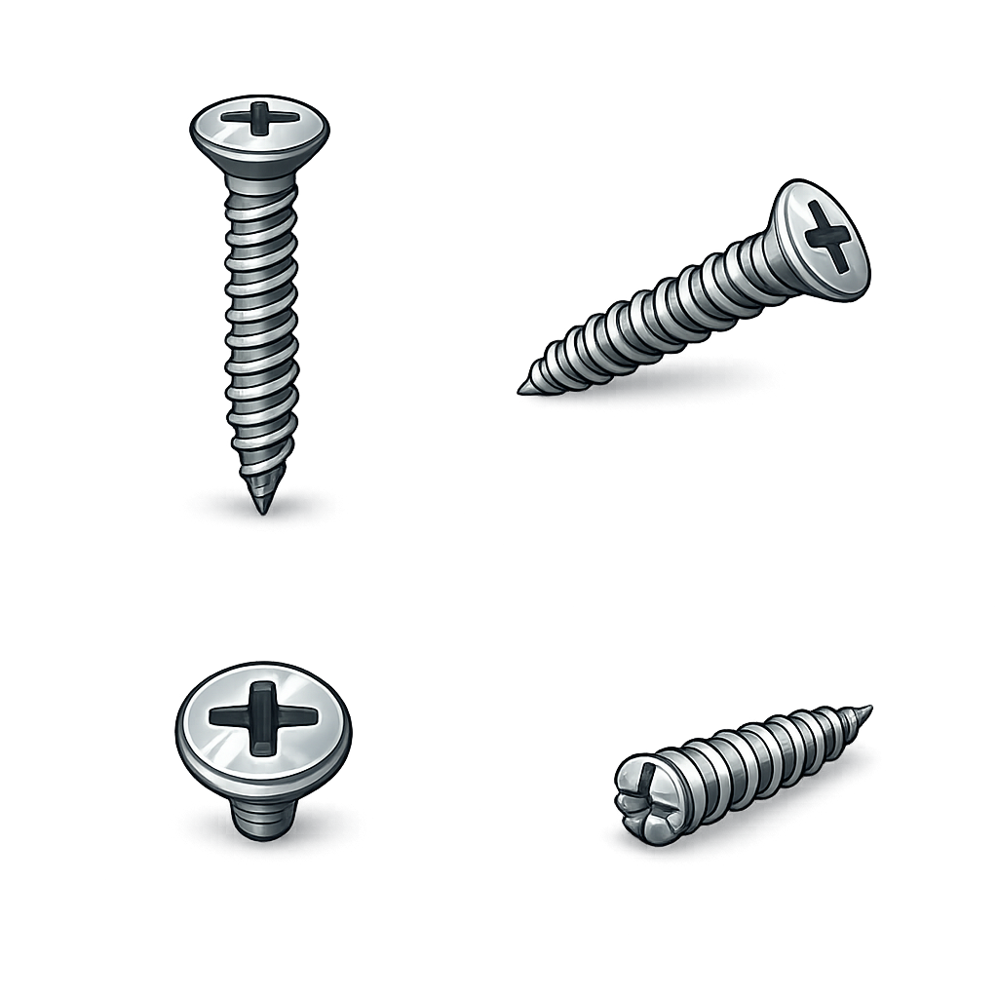
A tiny screw weighs 0.005 kg.
A factory produces 1,000 screws.
What is the total weight?
?
5
0.005 x 1000 =

