Slide 1


Lesson 1:
Halving Word Problems (Within 10)
www.arithmagicians.com

Slide 2

🎵 Let’s Say
Our Halves to 10!
Halve 2 is 1 Halve 4 is 2 Halve 6 is 3 Halve 8 is 4 Halve 10 is 5

Slide 3

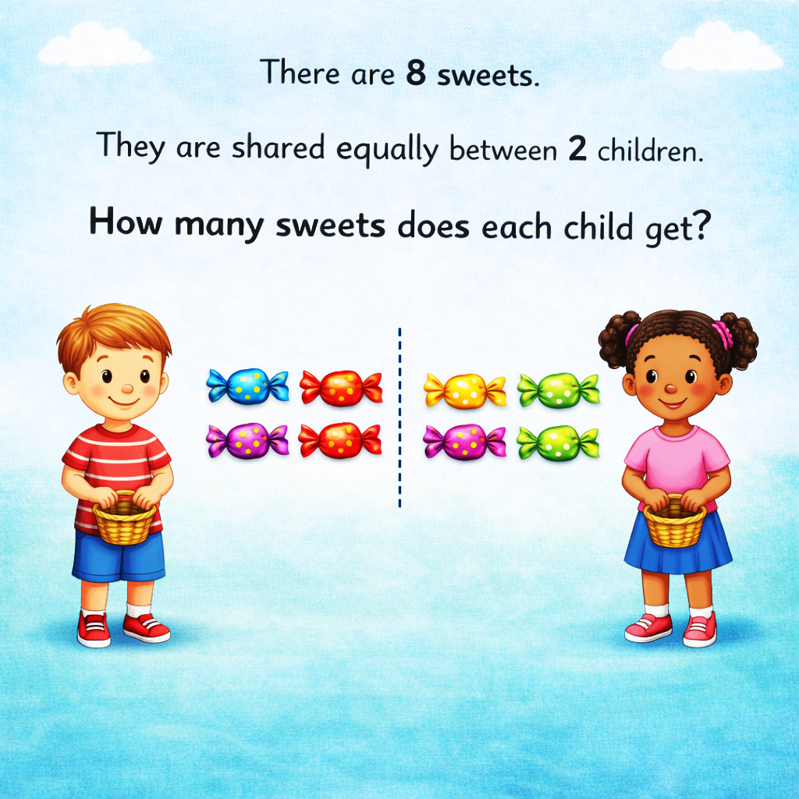
4
4

Slide 4
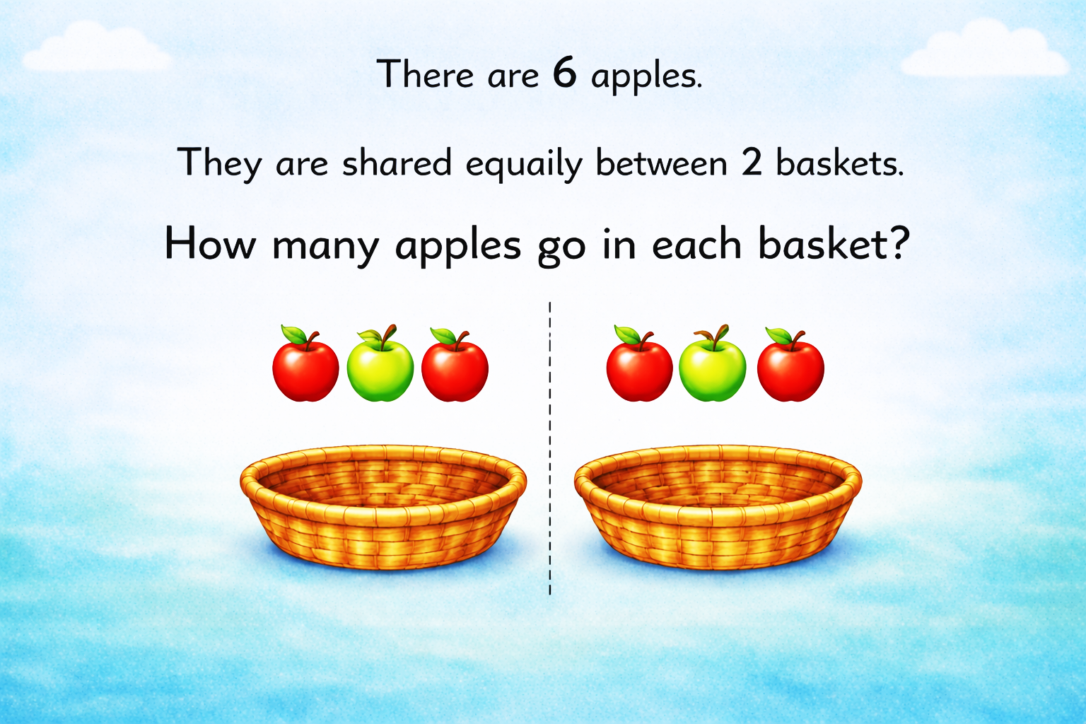
3
3

Slide 5
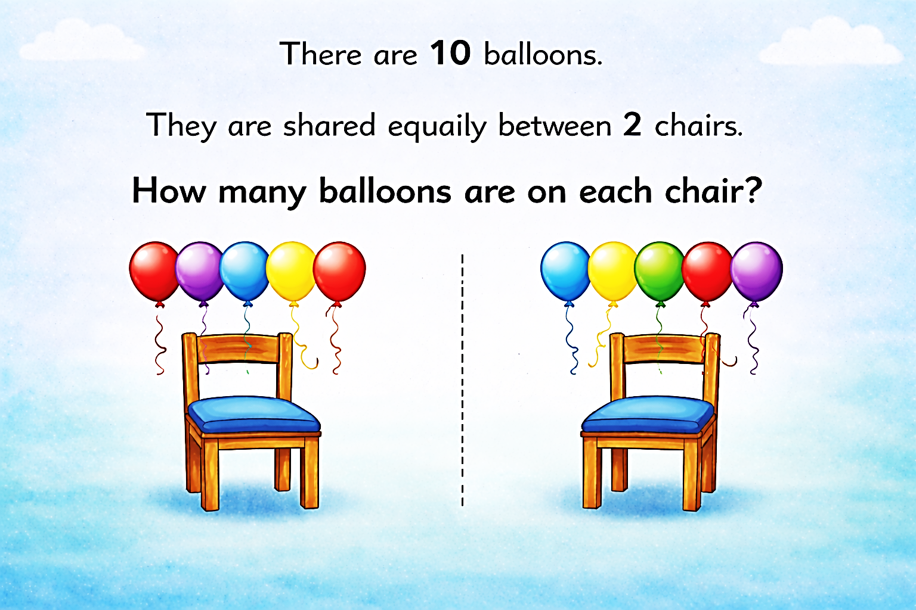
5
5

Slide 6


Your Turn
There are 4 counters. They are shared equally between 2 children. How many counters does each child get?
4
?
?
2
2

Slide 7
Your Turn
There are 8 cupcakes. They are shared equally between 2 plates. How many cupcakes are on each plate?
8
?
?
4
4

