Slide 1


Lesson 2:
Halving Word Problems (Within 20)
www.arithmagicians.com

Slide 2

🎵 Let’s Say
Our Halves!
Halve 12 is 6
Halve 14 is 7
Halve 16 is 8
Halve 18 is 9
Halve 20 is 10

Slide 3

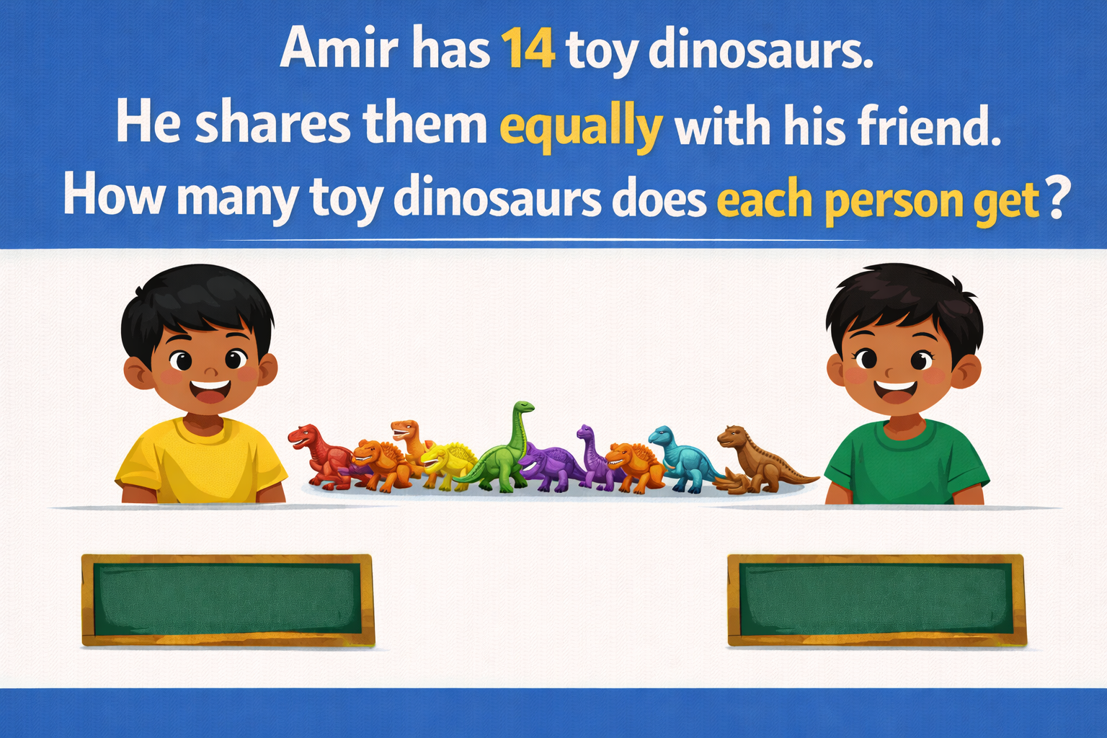
7
7

Slide 4
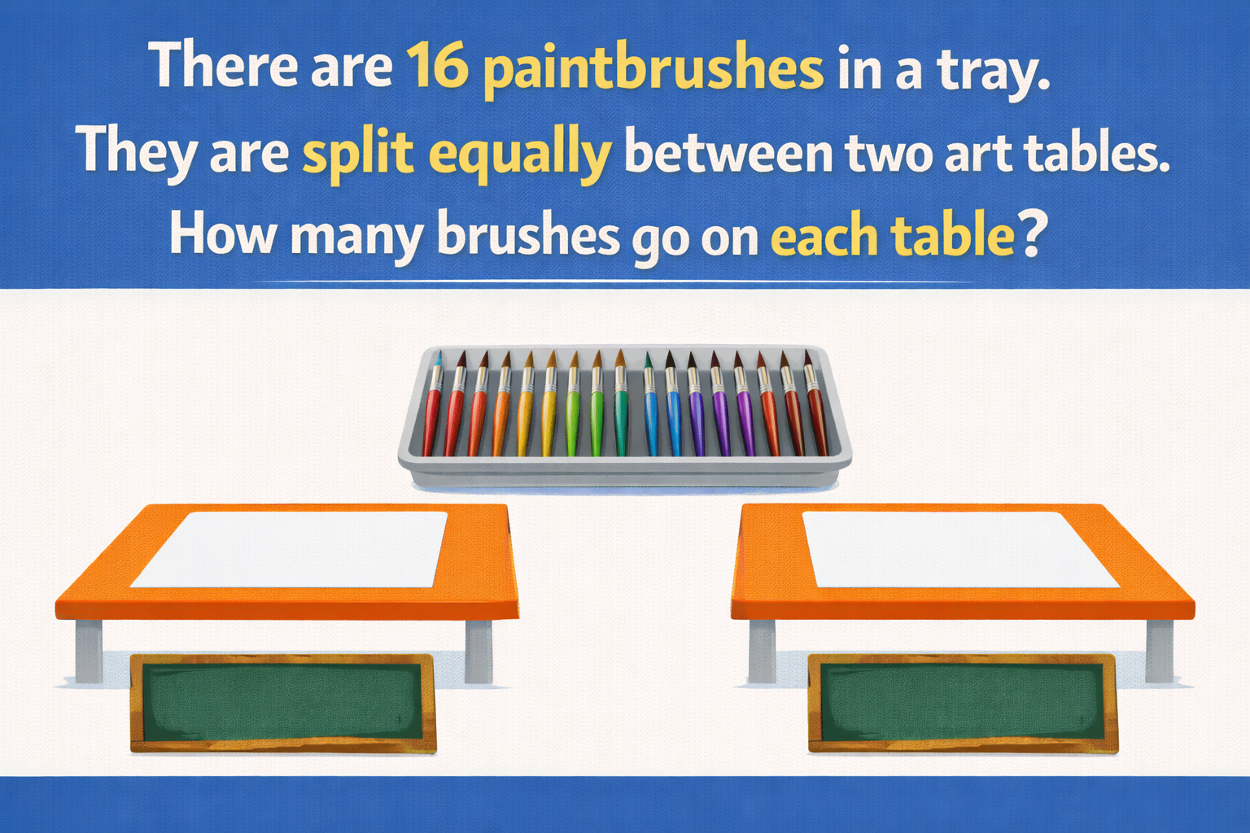
8
8

Slide 5
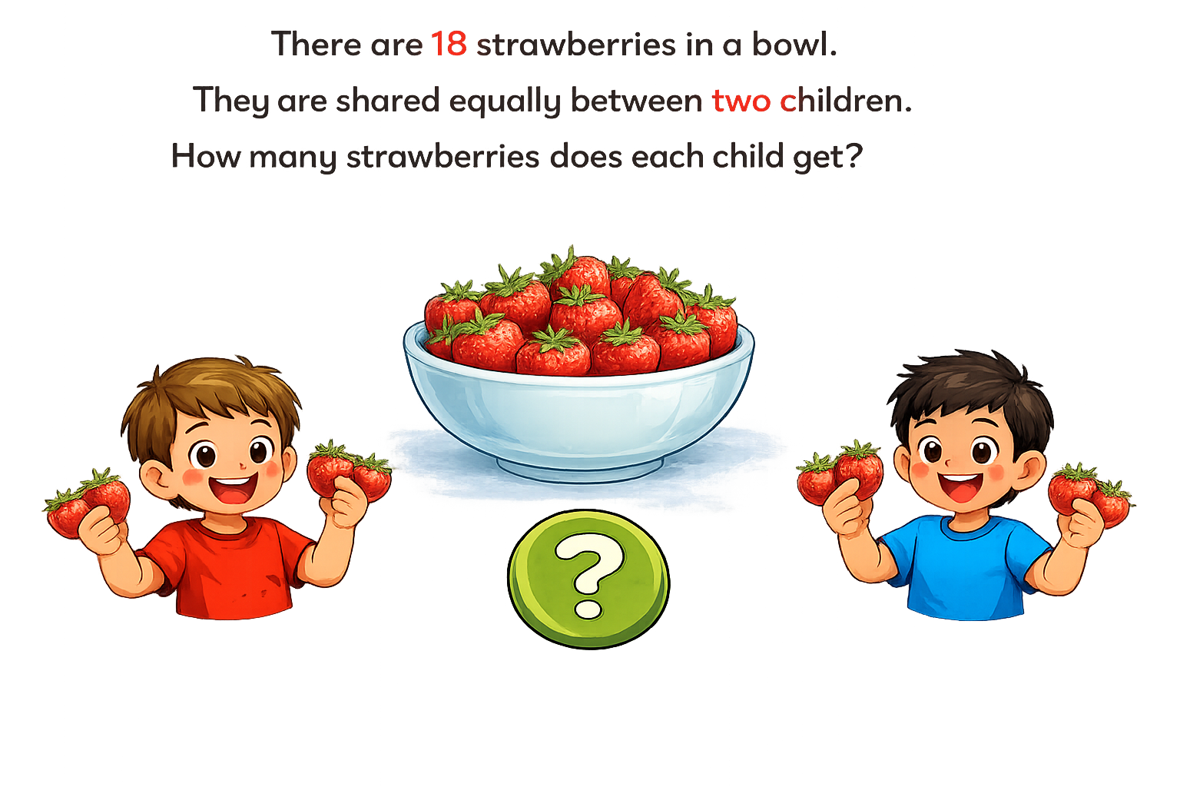
9
9

Slide 6


Your Turn
There are 12 hats.
They are shared equally between 6 children.
How many hats does each child get?
12
?
?
6
6

Slide 7
Your Turn
There are 14 frogs.
They are shared equally between 2 logs.
How many frogs are on each log?
14
?
?
7
7

