Slide 1
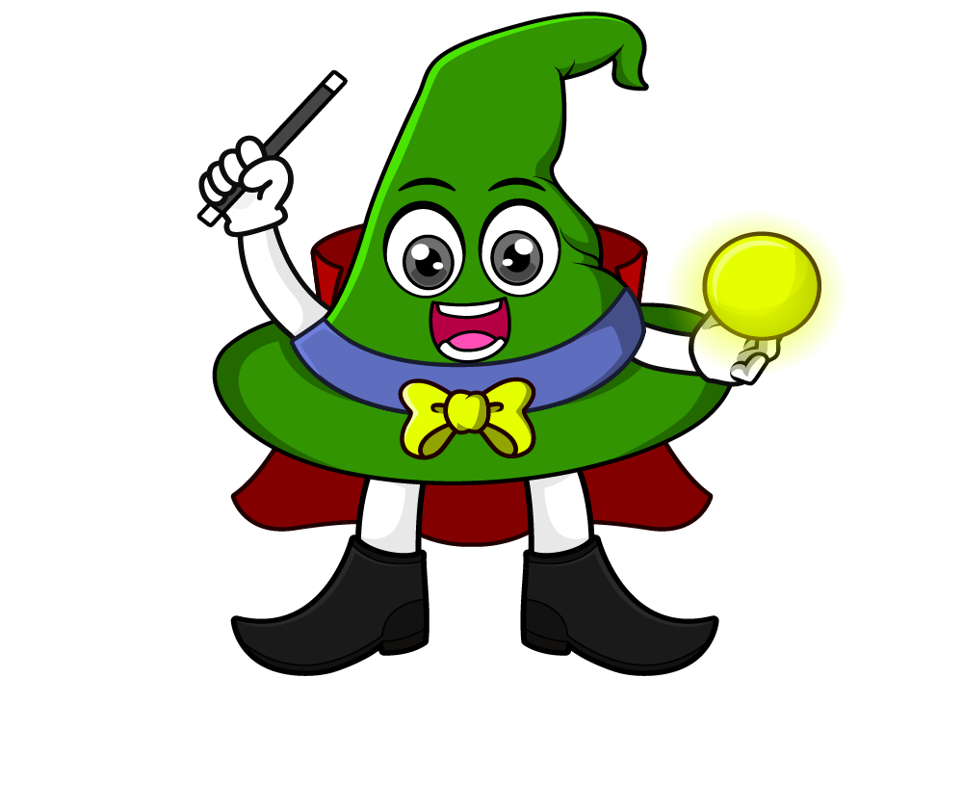

Lesson 2:
Word problems involving x10 & x100
www.arithmagicians.com

Slide 2

Recap:
10
1) 42 x ? = 420
100
2) 36 x ? = 3600
100
3) ? x 77 = 7700
10
4) ? x 100 = 1000

Slide 3


A shop sells apples in bags of 10. You buy 56 bags. How many apples do you have?
560
?
10 x 56 =

Slide 4

A toy shop packs 100 toys in each box. There are 48 boxes. How many toys are there altogether?
4800
?
100 x 48 =

Slide 5
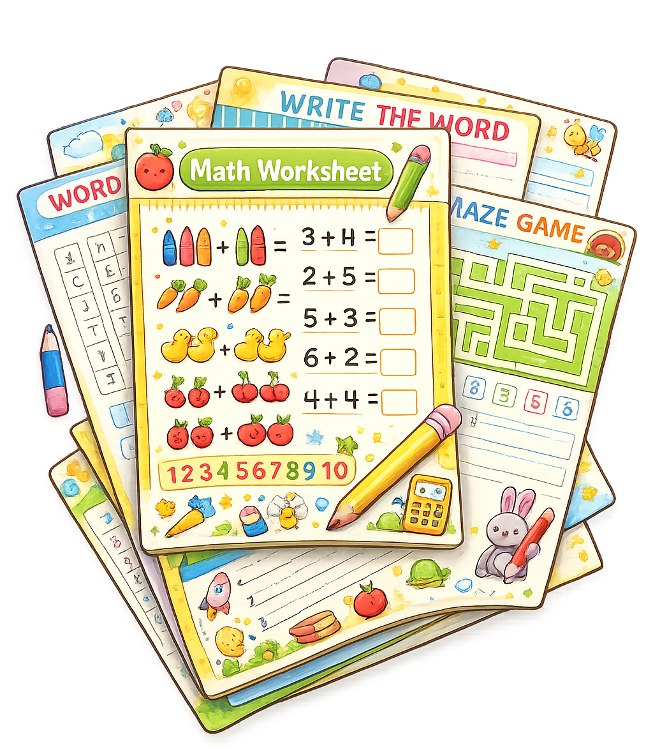
A school prints 100 worksheets
for each class. There are 24 classes. How many worksheets are printed?
?
2400
100 x 24 =

Slide 6

A charity collects 100 cans each week. After 39 weeks, how many
cans have they collected?
3900
?
100 x 39 =

